Slide 1
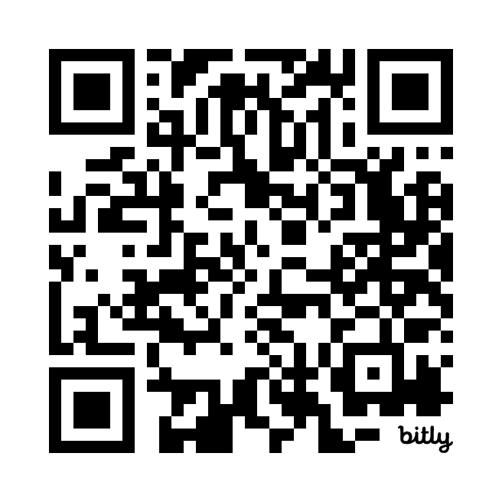
Your Voice Matters
Get more information
Connect with today’s speaker
Learn how to join PNHP

