Slide 1
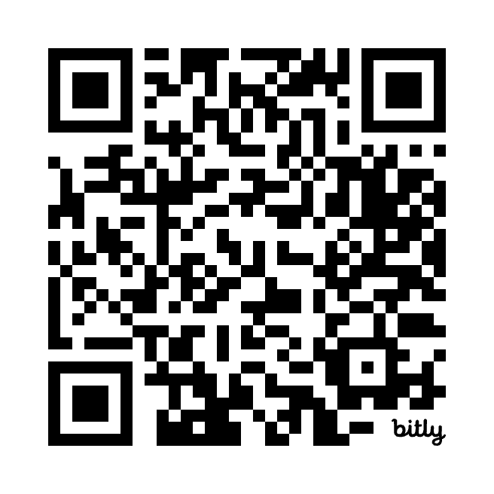
Your Voice Matters
Join PNHP today!

