Slide 1
Written by PNHP Policy Committee
Donald Bourne, MD/PhD 2027; Stephen Kemble, MD; Mark Krasnoff, MD; Susan Rogers, MD; Kip Sullivan, JD; Kay Tillow; James Patrick Waters, MS4; and Ed Weisbart, MD, working closely with PNHP Communications Specialist Gaurav Kalwani
Drafts reviewed by additional experts
Diane Archer (Just Care USA), Gretchen Jacobson (Commonwealth Fund), James G. Kahn MD MPH (UCSF), Eagan Kemp (Public Citizen), David Lipschutz (Center for Medicare Advocacy), Dhyan Wolf (Video Editor), ASO Communications, and others
PNHP conducted dozens of interviews
Patients, family members, physicians, allied health professionals, and Medicare supporters
36 high-quality studies cited
Overwhelming evidence that harm is common across MA in general
Very little public data to assess individual MA plans

Slide 2
Conclusion: Medicare “Advantage” corporations inflict More Harm Than We’d Realized
Death rates double after some cancer surgeries
MA patients often blocked from the best cancer doctors / hospitals
Prior authorizations, narrow networks, underinsurance,
and deaths.
These numbers are all related
to each other.
7.3 million people in MA are underinsured
High out-of-pocket costs force people to avoid and delay needed care
11.7 million people in MA are in a narrow network
“Insurance” that excludes most of the physicians in their county
Up to 20 million hours per year wasted
Medical practice time spent on “Prior Authorizations” just from MA
Notes: Pancreatic surgery 30-day post-operative mortality rate adjusted odds ratio of 2.0 in MA vs TM;
“Narrow network” defined as excluding more than 70% of physicians in a patient’s county
PNHP.org/HarmsReport

Slide 3
Traditional Medicare Is Simple, Efficient, and Equitable
Notes:
Pay taxes, get insurance card, and medicare pays the doctors. No middle man.

Slide 4
Medicare Advantage (“MA”) Is Complicated, Harmful, and Worsens Disparities
MA Is Not
Real Medicare
Blocks access to many physicians and hospitals
Delays and denies access to covered care
Uses HMO-style tools (Prior Authorizations, etc)
Most people are trapped in MA after one year
Harm is intrinsic to corporate profiteering
Notes:
Medicare pays all of the insurance companies. ALREADY more complicated. Then they pay their own contracts to doctors, and then limit their networks within their contracts so you can only go to certain doctors
MA is NOT Medicare NOR an advantage for all of these reasons, which is what we will discuss during this presentation.
BAD part is that MA is still growing

Slide 5
Our report documents many ways that MA Harms Patients and Physicians
Prior Authorizations
Barriers to Caring
Little of this is
disclosed to “consumers”.
By the time people
encounter these problems,
many find themselves
trapped in MA.
Narrow/“Ghost” Networks
Administrative Burdens
Restrictions and Limits on Care
Financialization
Unaffordable Care
Corporatization
PNHP.org/HarmsReport

Slide 6
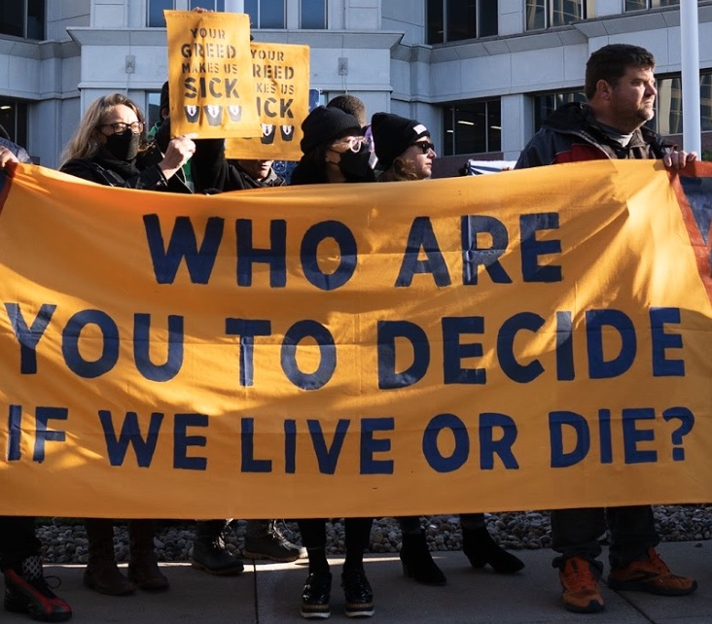
Corporations have begun saying it out loud: They Don’t Care About Harm
Corporate Values
“Margin Over Membership”
People’s Action
“Care Over Cost”
CVS may cut MA benefits, leave unprofitable counties.
“The goal is margin over membership.
“Lose up to 10% of our Medicare members? That’s okay.”
“People are stuck with bills they can’t pay, take money from rent and food, and go bankrupt.
“People stay sick or injured, and sometimes die.”
Tom Cowhey
CVS Health CFO
CareOverCost.org helps appeal denied claims
https://www.fiercehealthcare.com/ai-and-machine-learning/bofa-cvs-warns-it-could-lose-10-its-members-next-year
https://peoplesaction.org/campaigns/health-care-for-all/
Accessed May 31, 2024

Slide 7
Our report’s conclusion: They Are Taking Advantage of Us
Industry claims MA relieves inequities.
This is exactly backwards.
Cost-related problems accessing care by people in fair or poor health
Higher percentages of low-income people and people of color are in MA than TM.
People with more financial resources reject the inferior insurance that is MA.
MA’s narrow networks are particularly harmful in rural communities.
PNHP.org/HarmsReport, references 24 and 58

Slide 8
Our report’s conclusion: They Are Taking Advantage of Us
Industry claims MA relieves inequities.
This is exactly backwards.
Percentage of local physicians
in TM who see MA patients
Higher percentages of low-income people and people of color are in MA than TM.
People with more financial resources reject the inferior insurance that is MA.
MA’s narrow networks are particularly harmful in rural communities.
Metropolitan
Rural
42%
65%
Not in local MA Network
PNHP.org/HarmsReport, references 24 and 58

Slide 9
Our report’s conclusion: They Are Taking Advantage of Us
Industry claims MA relieves inequities.
This is exactly backwards.
We Are Being
Cheated By MA
Higher percentages of low-income people and people of color are in MA than TM.
People with more financial resources reject the inferior insurance that is MA.
MA’s narrow networks are particularly harmful in rural communities.
Medicare “Advantage” was created to save money and improve care.
These corporations are not doing what they’re paid to do; instead, they harm us.
We must protect the people in MA but stop paying for things that are bad for us.
Overwhelming evidence that insurance corporations
are harming people in order to make money.
PNHP.org/HarmsReport, references 24 and 58

Slide 10
Both reports now available at
PNHP.org

