Slide 1
Reports from workshops: Campaigns for PNHP’s Future
Ashley Duhon MD
Ed Weisbart MD

Slide 2
Single Payer
PNHP’s “Triple Aim”
End Profiteering
Improve Traditional Medicare

Slide 3
Single Payer
End Profiteering
Improve Traditional Medicare

Slide 4
Single Payer
Membership
growth
Fundraising
and grants
Legislative relationships
Advocacy
alliances
PNHP POWER
PNHP
POWER
PNHP
POWER
PNHP
POWER
PNHP
POWER

Slide 5
Report Back from the Workshops
Time is limited
Address these 4 items
Campaign workshops:
3 minutes
Skills workshops:
1 minute (yikes!)
What was your workshop?
Connect the dots between your workshop and PNHP’s triple aim / power building.
To what activities are your participants committed?
What is the timeline?

Slide 6
Single Payer
Single Payer
PNHP’s “Triple Aim”
End Profiteering
End Profiteering
Improve Traditional Medicare
Improve Traditional Medicare

Slide 7
 | Q1 |  | Q2 |  | Q3 |  | Q4
Legislative Action (Dan)
Medical Societies (Shannon) |  |  | Develop timelines Develop targets
Moral Injury (Diljeet)
Local Power (Toby)
Skill Building | Coalitions (Brian) Build up allies! | Communications (Natalie) Call to action! |  | Recruiting (Krita) Just do it! |  | Leadership skills (Zach) Inclusion, action |  | Elected officials (Belinda) Build power!
Dueling letters
MFA bills
Level Playing Field
Equity briefings
Legislative visits
Equity Report
Open Enrollme nt
Single Payer
APA in May
ASPC in Fall
Improve TM
ACOP in May
AAFP in Fall
End profiteering
ACPM in May
AAP in Fall
Survey gathering
MI Report
Develop speaking skills
Determine what’s next for
the MI campaign?
Interviews for MI Report
Set chapter-specific goals
Overcome obstacles
Recruitment / base building – throughout the year!
Single Payer
Improve TM
End profiteering

Slide 8
Founding mission was to expose the problem and describe the solution Now We Bring Power to Truth
Policy
Milestones
Advocacy Milestones
Strategy Milestones
Research and education in the service of
policy has always been PNHP”s DNA.
“One leap across the chasm”
was the right frame for many years.
Now we want to build
the power to win.
1989 Physician Proposal
2003 Conyers’ MFA bill
2016 Sanders’ MFA bill
Kitchen Table Campaign
DCE / ACO REACH Campaign
Anti-profiteering
Created SNaHP
Impacted the value of insurance corporations
Developing a strategic plan

Slide 9
 | Q1 |  | Q2 |  | Q3 |  | Q4
Legislative Action
Key Med Societies
Moral Injury
Local Power (ongoing)
Skills Key (Learnings)
You
are the timeline
Single Payer Improve Traditional Medicare End Profiteering

Slide 10
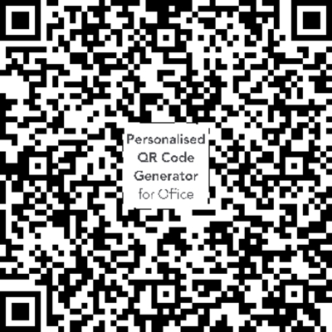
Reminder:
Tell us about your experience with the Moral Injury of dealing with health insurance corporations.
Moral Injury Survey

