Slide 1
Bring power to truth –
Fighting Medicare Advantage
Shruthi Bhuma and Swathi Bhuma
Students for a National Health Program
National board members

Slide 2
Single Payer
This session is about adapting our strategy
to the new landscape.
Spoiler alert:
we’ve just begun.
PNHP’s
“Triple Aim”
End Profiteering
End Profiteering
Improve Traditional Medicare
Improve Traditional Medicare

Slide 3
MA Is Now the Majority of Medicare
Fraction of Medicare beneficiaries in MA
https://www.kff.org/medicare/issue-brief/medicare-advantage-in-2024-enrollment-update-and-key-trends/
Accessed Aug. 29 2024

Slide 4

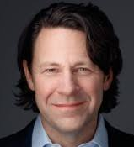
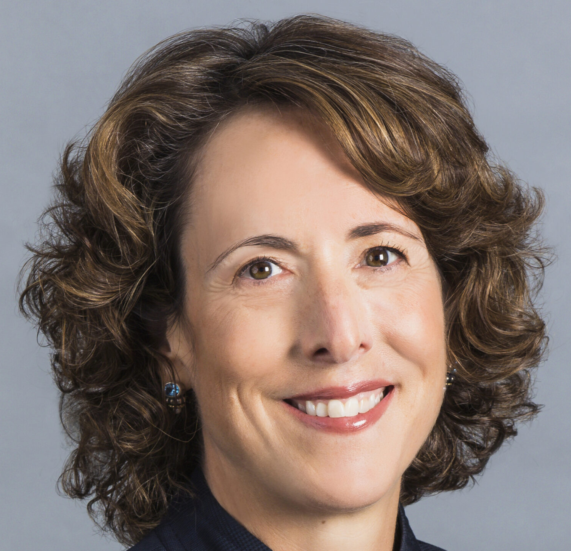
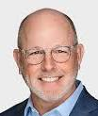
Four Corporations Now Control 73% of MA
2024 Market Share
UnitedHealthcare | Humana
BCBS Plans | CVS Health
CEO: Sir Andrew Witty
CEO:
Jim Rechtin
United
Healthcare
29%
Humana
18%
4 CEOs
who control
73% of MA
BCBS
14%
Other
16%
CEO:
Kim Keck
CEO:
David Joyner
CVS
12%
Cigna
Centene
Kaiser
https://www.kff.org/medicare/issue-brief/medicare-advantage-in-2024-enrollment-update-and-key-trends/
Accessed Aug. 29 2024

Slide 5
Four Corporations Now Control 73% of MA
2024 Market Share
The MA Market Is Consolidating Under UnitedHealthcare
United
Healthcare
29%
Humana
18%
29%
25%
24%
20%
19%
BCBS
14%
16%
Other
16%
CVS
12%
Cigna
Centene
Kaiser
https://www.kff.org/medicare/issue-brief/medicare-advantage-in-2024-enrollment-update-and-key-trends/
Accessed Aug. 29 2024

Slide 6
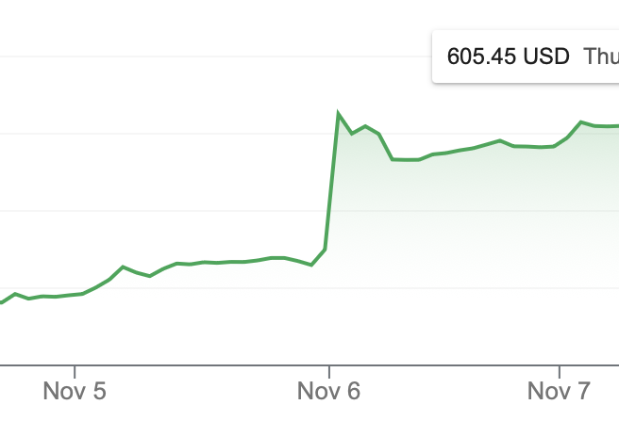
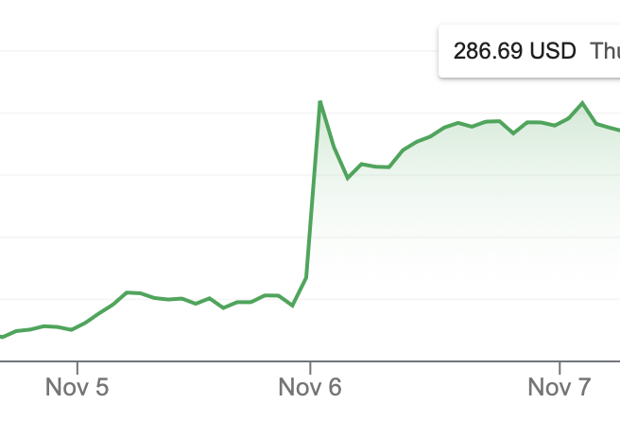
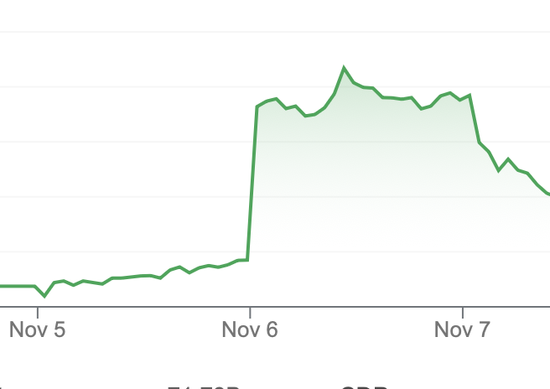
November 6, 2024:
“MA Stock Prices Soar Following Trump Win”
Unitedhealth Group: Up 6.6%
Humana: Up 12%
CVS Health: Up 14%
https://www.beckerspayer.com/payer/medicare-advantage-stocks-soar-following-trump-win.html?
https://healthcareuncovered.substack.com/p/election-may-shift-the-agenda-but
Notes:
CVS’ largest intra-day gain in 24 years

Slide 7

The political climate will accelerate America’s healthcare crisis
and the need
for advocacy
Project 2025 page 465
https://static.project2025.org/2025_MandateForLeadership_FULL.pdf

Slide 8
“Make Medicare Advantage
the default enrollment option.”
No detail included, so we don’t know
what they really mean by that
PNHP evaluated the implications
of abrupt 100% MA penetration
with nothing else changed.
Project 2025 page 465
https://static.project2025.org/2025_MandateForLeadership_FULL.pdf

Slide 9

Assuming Project 2025’s end game is
100% MA penetration
Harm to patients
  24,000,000 seniors would be in networks with <30% of physicians in their county
Harm to clinicians
  Time spent on Prior Authorizations increases to 43,000,000 hours per year
PNHP projection assuming 100% MA penetration in 2025
Extrapoloations based on PNHP’s 2024 report “Taking Advantage” and 2024 Medicare Trustees Report (Page 59)
https://www.cms.gov/oact/tr/2024

Slide 10
Assuming Project 2025’s endgame of 100% MA penetration:
Immediate Deficit in Medicare Trust Fund
Projection of Medicare Trustees
Medicare Hospital Insurance Trust Fund balance
($Billions)
Over the next decade,
$1.5 trillion increase
in total Medicare expenses,
handed to MA corporations.
Our pain = their profits
Immediate shift into deficit spending
Trust Fund becomes insolvent in five years
Project 2025 Endgame
PNHP projection assuming 100% MA penetration in 2025
Extrapolations based upon 2024 Medicare Trustees Report (Page 59)
https://www.cms.gov/oact/tr/2024

Slide 11
Other Attacks on Medicare :
  Reintroduce Global Direct Contracting (DCE) (predecessor of REACH)
  Replace FFS Medicare with “value-based” payments
  Repeal Medicare’s new authority to negotiate drug prices (via IRA)
  Remove “burdensome policies that micromanage MA plans”
  “Remove restrictions on key benefits and services” – what aren’t they saying here???
https://static.project2025.org/2025_MandateForLeadership_FULL.pdf

Slide 12



We’re Working on Three Fronts
Legislative
Narrative
Organizing
Single Payer
More cosponsors for Medicare for All bills
Stop enabling corporate attacks on Medicare
  Create an out-of-pocket maximum in TM
  Improve benefits in TM
  Stop subsidizing MA
PNHP’s
“Triple Aim”
End Profiteering
Improve Traditional Medicare

Slide 13
Stop subsidizing MA and
We Can Afford to Improve Medicare
$
Benchmark increases 5-10%
for plans with >4 quality stars
CMS sets a benchmark based on average cost in the county for TM.
Benchmark is adjusted for disease burden, an opportunity for “upcoding”
Plan retains a portion as their “Rebate.”
Intended to add benefits or
reduce OOP
4.5 or 5 stars:
Plan keeps 75%
3.5 or 4 stars:
Plan keeps 65%
<3 stars:
Plan keeps 50%
Plan submits a bid (its estimated cost for covering Parts A and B for average enrollee in county)
https://www.commonwealthfund.org/publications/explainer/2024/mar/how-government-updates-payment-rates-medicare-advantage-plans
https://www.nber.org/system/files/working_papers/w27578/w27578.pdf
Accessed Aug 29 2024

Slide 14
MA corporations
game the payment model
PNHP estimates this adds up to $140 billion per year
$106 billion of that could be used to improve TM
MedPAC estimates
$83 billion
Ending MA subsidies would make
$83-106 billion
available to improve Medicare.
What could we do with those funds?
PNHP’s 2023 report on overpayments to Medicare Advantage
https://pnhp.org/system/assets/uploads/2023/09/MAOverpaymentReport_Final.pdf

Slide 15
When we reclaim the MA subsidies, we can afford to
Match MA’s Benefits in Traditional Medicare
$106
(PNHP)
$85 billion would allow TM to match the average MA benefits.
$ Billions per year
(Single Payer would provide
better benefits than MA does.)
$83
(MedPAC)
Ideal
Matches MA avg
62 million = people in both Parts A and B, including those in MA
“MOOP” = Maximum Out of Pocket. In this analysis also includes additional cost-sharing reduction to match average MA plans
2024 supplemental benefits data updated based on 2022 data from GAO at https://www.gao.gov/assets/d23105527.pdf
Numbers are not precisely additive due to rounding. Unpublished analysis by Rick Gilfillan MD (former administrator of CMMI)
Notes:
SLOW THIS DOWN A BIT.
So PNHP’s estimate of dozens of economic analyses reveals a range from $88B to a reasonable upper level of $140B. For all the reasons I’ve said earlier, I think the $140B number itself is pretty conservative and likely lowball.
Is $140B a large number in the scope of something as enormous as a federal budget? For me, that question is like asking whether Mars is closer than Venus. Whenever I see numbers this big, it helps to have a context of other numbers.
[CLICK]
To start, a shocking number emerged when we looked at the premiums paid by virtually all seniors and people with disabilities for Medicare Part B. Most pay about $170 a month, and most just have it taken out of their Social Security check. They know they do it, but they usually don’t see it. Nearly invisible.
[CLICK]
If you add up all of those monthly $170 payments by millions of people, that’s $131B across the country every year. That’s less than the money being grifted by MA corporations.
Medicare members all pay that because they’ve been told that’s the only way the federal government can afford to provide a Part B benefit. I believe they would be pretty angry if they realized that MA profiteers are diverting all of those premium dollars being taken out of their Social Security checks every month. Increasing their Social Security checks by $170 a month would be a big win for people on Medicare, and frankly for the politicians who made it happen. One of PNHP’s projects is to make sure this is widely understood. People would be angry about this, if they knew.
[CLICK]
Or, remember all the controversy and fighting over Medicare Part D? The entire federal spend on Part D is less than our estimate of the overpayments to MA.
[CLICK]
Or one of the things we really need to do to improve Traditional Medicare and level the playing field against MA – put in a maximum out-of-pocket cap. Those copays and deductibles can quickly bankrupt people, and there’s no limit to that in TM today. That’s why people have to buy Medigap if they can afford to, or go into MA and risk not getting the healthcare they need. So if we limited the out-of-pocket risk in TM, we’d help people avoid MA. PNHP would of course like to see that out-of-pocket max set at zero, but the Urban Institute modeled out a more modest out-of-pocket maximum of $5,000 per year. That would cost a tiny fraction of what MA drains from us, and would go a long way towards leveling the playing field.
[CLICK]
Finally, we could add the missing benefits that most people really want like dental, hearing, and vision. MA corporations market the heck out of that, people join MA to get those benefits, and then later find out how limited the benefits really are. It turns out that adding dental, hearing, and vision – not just to Medicare but even to all of Medicaid – would cost less than our lowest estimate of the overpayments.

Slide 16
Annual Advocacy Window on MA Rates
CMS publishes Advance Notice with 30-day comment period
CMS publishes
Rate Announcement
Plans submit Bids
Nov | Dec | Jan | Feb | Mar | Apr | May | Jun | Jul | Aug | Sep | Oct
CMS publishes early preview of changes
CMS reviews Bids
https://www.commonwealthfund.org/publications/explainer/2024/mar/how-government-updates-payment-rates-medicare-advantage-plans Accessed Aug 29 2024
Notes:
Calendar for 2025 with critical moments (Yellow Box, 2025: Refilling of Bills, Rate Notice, Open Enrollment)

Slide 17
We can’t expect this every year, but
Advocacy Works!
Our “Coalescence”
Intervened in 2024
The investment community
didn’t like this.
  44 leg visits (26 led by PNHP physicians)
  25K emails
  Bicameral letters from MOCs
As a result of 2024 advocacy,
MA corporations will be paid
$22B less in 2025
Plan payment savings percentages from Medicare Rate announcements and population estimates are from 2024 Medicare Trustees Report p. 162 at https://www.cms.gov/oact/tr/2024

Slide 18
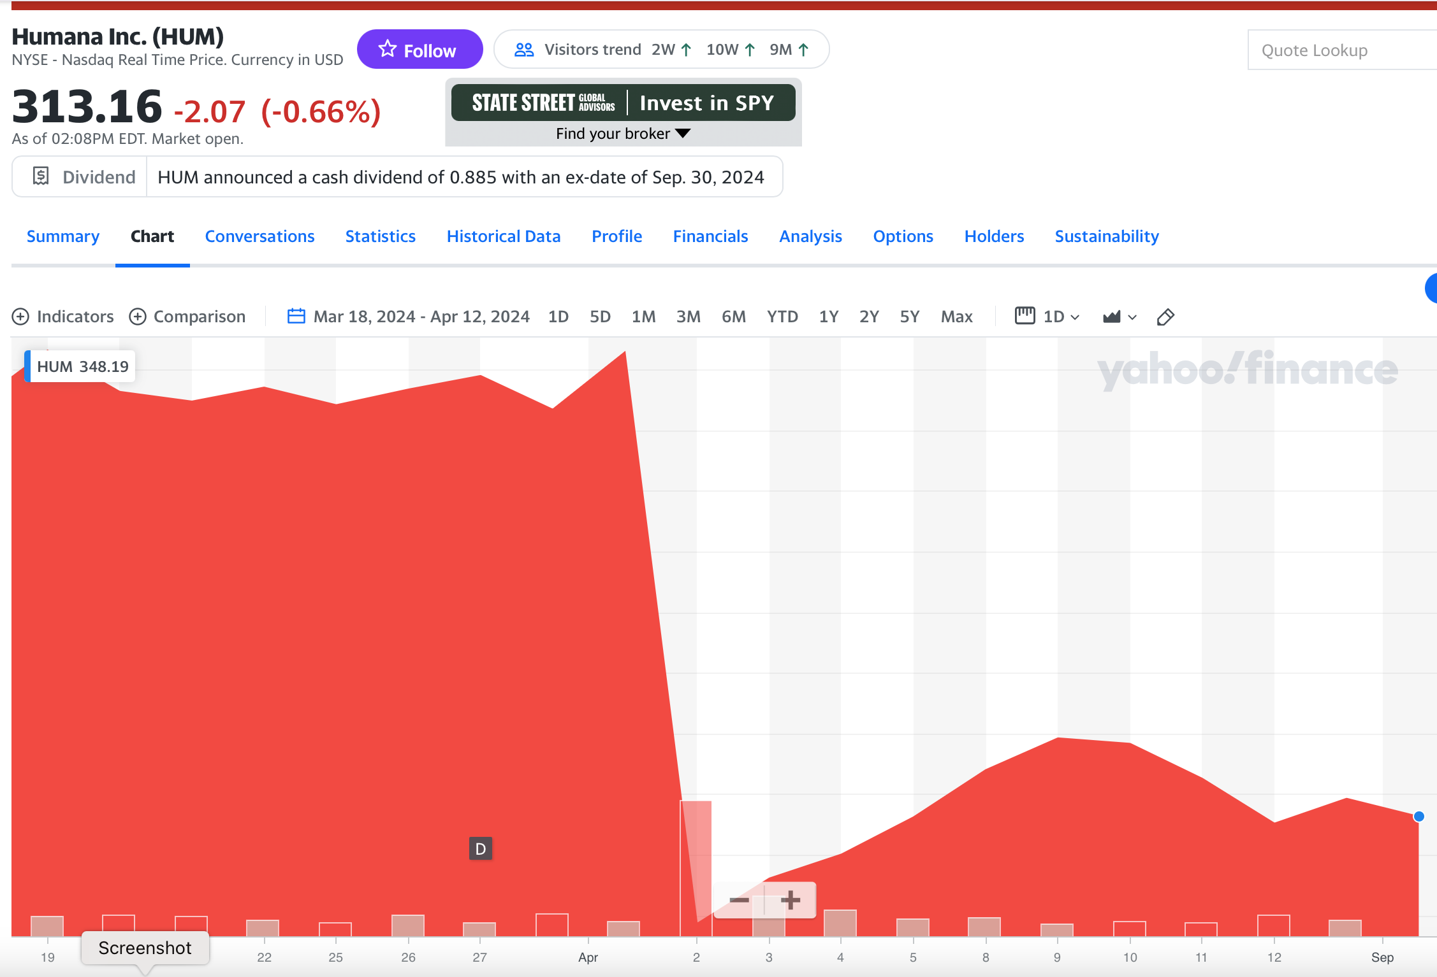
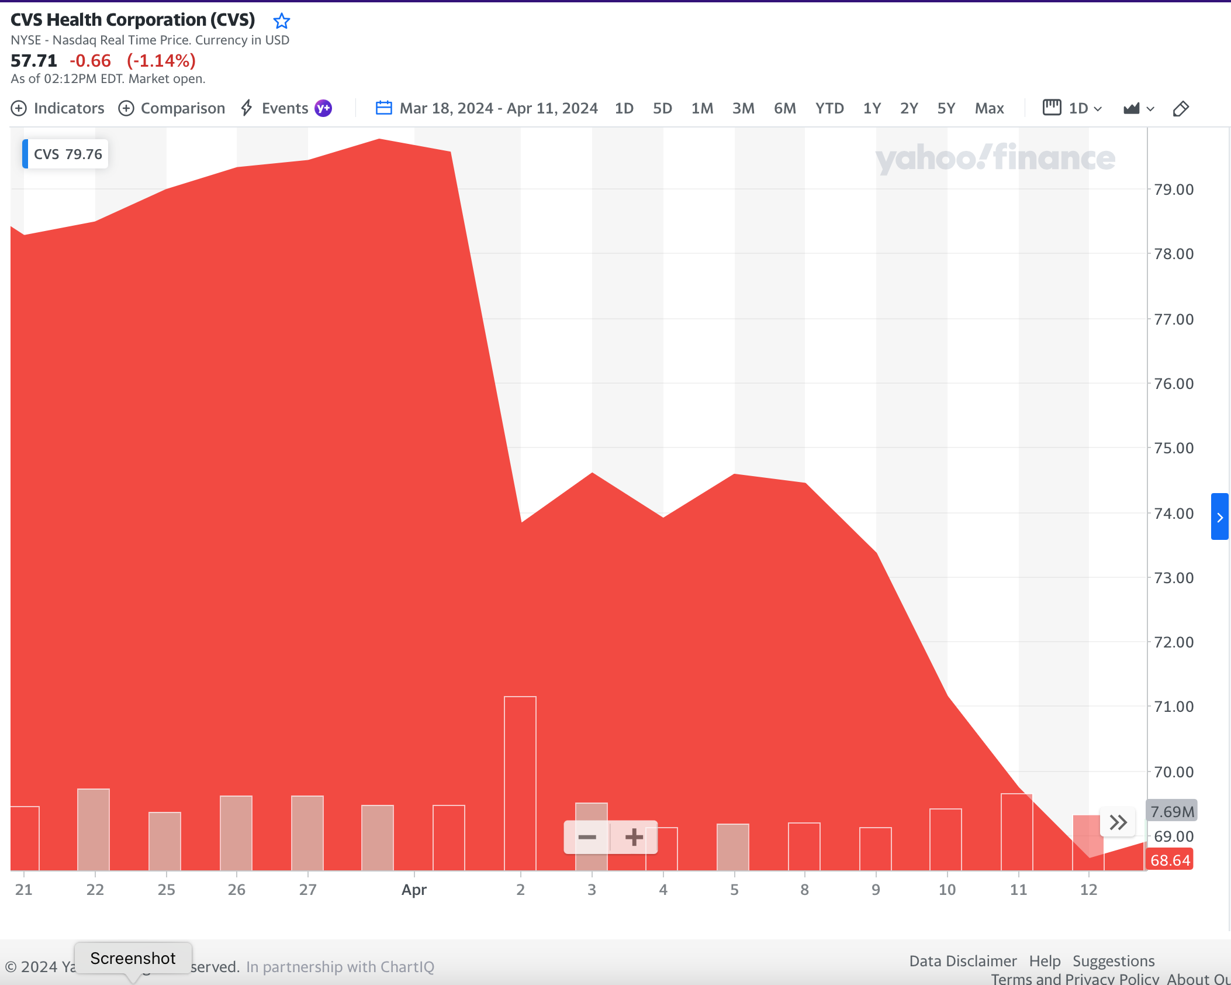
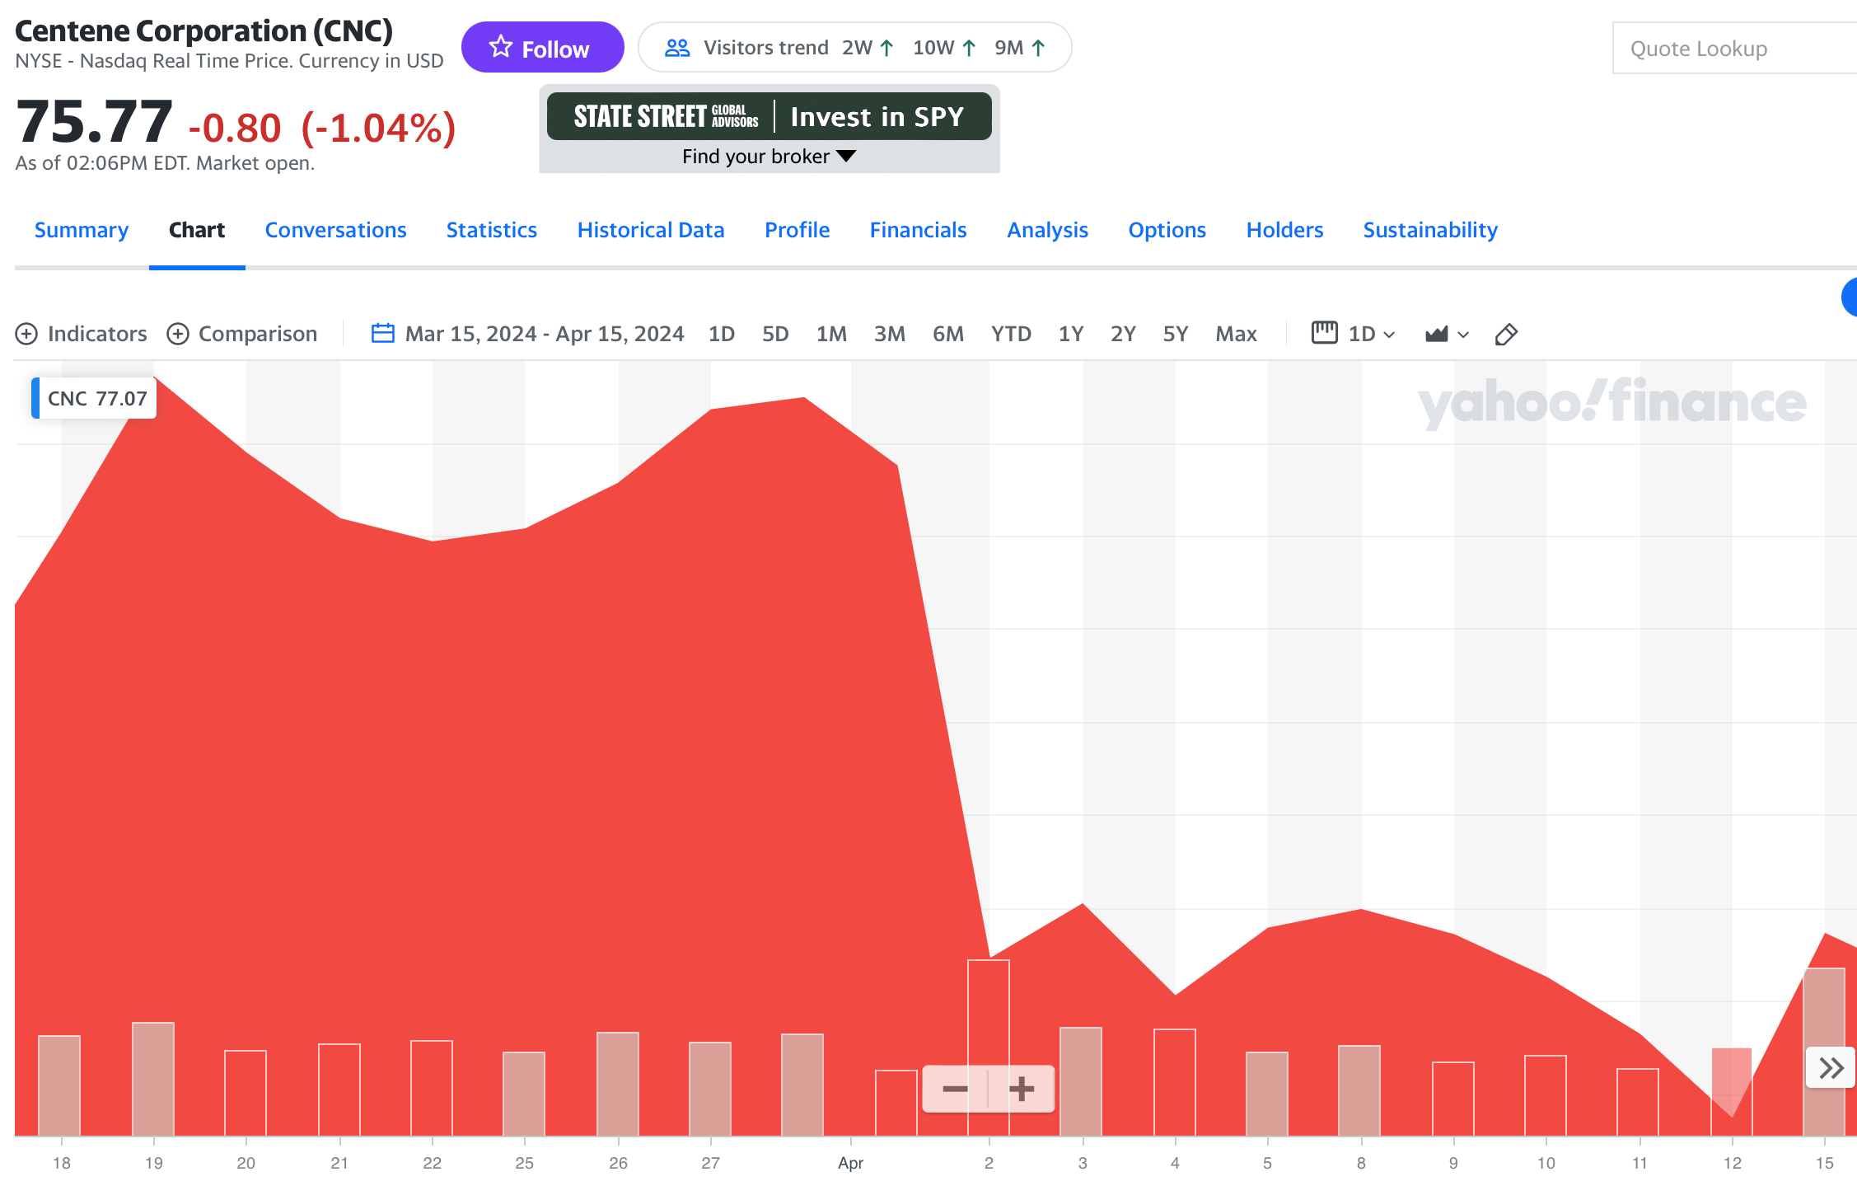
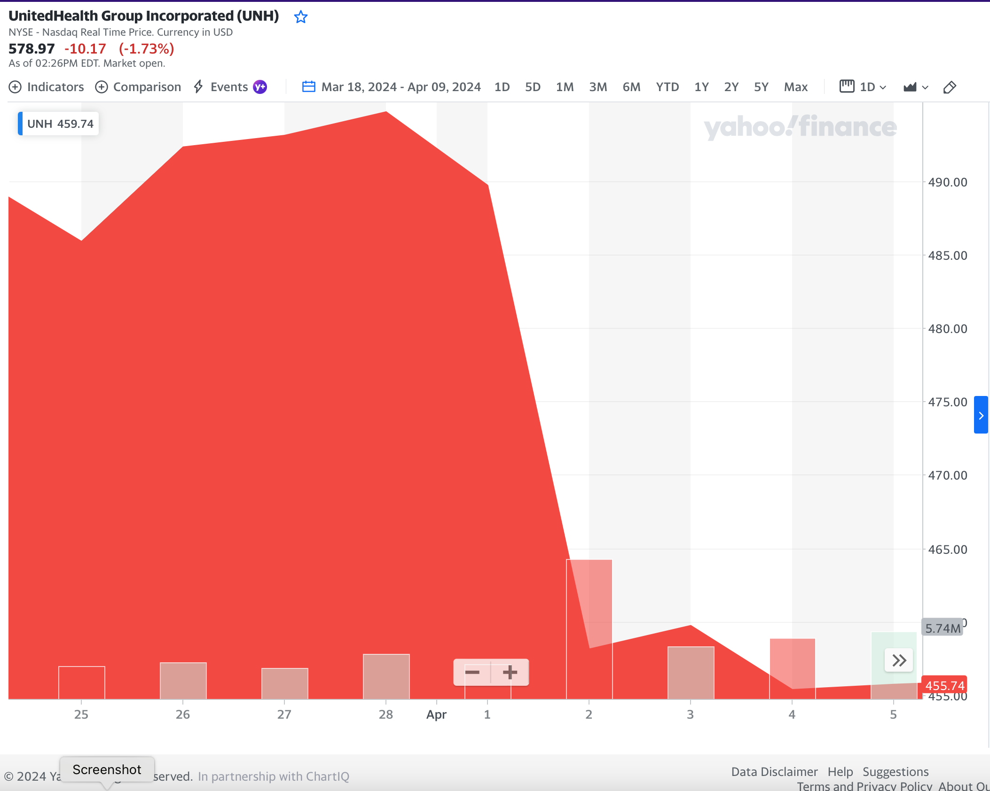
We can’t expect this every year, but
Advocacy Works!
Humana stock price
fell 12.3%
CVS/Aetna stock price
fell 7.1%
Within 24 hours,
UnitedHealth, Humana,
and CVS/Aetna
lost $95B
in market capitalization.
Other MA corporations
lost additional value.
Centene stock price
fell 7.3%
United stock price
fell 7.0%
https://healthcareuncovered.substack.com/p/nightmare-on-wall-street-for-medicare?utm_source=publication-search
https://finance.yahoo.com
Accessed Sept 17 2024

Slide 19
We’re Working on Three Fronts
Legislative
Narrative
Single Payer
“The water is rising, but
we know the way
to higher ground.”
PNHP’s
“Triple Aim”
End Profiteering
Improve Traditional Medicare

Slide 20
MA corporations weaponize data to falsely pose to Congress as a
Solution to Inequities
% of Medicare beneficiaries in MA
Income <$25,000
A system that harms people cannot be the solution to equity.
PNHP can help Congress see past the weaponized data.
https://www.ahip.org/resources/medicare-advantage-demographics Accessed Oct. 15 2023
https://www.kff.org/report-section/disparities-in-health-measures-by-race-and-ethnicity-among-beneficiaries-in-medicare-advantage-report/ Accessed Aug 19 2024

Slide 21
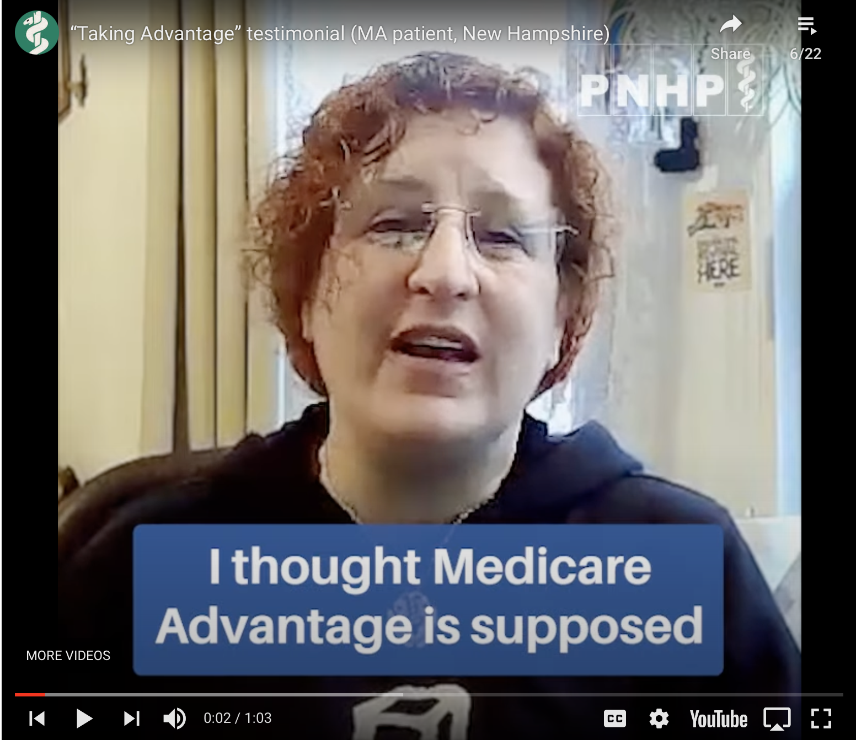


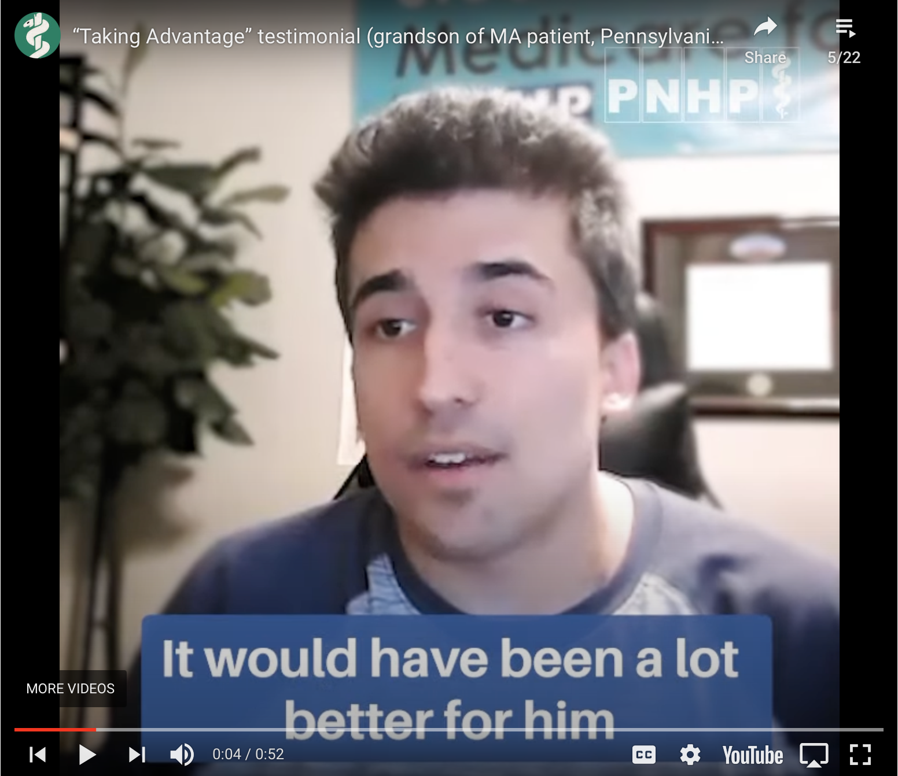
It’s more than just numbers on paper –
Our Real-life Stories Build Our Power

Slide 22
Health Affairs is calling for submissions about
MA Supplemental Benefits
Our campaign includes
publishing our MA experiences in Health Affairs.
SNaHP wants to collaborate with PNHP and coauthor submissions.
Tell Lori if you’re up to co-author with SNaHP.
Health Affairs. 2024 Supplemental Benefits in Medicare Advantage. https://www.healthaffairs.org/request-for-abstracts/2024-supplemental-benefits-in-medicare-advantage. Published 2024. Accessed September 7, 2024.

Slide 23
We’re Working on Three Fronts
Legislative
Narrative
Organizing
Single Payer
PNHP’s
“Triple Aim”
End Profiteering
Improve Traditional Medicare

Slide 24
MA growth isn’t only from individual decisions:
Employers Are Dumping Retirees into MA
Millions of MA Beneficiaries in Employer or Union MA Plan
In nine states today,
group enrollees make up
more than 25% of MA enrollees.
https://www.kff.org/medicare/issue-brief/medicare-advantage-in-2024-enrollment-update-and-key-trends/
Accessed Aug. 29 2024

Slide 25
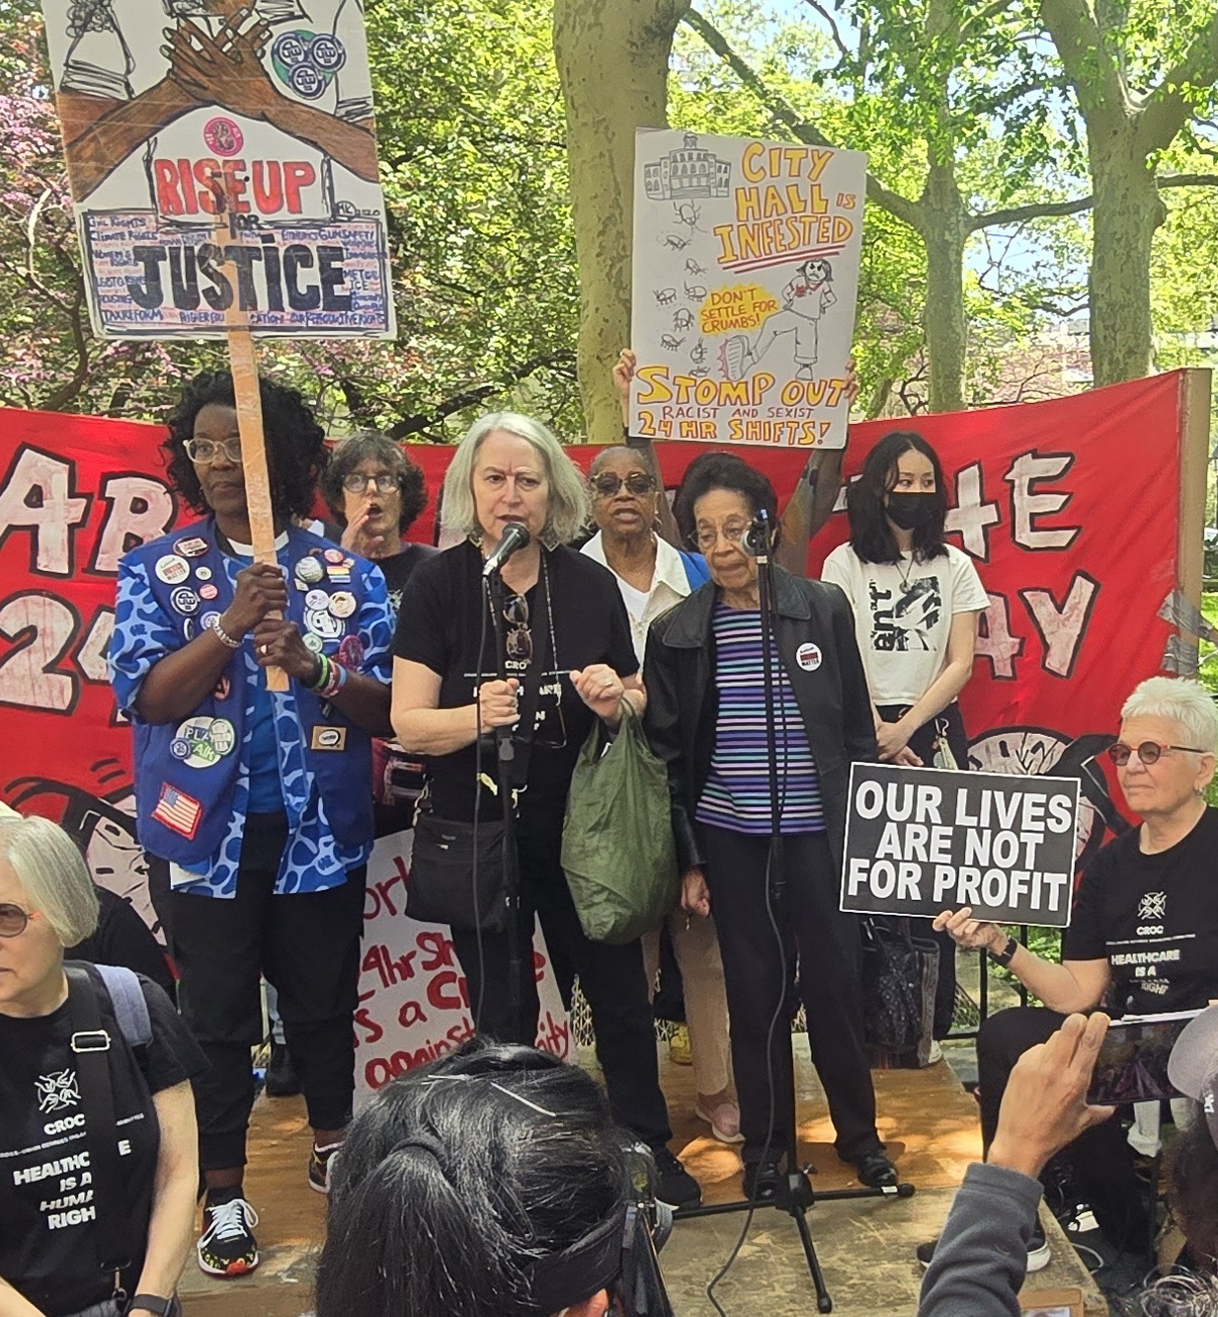
New York City labor is winning the fight against MA
Advocacy Works
NYC tried to stop paying Medigap premiums and move 250,000 retirees into an inferior MA plan
Retirees organized, held street actions, lobbied the City Council, and filed lawsuits
A large union backed off after anti-MA retirees won their Delegate Assembly election.
Retirees won all 9 suits and still have their benefits. (NYC is appealing; retirees are confident.)
Narrative recounted by Julie Schwartzberg, member of PNHP and of the Cross-union Retirees Organizing Committee

Slide 26
Imagine if this were happening all around the country!
Today’s challenge for you:
Decide how you will
engage with the campaign.

Slide 27


