Slide 1
Update in Health Policy: Physicians for a National Health Program 2024 Annual Conference
Adam Gaffney, MD MPH
Assistant Professor, Harvard Medical School
Pulmonary & Critical Care Medicine, Cambridge Health Alliance
Past President, Physicians for a National Health Program

Slide 2
US Health

Slide 3
Life Expectancy At Birth in the US: 1960-2022
Source
1960-2018:NCHS - Death rates and life expectancy at birth, available at https://data.cdc.gov/NCHS/NCHS-Death-rates-and-life-expectancy-at-birth/w9j2-ggv5/about_data. [Downlaoded 11-11-2024]
2019-2021: NVSS, National Vital Statistics Reports, United States Life Tables 2019, 2020, and 2021
20212:. NCHS Data Brief No. 492. March 2024. Mortality in the United States, 2022. https://www.cdc.gov/nchs/data/databriefs/db492.pdf.

Slide 4
Life Expectancy At Birth in the US among Black and White Individuals, 1950-2022
1960-2018:NCHS - Death rates and life expectancy at birth dataset, available at https://data.cdc.gov/NCHS/NCHS-Death-rates-and-life-expectancy-at-birth/w9j2-ggv5/about_data. [Downloaded 11-11-2024]
2007-2021: NVSS, National Vital Statistics Reports, United States Life Tables 2021 (Table 19). Note that before 2006, data is for Black and White individuals of both Hispanic and non-Hispanic ethnicity. However, from 2006 onward (indicated by dashed line), life expectancy is that of non-Hispanic Blacks and non-Hispanic Whites only. Race indicator is the CDC’s “Single Race” variable from 2018 onward, and before that “Bridge Race”; these categorizations are not fully comparable.

Slide 5
Economic disparities in hypertension control among hypertensive US adults is widening, 2013-23
Hardy, Shakia T, Byron C Jaeger, Kathryn Foti, Lama Ghazi, Gregory Wozniak, and Paul Muntner. “Trends in Blood Pressure Control in US Adults with Hypertension, 2013-2014 to 2021-2023.” American Journal of Hypertension, November 6, 2024, hpae141.

Slide 6
Cases of Congenital Syphilis in the US Increased More than 10 Times Between 2012 and 2022
McDonald, Robert, Kevin O’Callaghan, Elizabeth Torrone, Lindley Barbee, Jeremy Grey, David Jackson, Kate Woodworth, et al. “Vital Signs: Missed Opportunities for Preventing Congenital Syphilis — United States, 2022” 72, no. 46 (2023).

Slide 7
Even with the COVID-19 receding, US health is faltering — particularly among younger adults.

Slide 8
Coverage and Access to Care

Slide 9
Uninsured in the US: 1963 to 2023
Source for data before 2010: Council of Economic Advisers, “Methodological Appendix: Methods Used to Construct a Consistent Historical Time Series of Health Insurance Coverage,” 2014, https://obamawhitehouse.archives.gov/sites/default/files/docs/longtermhealthinsuranceseriesmethodologyfinal.pdf.
Source for data from 2010 – 2021: Early Release Estimates from the National Health Interview Survey, multiple years. Available at: https://www.cdc.gov/nchs/data/nhis/earlyrelease.pdf. Note that there was a change in survey methodology in 2019.

Slide 10
Medicaid Unwinding Continues: Enrollment Fell by 13 Million from April 2023 to July 2024
Data source: Kaiser Family Foundation https://www.kff.org/affordable-care-act/state-indicator/total-monthly-medicaid-and-chip-enrollment/?activeTab=graph&currentTimeframe=0&startTimeframe=126&selectedDistributions=total-monthly-medicaidchip-enrollment&selectedRows=%7B%22wrapups%22:%7B%22united-states%22:%7B%7D%7D%7D&sortModel=%7B%22colId%22:%22Location%22,%22sort%22:%22desc%22%7D [Access 11-11-24]

Slide 11
Medicaid “Unwinding” Projected to Increase Number Uninsured by ~6 Million — But Many Believe They Were Already Uninsured
Ding, Dong, Benjamin D. Sommers, and Sherry A. Glied. “Unwinding And The Medicaid Undercount: Millions Enrolled In Medicaid During The Pandemic Thought They Were Uninsured.” Health Affairs 43, no. 5 (May 2024): 725–31.

Slide 12
Uninsured will Rise to 32 million by 2027 New CBO Projections
Hale, Jessica, Nianyi Hong, Ben Hopkins, Sean Lyons, Eamon Molloy, and The Congressional Budget Office Coverage Team. “Health Insurance Coverage Projections For The US Population And Sources Of Coverage, By Age, 2024–34.” Health Affairs 43, no. 7 (July 2024): 922–32.

Slide 13
Employer-Sponsored Insurance, Family Coverage 2024 Deductibles
Source: Kaiser Family Foundation, 2024 Employer Health Benefits Survey.

Slide 14
ACA Marketplace Plan Average Deductibles, 2024
KFF. Deductibles in ACA Marketplace Plans, 2014-2024. December 22, 2023. https://www.kff.org/affordable-care-act/issue-brief/deductibles-in-aca-marketplace-plans/. 94% AV plan available for those with family income 100-150% FPL; 87% AV plan 151-200%FPL; and 73% AVP 201-250% FPL. For 2025, for a family of 4, these FPLs correspond to family income of $31,200 - $46,800; $46,801 - $62,400; and $62,400 - $78,000, respectively (https://aspe.hhs.gov/topics/poverty-economic-mobility/poverty-guidelines).

Slide 15
Mandatory Transition to High-Deductible Health Plan (HDHP) Increases Risk of Diabetes Complications
McCoy, Rozalina G., Kavya S. Swarna, David H. Jiang, Holly K. Van Houten, Jie Chen, Esa M. Davis, and Jeph Herrin. “Enrollment in High-Deductible Health Plans and Incident Diabetes Complications.” JAMA Network Open 7, no. 3 (March 22, 2024): e243394. All differences statistically significant p<0.01.

Slide 16
Cost Barriers to Care Among Non-Elderly Adults: 1997-2023

Slide 17
Medical Debt After Childbirth A 6 State + NYC Survey of Postpartum People
Allen H, Spishak-Thomas M, Underhill K, Liu C, Daw JR. When the Bough Breaks: The Financial Burden of Childbirth and Postpartum Care by Insurance Type. The Milbank Quarterly. 2024.

Slide 18
Job Lock among Parents of Children with and without Cystic Fibrosis
Difference statistically significant in unadjusted and adjusted analyses. Azaroff, Lenore S., Steffie Woolhandler, Danny McCormick, David U. Himmelstein, David Bor, Samuel Dickman, and Adam Gaffney. “Job Lock and Parents of Children With Cystic Fibrosis.” JAMA Pediatrics, October 28, 2024.

Slide 19
Risk of no health care clinician visits among those US prisoners with a chronic medical condition
Lupez, Emily Lupton, Steffie Woolhandler, David U. Himmelstein, Laura Hawks, Samuel Dickman, Adam Gaffney, David Bor, et al. “Health, Access to Care, and Financial Barriers to Care Among People Incarcerated in US Prisons.” JAMA Internal Medicine, August 5, 2024.

Slide 20
Even with uninsurance rates at historically low levels, we remain very far from true universal healthcare — single-tier seamless care without financial barriers over the lifespan for all.

Slide 21
Medicare Advantage

Slide 22
Medicare Advantage Penetration Reached 54% in 2024 Projected to Rise to 63.5% by 2034
Historical Data: Medicare Advantage in 2024: Enrollment Update and Key Trends. URL: https://www.kff.org/medicare/issue-brief/medicare-advantage-in-2024-enrollment-update-and-key-trends/. Downloaded 11-11-24.
Projections: Estimated from CBO’s Projected A+B Enrollment (Hale, Jessica, Nianyi Hong, Ben Hopkins, Sean Lyons, Eamon Molloy, and The Congressional Budget Office Coverage Team. “Health Insurance Coverage Projections For The US Population And Sources Of Coverage, By Age, 2024–34.” Health Affairs 43, no. 7 (July 2024): 922–32 and Managed Medicare Enrollment projections (CBO Baseline Projections, Medicare, June 2024, https://www.cbo.gov/system/files/2024-06/51302-2024-06-medicare.pdf).

Slide 23
Overpayments to Medicare Advantage plans totaled $591 billion from 2007-2024 Total Medicare Advantage Administrative Costs Closely Similar
Overpayment estimates were drawn from MedPAC, Report to the Congress, Medicare Payment Policy, March 2024. Administrative spending was calculated from MLR estimates drawn from a 2008 GAO Report (years 2006-10); a 2013 GAO report (20111-2014), and estimates from Milliman (2015-2022; 2022 estimate applied to 2023 and 2024). These MLR percentages were then multiplied by total (reported or [for 2023-24] projected ) Medicare Advantage expenditures from the 2008-2023 Trustees’ Reports.

Slide 24
In-home health risk assessments and chart reviews inflate MA enrollees risk scores Translates to $3-15 billion in increased payments in 2021
Jacobs, Paul D. “In-Home Health Risk Assessments And Chart Reviews Contribute To Coding Intensity In Medicare Advantage.” Health Affairs 43, no. 7 (July 2024): 942–49. $15 billion is gross increased payments; $3 billion figure is if the CMS’s entire statutory MA risk score adjustment were applied solely to risk assessment/chart review payment increase

Slide 25
Differences in Home Care Utilization: Medicare Advantage vs. Traditional Medicare Beneficiaries
Data from: Prusynski RA, D’Alonzo A, Johnson MP, Mroz TM, Leland NE. Differences in Home Health Services and Outcomes Between Traditional Medicare and Medicare Advantage. JAMA Health Forum 2024;5(3):e235454. Differences are adjusted.

Slide 26
Enrollment of Veterans in MA Plans and Veteran-focused “High-Veteran” MA Plans, 2016 and 2022
* Of those Medicare eligible
** Of those enrolled in an MA plan. “High-Veteran MA Plan” defined as those with >= 20% VHA enrollees.
Data: Ma, Yanlei, Jessica Phelan, Kathleen Yoojin Jeong, Thomas C. Tsai, Austin B. Frakt, Steven D. Pizer, Melissa M. Garrido, Allison Dorneo, and José F. Figueroa. “Medicare Advantage Plans With High Numbers Of Veterans: Enrollment, Utilization, And Potential Wasteful Spending.” Health Affairs 43, no. 11 (November 2024): 1508–17.

Slide 27
Total and OOP Dental Expenditures per Year: TM vs. MA Beneficiaries
OOP difference is statistically significant only (p=0.04). Data from: Simon L, Cai C. Dental Use and Spending in Medicare Advantage and Traditional Medicare, 2010-2021. JAMA Netw Open 2024;7(2):e240401.

Slide 28
Transition to MA (vs. staying in TM) does not lead to any improvement in financial protection
OOP=Out-of-Pocket: Source: Park S, Meyers DJ, Trivedi AN. Association of Medicare Advantage Enrollment With Financial Burden of Care. Ann Intern Med [Internet] 2024 [cited 2024 Jun 24];Available from: https://www.acpjournals.org/doi/10.7326/M23-2480

Slide 29
Beneficiary Characteristics by Enrollment: MA Zero-Premium, MA Non-Zero Premium, and FFS
Data from: Harvard-Inovalon Medicare Study: The Importance of Plan Design in Medicare Advantage [Internet]. Inovalon. [cited 2024 Apr 22];Available from: https://www.inovalon.com/resource/harvard-inovalon-medicare-study-the-importance-of-plan-design-in-medicare-advantage/

Slide 30
Medicare Advantage does not only waste money— its business model is based on care denial, and it is undermining the idea of equitable, single-tier for the elderly.

Slide 31
Supply and Capital

Slide 32
US has Second Highest Supply of Specialists but Lowest Supply of Primary Care Doctors vs. 4 Peer Nations
Source: OECD Data Explorer, data downloaded July 2, 2024. Note: specialists include general pediatricians, obstetricians and gynecologists, psychiatrists, medical group of specialists, surgical group of specialists, other specialists not elsewhere classified.

Slide 33
Surgeries that should be performed electively are more likely to required emergently in PCP shortage areas Emergent provision also increases complication rate
Very mild = HPSA severity score 1-5; mild = 6-10; moderate == 11-15; severe = 16-20; very severe = 21-25.
Data from: Schaefer, Sara L., Shukri H. A. Dualeh, Nicholas Kunnath, John W. Scott, and Andrew M. Ibrahim. “Higher Rates Of Emergency Surgery, Serious Complications, And Readmissions In Primary Care Shortage Areas, 2015–19.” Health Affairs 43, no. 3 (March 2024): 363–71.

Slide 34
Black Communities More Likely to Lose Their Hospitals Risk of Hospital Closure (2007-2018) by Region’s Black Population Share
Tung EL, Bruch JD, Chin MH, Menconi M, Peek ME, Huang ES. Associations of U.S. Hospital Closure (2007-2018) with Area Socioeconomic Disadvantage and Racial/Ethnic Composition. Annals of Epidemiology 2024.

Slide 35
Hospitals Unlikely to Start PCI Service Lines in Black & Segregated Communities Hospital adoption of percutaneous coronary intervention service by community characteristics, 2000-20
Hsia RY, Shen Y-C. Structural Inequities In The Adoption Of Percutaneous Coronary Intervention Services By US Hospitals, 2000–20. Health Affairs 2024;43(7):1011–20.

Slide 36
Capital, Health, and Healthcare: A Population-Based Study of US Counties
Regional hospital capital is (+) associated with:
Population health
Population income and healthcare coverage
Hospital utilization (explainable by bed density)
Hospitalization costs
Takeaway: Investment in hospitals associated with community wealth but not population needs, and may drive use/costs.
Gaffney A, McCormick D, Bor D, Woolhandler S, Himmelstein DU. Hospital Capital Assets, Community Health, and the Utilization and Cost of Inpatient Care: A Population-Based Study of US Counties. Medical Care 2024;10.1097/MLR.0000000000001999.

Slide 37
Hospital NICU Capacity is Associated with Higher NICU Admission for Lower Need but NOT Higher Need Neonates And no correlation between capacity and improved outcome
Beds per 100 births
Goodman, David C., Patrick Stuchlik, Cecilia Ganduglia-Cazaban, Jon E. Tyson, JoAnna Leyenaar, Elenir B. C. Avritscher, Mathew Rysavy, et al. “Hospital-Level NICU Capacity, Utilization, and 30-Day Outcomes in Texas.” JAMA Network Open 7, no. 2 (February 14, 2024): e2355982. Relative risks are adjusted for patient and hospital confounders. Late preterm = 34-36 weeks.

Slide 38
Major Capital Investment Program by the Duke Endowment (1927-41) Expanded Regional Health Infrastructure and Improved Health
Hollingsworth, Alex, Krzysztof Karbownik, Melissa A. Thomasson, and Anthony Wray. “The Gift of a Lifetime: The Hospital, Modern Medicine, and Mortality.” American Economic Review 114, no. 7 (July 2024): 2201–38.

Slide 39
Healthcare capital should be allocated on the basis of community need — not wealth.
Market allocation underlies the “inverse care law.”

Slide 40
For-Profit Care

Slide 41
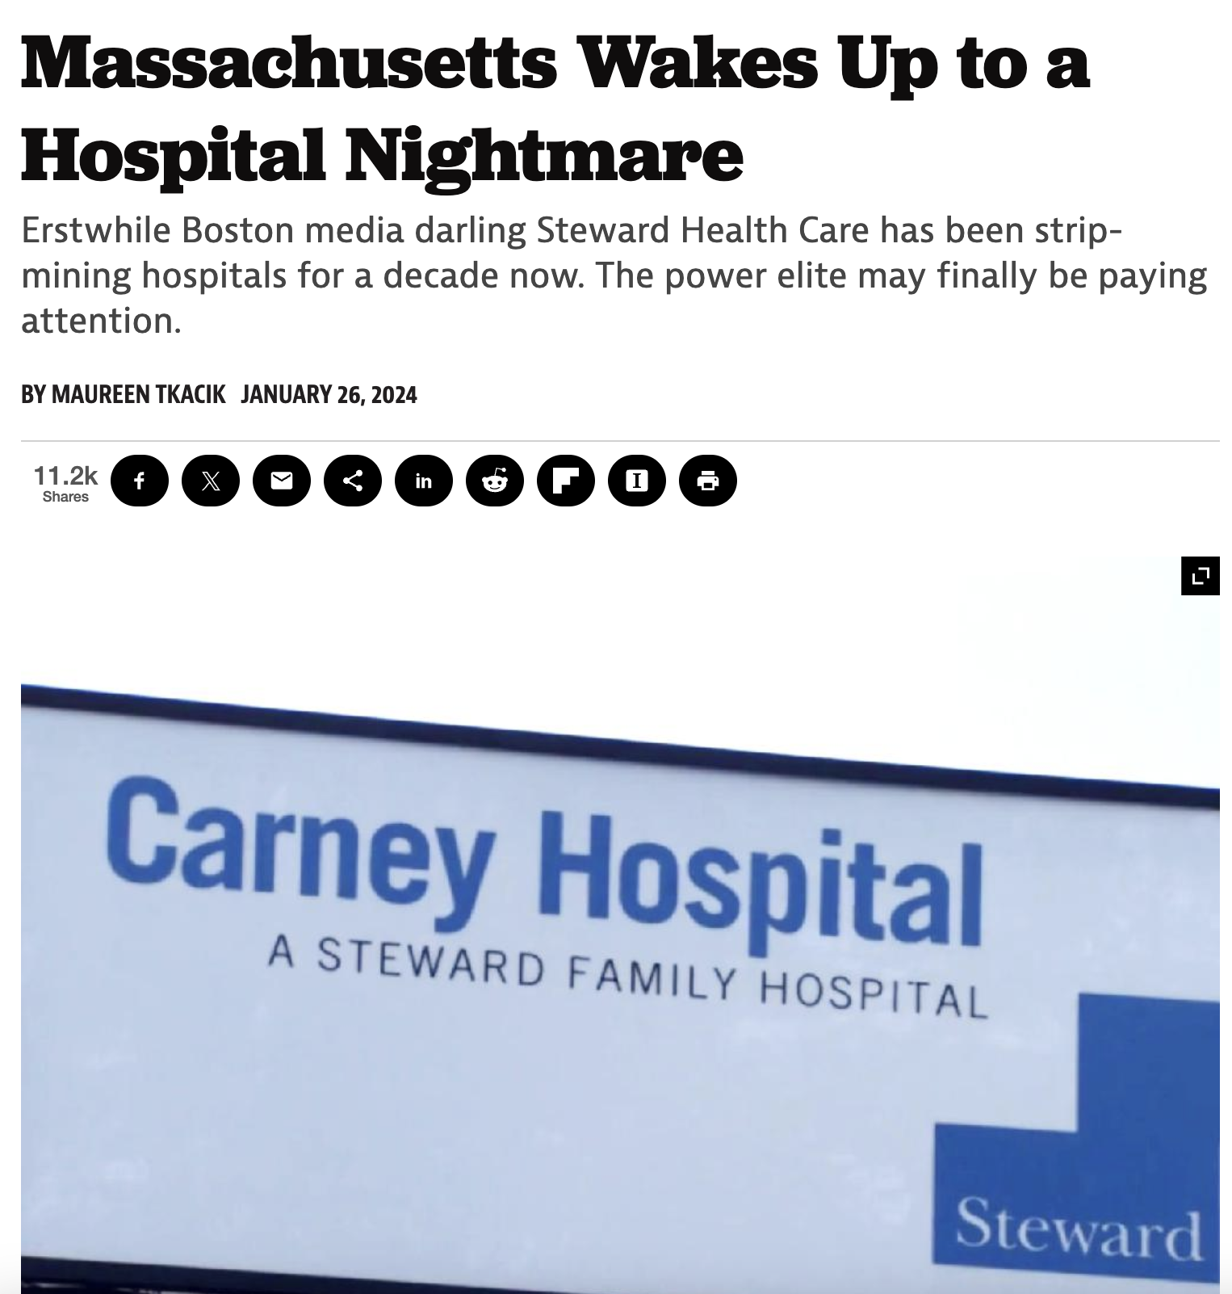

Slide 42
Steward Healthcare: How PE Loots Communities
2010: Boston Archdiocese sells its hospitals to Cerebrus against opposition from community.
2010-2016: Sells medical office buildings; closed a pediatric ward; sold off laboratory testing / cytology business; mostly closed Quincy Medical Center
2016: Sells off its real estate to Medical Properties Trust (MPT) Real Estate Investment Trust (REIT), generating $1.2 billion payoff and $484 million in dividends to investors. Hospitals saddled with unaffordable rent.
2017: Buys up distressed hospitals outside MA to 37-hospital system. Closes 2 of these soon after.
2020: More debt acquisition allows Cerebrus to sell off Steward to new physician owners, including CEO Ralph de la Torre.
-Cerebrus made $800 million+ off the system.
-New owners receive $111 million in dividends.
-CEO Ralph de la Torre buys a $40 million yacht.
2020-24: Spiraling finances, deteriorating care, unpaid bills, equipment shortages, hospital closures, understaffing.
2024: Files for bankruptcy in Texas, with $9 bn in liabilities mostly lease liabilities, $90 million in unpaid compensation.
Drawn from: PE Stakeholder Project. “The Pillaging of Steward Health Care.” Private Equity Stakeholder Project PESP, June 26, 2024. https://pestakeholder.org/reports/the-pillaging-of-steward-health-care/.

Slide 43
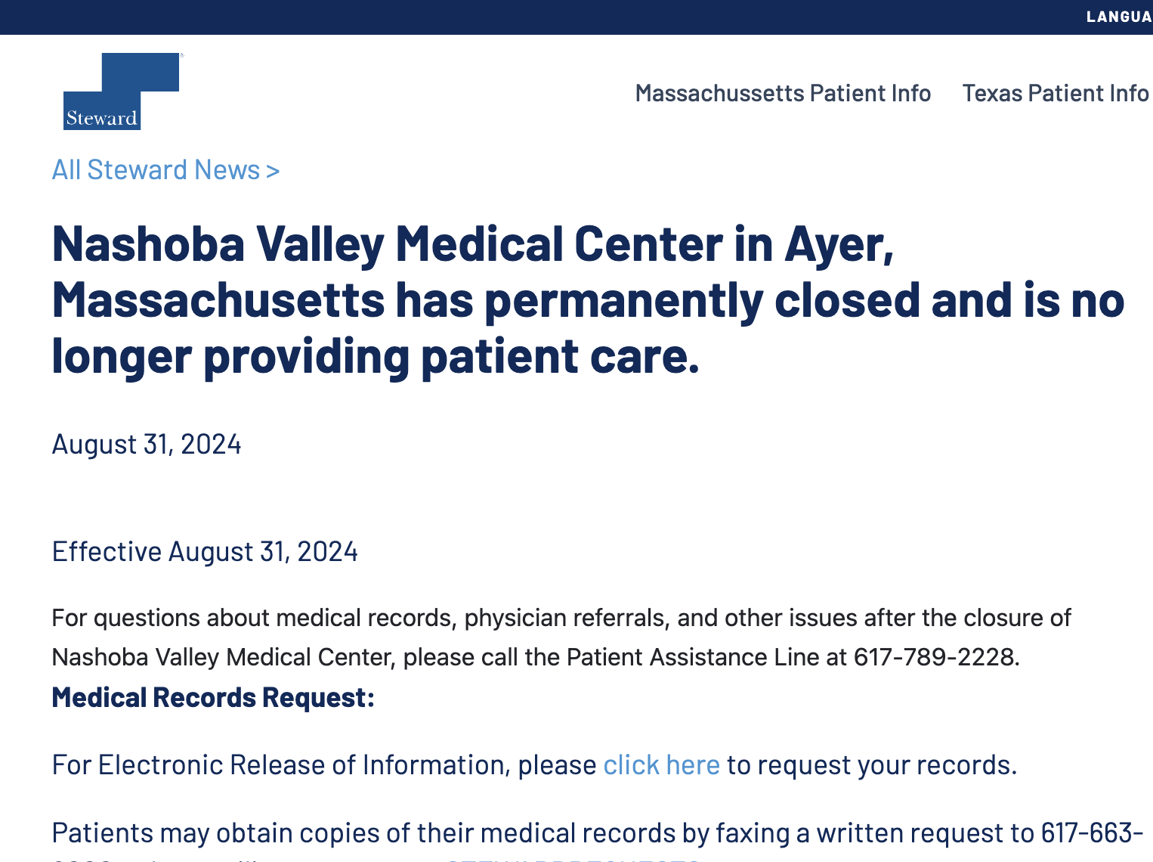
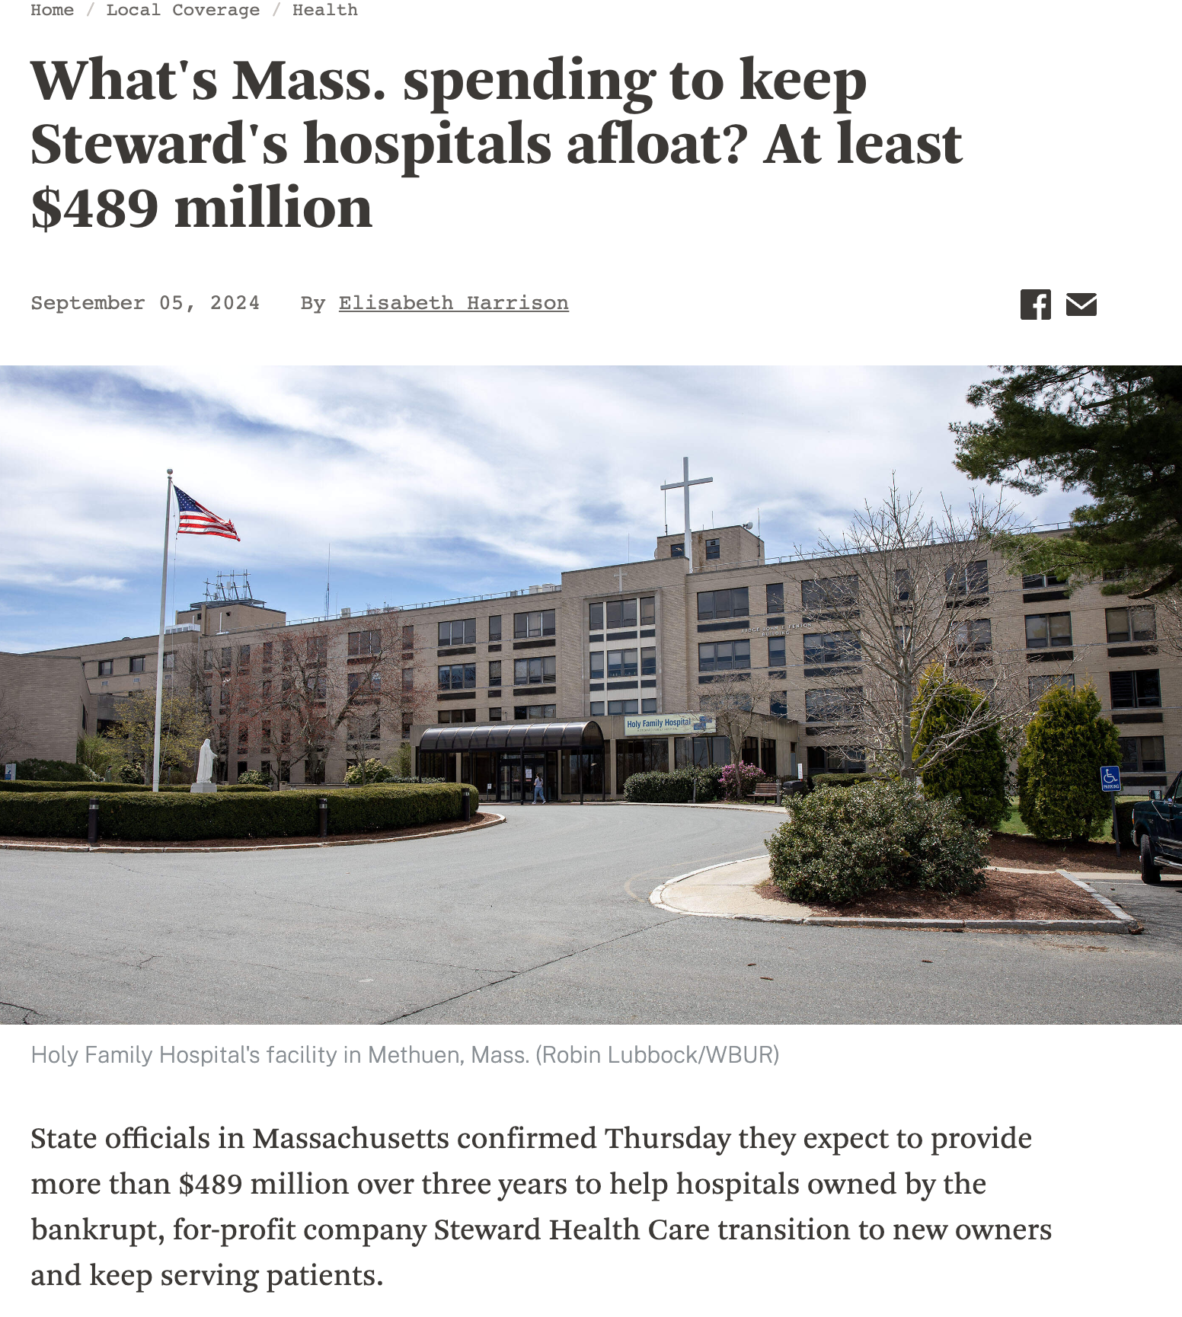

Slide 44
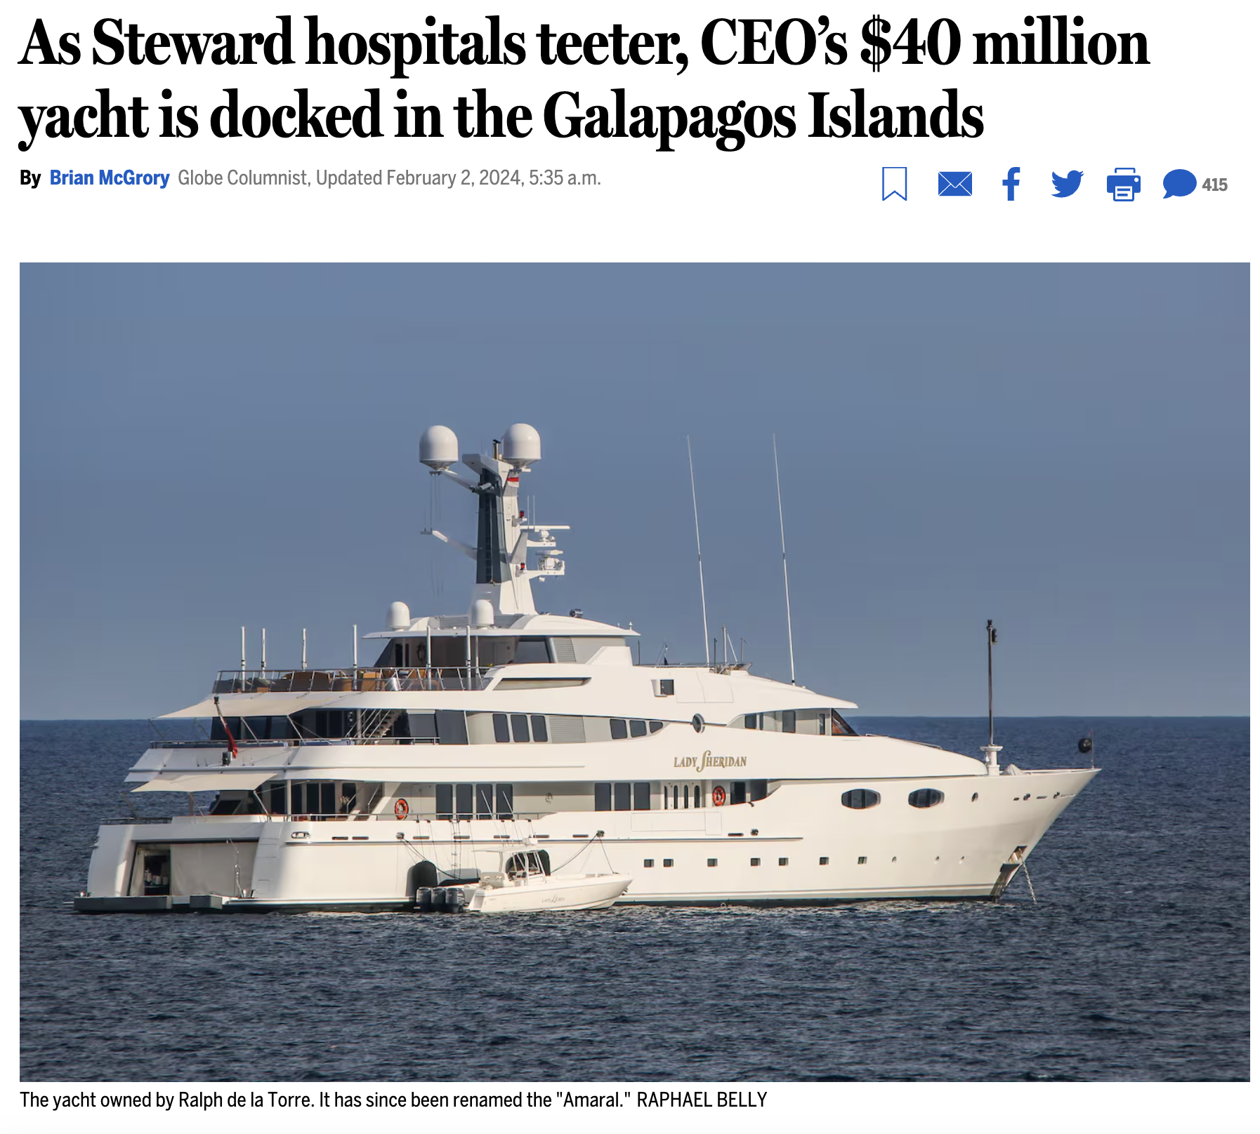

Slide 45
In the two years following PE Acquisition, Hospitals Lost 24% of their Capital
Schrier, Elizabeth, Hope E. M. Schwartz, David U. Himmelstein, Adam Gaffney, Danny McCormick, Samuel L. Dickman, and Steffie Woolhandler. “Hospital Assets Before and After Private Equity Acquisition.” JAMA, July 30, 2024. https://doi.org/10.1001/jama.2024.13555.

Slide 46
After Private Equity (PE) Acquisition, Hospitals See Sharp Rise in Complication Rates
Kannan S, Bruch JD, Song Z. Changes in Hospital Adverse Events and Patient Outcomes Associated With Private Equity Acquisition. JAMA 2023;330(24):2365–75.

Slide 47
PE acquired 41 cardiology practices across 342 clinic sites (2.9% of all clinics) from 2013-2022
Bartlett VL, Liu M, Ati S, Yeh RW, Zheng Z, Wadhera R. Private Equity Acquisitions of Outpatient Cardiology Practices in the United States, 2013-2023. Journal of the American College of Cardiology [Internet] [cited 2024 Jul 2];0(0). Available from: https://www.jacc.org/doi/10.1016/j.jacc.2024.06.011

Slide 48
PE-Acquired Physician Practices: Most Sold to Larger PE Firms within 3 Years
Data from: Singh Y, Reddy M, Zhu JM. Life Cycle of Private Equity Investments in Physician Practices: An Overview of Private Equity Exits. Health Affairs Scholar 2024;qxae047.

Slide 49
"Rollup": Median 595% Increase in Practice Sites Before PE Exit
Data from: Singh Y, Reddy M, Zhu JM. Life Cycle of Private Equity Investments in Physician Practices: An Overview of Private Equity Exits. Health Affairs Scholar 2024;qxae047.

Slide 50
PE acquired 2,806 behavioral health facilities (~7% of all facilities): 2010-2021
Figure reproduced from: Thornburg B, McGinty EB, Eddelbuettel J, Kennedy-Hendricks A, Braun RT, Eisenberg MD. Acquisitions of behavioral health treatment facilities from 2010 to 2021. Health Affairs Scholar 2024;2(7):qxae080.

Slide 51
124 hospices were taken over by 47 PE-firms from 2015-2022
Data source: Aldridge, Melissa D., Lauren J. Hunt, Zelle Halloran, and Krista L. Harrison. “Private Equity Acquisitions Of Hospices Are Increasing; Ownership Remains Opaque.” Health Affairs 43, no. 9 (September 2024): 1306–10.

Slide 52
Communities and the public — not profiteers and corporations — should be the owners of our vital healthcare infrastructure.

Slide 53
Administrative Waste

Slide 54
Administrative Spending as a Share of NHE : Public vs. Private, 1960-2022 Total public+private administrative spending = $334 billion in 2022
Source: CMS’ Historical National Health Expenditures Accounts, 1960-2022. “Private” includes publicly-sponsored private plans, e.g Managed Care Medicaid and Medicare

Slide 55
Share of Healthcare Workforce in Administrative Occupations: Private Sector vs. Veterans Health Administration (VA or VHA)
Source: Woolhandler, Steffie, Andrew Toporek, Jian Gao, Eileen Moran, Andrew Wilper, and David U. Himmelstein. “Administration’s Share of Personnel in Veterans Health Administration and Private Sector Care.” JAMA Network Open 7, no. 1 (January 18, 2024): e2352104.

Slide 56
“A Denial a Day Keeps the Doctor Away”: Haggling Costs" of Typical Visit are High, Especially for Medicaid Costs Also Associated with Reduced Physician Medicaid Acceptance
Dunn, Abe, Joshua D Gottlieb, Adam Hale Shapiro, Daniel J Sonnenstuhl, and Pietro Tebaldi. “A Denial a Day Keeps the Doctor Away*.” The Quarterly Journal of Economics 139, no. 1 (February 1, 2024): 187–233.

Slide 57
Single-payer reform, and not other reforms, would allow full re-purposing of hundreds of billions in administrative waste to care.

Slide 58
Pharmaceuticals

Slide 59
Medicare Drug Negotiation Achieved Reduced Prices for 10 Negotiated Drugs
Calculated from Negotiated and List prices estimated/provided in: Rome, Benjamin N., Aaron S. Kesselheim, and William B. Feldman. “Medicare’s First Round of Drug-Price Negotiation — Measuring Success.” New England Journal of Medicine. 2024.

Slide 60
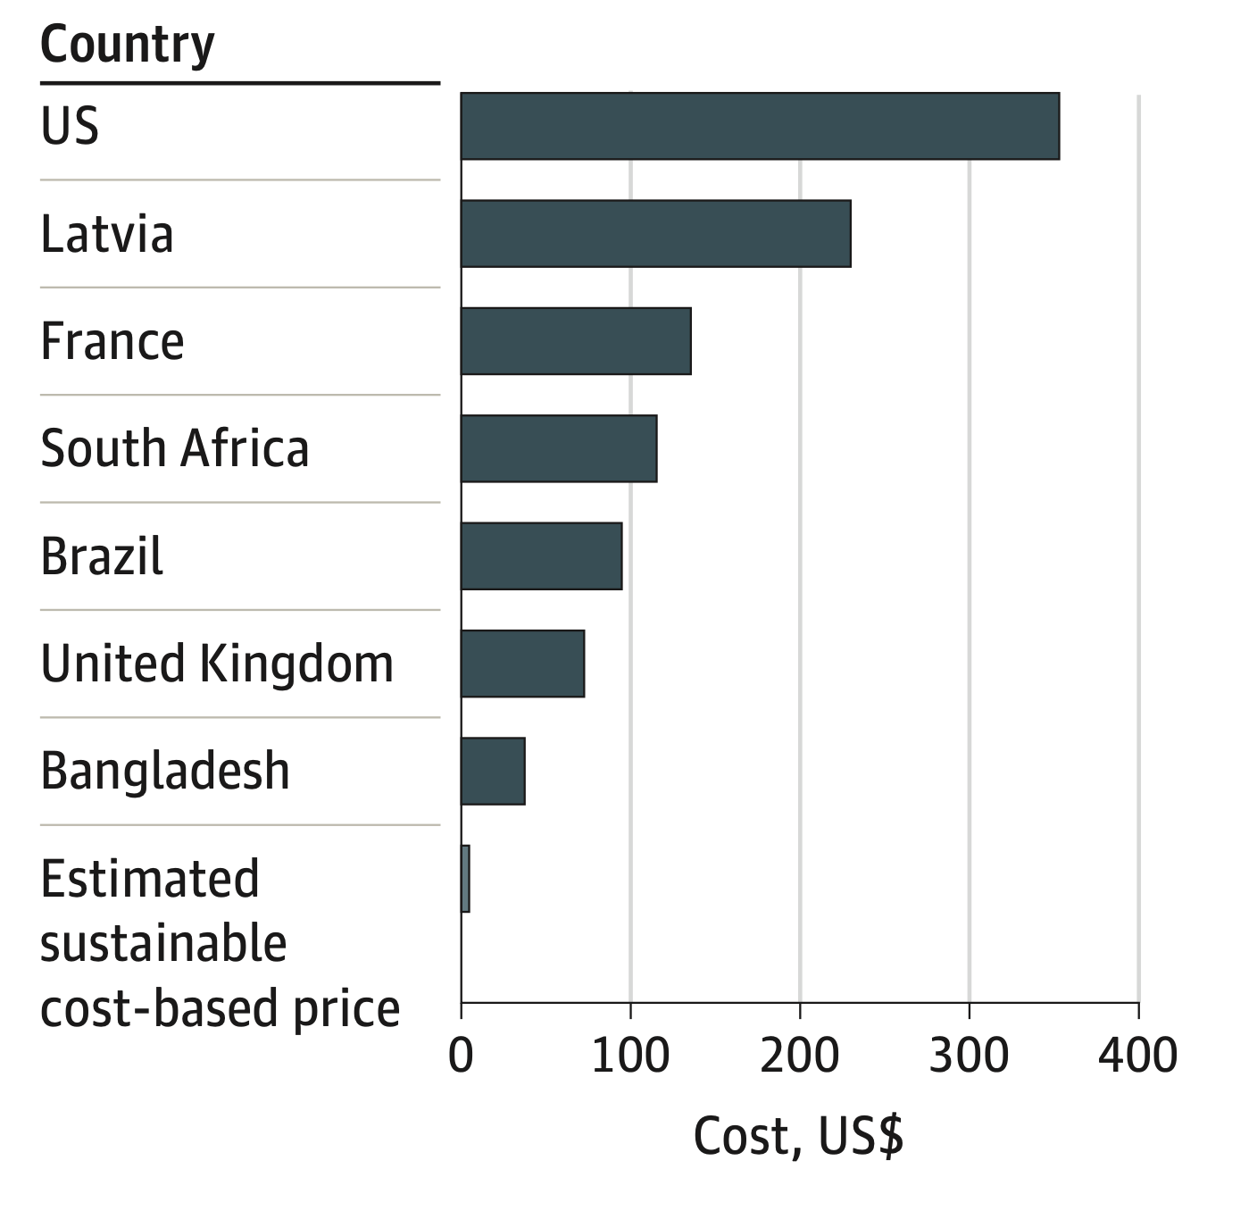
Semaglutide Prices: Higher in the US, Orders of Magnitude Higher Than the Cost of Production
$353.74
$4.73
Barber, Melissa J., Dzintars Gotham, Helen Bygrave, and Christa Cepuch. “Estimated Sustainable Cost-Based Prices for Diabetes Medicines.” JAMA Network Open 7, no. 3 (March 27, 2024): e243474. Cost is estimated monthly cost.

Slide 61
Publicly-financed drug development could allow drug provision close to the cost of production.

Slide 62
Reproductive Healthcare

Slide 63
Distance to closest abortion provider before and after Dobbs, January 2009 – October 2024

Slide 64
Post-Dobbs Change in Infant Mortality, Overall and with Congenital Anomalies Through June 2023
Source: Singh, Parvati, and Maria F. Gallo. “National Trends in Infant Mortality in the US After Dobbs.” JAMA Pediatrics, October 21, 2024.

Slide 65
Catastrophic Health Expenditures (CHE) For Abortion Care and Related (e.g. Travel) Expenses: Results of a Three State Survey CHE Associated with Anxiety, Depression
CHE defined as >= 40% of monthly income after food/housing. Wasser, Ortal, Lauren J. Ralph, Shelly Kaller, and M. Antonia Biggs. “Catastrophic Health Expenditures for In-State and Out-of-State Abortion Care.” JAMA Network Open 7, no. 11 (November 8, 2024): e2444146.

Slide 66
Immigrants & Health

Slide 67
Immigration Enforcement and Infant Health: Effects of “Secure Communities” (450,000 deportations) on Birth Outcomes Nutrition, Psychosocial stress may be mediators
Vu, Hoa. “I Wish I Were Born in Another Time: Unintended Consequences of Immigration Enforcement on Birth Outcomes.” Health Economics 33, no. 2 (2024): 345–62.

Slide 68
Number of ICE Detainee Requests Associated with Reduced Medicaid Uptake When SC Active, 2019
Quartiles = quartile of county-level ICE detainee requests to local law enforcement. Data shown is for immigrant families only, which are more marked compared to non-immigrant households. Regressions adjusted for potential confounders. Only year 2019 data shown here. Source: Kravitz, Caroline, Amy H. Auchincloss, M. Pia Chaparro, Sofia Argibay, Alexandra Eastus, and Brent A. Langellier. “ICE Detainer Requests Were Associated With Lower Medicaid And SNAP Enrollment Among Eligible Adults, 2011–19.” Health Affairs 43, no. 9 (September 2024): 1244–53.

Slide 69
Immigrant Share of Care Workers Relied on Older and Disabled Adults, 2021
Data from: https://www.migrationpolicy.org/article/immigrant-health-care-workers-united-states

Slide 70
International Developments

Slide 71
NHS-Funded Primary Hip Replacement Surgery Provided by NHS vs. Private Providers, Fiscal Years 1998-2019
Kirkwood, Graham, Allyson M Pollock, and Peter Roderick. “Private Sector Expansion and the Widening NHS Treatment Gap between Rich and Poor in England: Admissions for NHS-Funded Elective Primary Hip and Knee Replacements between 1997/98 and 2018/19.” Health Policy 146 (August 1, 2024): 105118.

Slide 72
Number undergoing NHS-funded hip/knee replacement from least deprived quartile per 10 from most deprived quintile: 1998 and 2019
Kirkwood, Graham, Allyson M Pollock, and Peter Roderick. “Private Sector Expansion and the Widening NHS Treatment Gap between Rich and Poor in England: Admissions for NHS-Funded Elective Primary Hip and Knee Replacements between 1997/98 and 2018/19.” Health Policy 146 (August 1, 2024): 105118.

Slide 73
Outsourcing healthcare services to the private sector associated with a rise in treatable mortality rates in England: 2013-2020
Goodair, Benjamin, and Aaron Reeves. “Outsourcing Health-Care Services to the Private Sector and Treatable Mortality Rates in England, 2013-20: An Observational Study of NHS Privatisation.” The Lancet. Public Health 7, no. 7 (July 2022): e638–46.

Slide 74
Why Private Healthcare Undercuts the Public Healthcare
Financial resources
Public healthcare system
Professional resources
Political support
AUSTERITY
Parallel private healthcare sector
The point here draws on: Prémont M-C, Verbauwhede C. Canadian legislatures and the regulation of the private health-care industry. University of Toronto Law Journal. 2018;68(2):231-258; Woolhandler, Steffie, David U. Himmelstein, and Adam Gaffney. Review of The Only Way to Fix US Health Care, by Liran Einav and Amy Finkelstein. The New York Review of Books, November 7, 2024.

Slide 75
The Coming Era of Trump 2

Slide 76
Coverage Worsened under Trump 1 Pre-COVID Uninsurance Rate in American Community Survey, 2016-19
2016 CPS Estimate: Berchick ER, Jackson HM. Health Insurance Coverage in the 2017 CPS ASEC Research File. US Census Bureau 2019. https://www.census.gov/content/dam/Census/library/working-papers/2019/demo/sehsd-wp2019-01.pdf.
2017 CPS Estimate: Berchick ER, Barnett JC, Upton RD. Health Insurance Coverage in the United States: 2018. US Census Bureau 2019. https://www.census.gov/content/dam/Census/library/publications/2019/demo/p60-267.pdf.
2018-19 CPS Estimate: US Census Bureau. Health Insurance Coverage in the United States: 2019. https://www.census.gov/library/publications/2020/demo/p60-271.html (accessed Sept 15, 2020).
NHIS Estimates: Health Insurance Coverage: Estimates from the National Health Interview Survey. https://www.cdc.gov/nchs/nhis/healthinsurancecoverage.htm (accessed Sept 16, 2020).
American Community Survey Estimates: Census Bureau. American Community Survey Tables for Health Insurance Coverage. The United States Census Bureau. https://www.census.gov/data/tables/time-series/demo/health-insurance/acs-hi.html (accessed Sept 15, 2020).

Slide 77
Uninsurance and Underinsurance among Children Worsened Under Trump 1, 2016-2019
Data from: Gaffney A, Dickman S, Cai C, McCormick D, Himmelstein DU, Woolhandler S. Medical Uninsurance and Underinsurance Among US Children: Findings From the National Survey of Children’s Health, 2016-2019. JAMA Pediatrics. 2021. Uninsurance includes those currently uninsured and those with a lapse of coverage in past year.

Slide 78
Projected coverage losses and associated deaths under policies that may be enacted during a second Trump administration
Sources for coverage losses: (a) Coverage losses among non-elderly adults during first Trump administration, from 2016-19, according to the American Community Survey (see: Gaffney A, Himmelstein D, Woolhandler S. How Much Has The Number of Uninsured Risen Since 2016 — And At What Cost To Health And Life? Health Affairs Blog. October 29, 2020. (b) Congressional Budget Office. Budgetary Outcomes Under Alternative Assumptions About Spending and Revenues. Published online May 2024. Accessed November 12, 2024. https://www.cbo.gov/system/files/2024-05/60114-Budgetary-Outcomes.pdf. (c) CBO’s projections of impacts of the Senate’s 2017 ACA repeal bill, Senate’s 2017 Better Care Reconciliation Act (BRCA). To estimate number of deaths projected to follow from each policy, we abstracted or derived the “number needed to insure” (NNI) to prevent one death annually from three quasi-experiment analyses that examined the effect of ACA or pre-ACA coverage expansions on mortality; we then divided coverage losses by the NNI from each study. Finally, to produce the death estimates provided above, we averaged these three death estimates. Sommers BD. State Medicaid Expansions and Mortality, Revisited: A Cost-Benefit Analysis. American Journal of Health Economics. 2017;3(3):392-421; Miller S, Johnson N, Wherry LR. Medicaid and Mortality: New Evidence From Linked Survey and Administrative Data*. The Quarterly Journal of Economics. 2021; Sommers BD, Long SK, Baicker K. Changes in mortality after massachusetts health care reform: A quasi-experimental study. Annals of internal medicine. 2014;160(9):585-593.

Slide 79
More than 100 Environment Rules Rolled Back During the First Administration
Popovich N, Albeck-Ripka L, Pierre-Louis K. The Trump Administration Rolled Back More Than 100 Environmental Rules. Here’s the Full List. [Internet]. The New York Times. 2021. From: https://www.nytimes.com/interactive/2020/climate/trump-environment-rollbacks-list.html,

Slide 80
Universal coverage, Medicaid, & Medicare Are Popular. The Trump Healthcare Agenda is Not.
Blendon, Robert J., John M. Benson, and Natalie B. Le. “Implications of the 2024 Election Outcome for U.S. Health Policy.” New England Journal of Medicine 391, no. 15 (October 16, 2024): e33.

Slide 81
Need to fight back against the degradation of healthcare, and broader threats to health, is urgent.
But defense, alone, is a losing battle.

