Slide 1
Physicians for a National Health Program 2024 Annual Conference Update in Health Policy
Adam Gaffney, MD MPH
Assistant Professor, Harvard Medical School
Pulmonary & Critical Care Medicine, Cambridge Health Alliance
Past President, Physicians for a National Health Program

Slide 2
US Health

Slide 3
Life Expectancy At Birth in the US (1960-2022)
1960-2018:NCHS - Death rates and life expectancy at birth, available at https://data.cdc.gov/NCHS/NCHS-Death-rates-and-life-expectancy-at-birth/w9j2-ggv5/about_data. [Downlaoded 11-11-2024]
2019-2021: NVSS, National Vital Statistics Reports, United States Life Tables 2019, 2020, and 2021
2022:. NCHS Data Brief No. 492. March 2024. Mortality in the United States, 2022. https://www.cdc.gov/nchs/data/databriefs/db492.pdf.

Slide 4
Life Expectancy At Birth in the US Among Black and White Individuals, 1950-2022
White
Black
1950-2005:NCHS - Death rates and life expectancy at birth dataset, available at https://data.cdc.gov/NCHS/NCHS-Death-rates-and-life-expectancy-at-birth/w9j2-ggv5/about_data. [Downloaded 11-11-2024] and 2022 data from https://www.cdc.gov/nchs/data/vsrr/vsrr031.pdf downloaded Dec 4 2024
2006-2021: NVSS, National Vital Statistics Reports, United States Life Tables 2021 (Table 19). Note that before 2006, data is for Black and White individuals of both Hispanic and non-Hispanic ethnicity. However, from 2006 onward (indicated by dashed line), life expectancy is that of non-Hispanic Blacks and non-Hispanic Whites only. Race indicator is the CDC’s “Single Race” variable from 2018 onward, and before that “Bridge Race”; these categorizations are not fully comparable.

Slide 5
Economic Disparities in Hypertension Control Among Hypertensive US Adults Is Widening
Hardy, Shakia T, Byron C Jaeger, Kathryn Foti, Lama Ghazi, Gregory Wozniak, and Paul Muntner. “Trends in Blood Pressure Control in US Adults with Hypertension, 2013-2014 to 2021-2023.” American Journal of Hypertension, November 6, 2024, hpae141.

Slide 6
Cases of Congenital Syphilis Increased More than 10 Times Between 2012 and 2022
Cases of Congenital Syphilis in US
McDonald, Robert, Kevin O’Callaghan, Elizabeth Torrone, Lindley Barbee, Jeremy Grey, David Jackson, Kate Woodworth, et al. “Vital Signs: Missed Opportunities for Preventing Congenital Syphilis — United States, 2022” 72, no. 46 (2023).

Slide 7
Even with COVID-19 receding,
US health is faltering –
particularly among younger adults.

Slide 8
Coverage and Access to Care

Slide 9
Uninsured in the US
Uninsured (percentage)
Source for data before 2010: Council of Economic Advisers, “Methodological Appendix: Methods Used to Construct a Consistent Historical Time Series of Health Insurance Coverage,” 2014, https://obamawhitehouse.archives.gov/sites/default/files/docs/longtermhealthinsuranceseriesmethodologyfinal.pdf.
Source for data from 2010 – 2021: Early Release Estimates from the National Health Interview Survey, multiple years. Available at: https://www.cdc.gov/nchs/data/nhis/earlyrelease.pdf. Note that there was a change in survey methodology in 2019.

Slide 10
Medicaid Unwinding Continues: Enrollment fell by 13 million from April 2023 to July 2024
Medicaid Enrollees (Millions)
Data source: Kaiser Family Foundation https://www.kff.org/affordable-care-act/state-indicator/total-monthly-medicaid-and-chip-enrollment/?activeTab=graph&currentTimeframe=0&startTimeframe=126&selectedDistributions=total-monthly-medicaidchip-enrollment&selectedRows=%7B%22wrapups%22:%7B%22united-states%22:%7B%7D%7D%7D&sortModel=%7B%22colId%22:%22Location%22,%22sort%22:%22desc%22%7D [Access 11-11-24]

Slide 11
Medicaid “unwinding” projected to increase number uninsured by ~6 million, But Many Believe They Were Already Uninsured
Number who already believed they were uninsured in 2022
2.7 million
Number estimated to become uninsured
5.9 million
Ding, Dong, Benjamin D. Sommers, and Sherry A. Glied. “Unwinding And The Medicaid Undercount: Millions Enrolled In Medicaid During The Pandemic Thought They Were Uninsured.” Health Affairs 43, no. 5 (May 2024): 725–31.

Slide 12
July 2024 CBO projections (pre-election): Uninsured Will Rise to 32 Million by 2027
Hale, Jessica, Nianyi Hong, Ben Hopkins, Sean Lyons, Eamon Molloy, and The Congressional Budget Office Coverage Team. “Health Insurance Coverage Projections For The US Population And Sources Of Coverage, By Age, 2024–34.” Health Affairs 43, no. 7 (July 2024): 922–32.

Slide 13
2024 Employer-sponsored insurance Family Coverage Deductibles
Source: Kaiser Family Foundation, 2024 Employer Health Benefits Survey.

Slide 14
2024 ACA Marketplace plan Average Deductibles
No Cost-Sharing Reduction
Silver, with Cost-Sharing Reduction
KFF. Deductibles in ACA Marketplace Plans, 2014-2024. December 22, 2023. https://www.kff.org/affordable-care-act/issue-brief/deductibles-in-aca-marketplace-plans/. 94% AV plan available for those with family income 100-150% FPL; 87% AV plan 151-200%FPL; and 73% AV 201-250% FPL. For 2025, for a family of 4, these FPLs correspond to family income of $31,200 - $46,800; $46,801 - $62,400; and $62,400 - $78,000, respectively (https://aspe.hhs.gov/topics/poverty-economic-mobility/poverty-guidelines).

Slide 15
Mandatory Transition to High-Deductible Health Plan Increases Risk of Diabetes Complications
McCoy, Rozalina G., Kavya S. Swarna, David H. Jiang, Holly K. Van Houten, Jie Chen, Esa M. Davis, and Jeph Herrin. “Enrollment in High-Deductible Health Plans and Incident Diabetes Complications.” JAMA Network Open 7, no. 3 (March 22, 2024): e243394. All differences statistically significant p<0.01.

Slide 16
Cost Barriers to Care Among Non-Elderly Adults
Percent of non-elderly adults
Dotted vertical line indicates change in survey; trends across this line should be interpreted cautiously.
Source: National Health Interview Survey analysis by Adam Gaffney

Slide 17
Survey of postpartum people in six states + New York City Medical Debt After Childbirth
Allen H, Spishak-Thomas M, Underhill K, Liu C, Daw JR. When the Bough Breaks: The Financial Burden of Childbirth and Postpartum Care by Insurance Type. The Milbank Quarterly. 2024.

Slide 18
Job lock among parents of children With and Without Cystic Fibrosis
Percent of parents with “job lock”
Difference statistically significant in unadjusted and adjusted analyses. Azaroff, Lenore S., Steffie Woolhandler, Danny McCormick, David U. Himmelstein, David Bor, Samuel Dickman, and Adam Gaffney. “Job Lock and Parents of Children With Cystic Fibrosis.” JAMA Pediatrics, October 28, 2024.

Slide 19
Even with uninsurance rates at historically low levels,
we remain very far from true universal healthcare:
Single-tier seamless care
without financial barriers
over the lifespan for all.

Slide 20
Medicare Advantage

Slide 21
MA Penetration Reached 54% in 2024 Projected to Rise to 63.5% by 2034 (Projections prior to 2024 election)
Projected
Historical
Historical Data: Medicare Advantage in 2024: Enrollment Update and Key Trends. URL: https://www.kff.org/medicare/issue-brief/medicare-advantage-in-2024-enrollment-update-and-key-trends/. Downloaded 11-11-24.
Projections: Estimated from CBO’s Projected A+B Enrollment (Hale, Jessica, Nianyi Hong, Ben Hopkins, Sean Lyons, Eamon Molloy, and The Congressional Budget Office Coverage Team. “Health Insurance Coverage Projections For The US Population And Sources Of Coverage, By Age, 2024–34.” Health Affairs 43, no. 7 (July 2024): 922–32 and Managed Medicare Enrollment projections (CBO Baseline Projections, Medicare, June 2024, https://www.cbo.gov/system/files/2024-06/51302-2024-06-medicare.pdf).

Slide 22
2007-2024: Overpayments to MA plans Totaled $591 Billion Total MA Administrative Costs Closely Similar
Overpayment estimates were drawn from MedPAC, Report to the Congress, Medicare Payment Policy, March 2024. Administrative spending was calculated from MLR estimates drawn from a 2008 GAO Report (years 2006-10); a 2013 GAO report (20111-2014), and estimates from Milliman (2015-2022; 2022 estimate applied to 2023 and 2024). These MLR percentages were then multiplied by total (reported or [for 2023-24] projected ) Medicare Advantage expenditures from the 2008-2023 Trustees’ Reports.

Slide 23
In-home health risk assessments and chart reviews Inflate MA Enrollees Risk Scores
Translates to
$3-15 billion
in increased payments
just in 2021
Jacobs, Paul D. “In-Home Health Risk Assessments And Chart Reviews Contribute To Coding Intensity In Medicare Advantage.” Health Affairs 43, no. 7 (July 2024): 942–49. $15 billion is gross increased payments; $3 billion figure is if the CMS’s entire statutory MA risk score adjustment were applied solely to risk assessment/chart review payment increase

Slide 24
Differences in home care utilization: MA vs. Traditional Medicare Beneficiaries
Data from: Prusynski RA, D’Alonzo A, Johnson MP, Mroz TM, Leland NE. Differences in Home Health Services and Outcomes Between Traditional Medicare and Medicare Advantage. JAMA Health Forum 2024;5(3):e235454. Differences are adjusted.

Slide 25
TM vs. MA beneficiaries 2010-2021: Annual Dental Expenditures
Traditional Medicare
Medicare Advantage
Converted to 2021 dollars
OOP difference is statistically significant only (p=0.04). Data from: Simon L, Cai C. Dental Use and Spending in Medicare Advantage and Traditional Medicare, 2010-2021. JAMA Netw Open 2024;7(2):e240401.

Slide 26
Beneficiary Characteristics by Enrollment
Data from: Harvard-Inovalon Medicare Study: The Importance of Plan Design in Medicare Advantage [Internet]. Inovalon. [cited 2024 Apr 22];Available from: https://www.inovalon.com/resource/harvard-inovalon-medicare-study-the-importance-of-plan-design-in-medicare-advantage/
“Low income neighborhood” defined as <300% FPL

Slide 27
Medicare Advantage does not only waste money –
Its business model is
based on care denial,
and it is undermining the idea of
equitable, single-tier for the elderly.

Slide 28
Supply and Capital

Slide 29
US Has Second Highest Supply of Specialists but Lowest Supply of Primary Care Doctors vs. 4 Peer Nations
Doctors per 1,000 population
Canada
France
Germany
UK
USA
Generalist Physicians
Specialist Physicians
3.5
3.0
2.5
2.0
1.5
1.0
.5
0
3.5
3.0
2.5
2.0
1.5
1.0
.5
0
2014 | 2016 | 2018 | 2020 | 2022
2014 | 2016 | 2018 | 2020 | 2022
Source: OECD Data Explorer, data downloaded July 2, 2024. Note: specialists include general pediatricians, obstetricians and gynecologists, psychiatrists, medical group of specialists, surgical group of specialists, other specialists not elsewhere classified.

Slide 30
Surgeries That Should Be Performed Electively Are More Likely To Be Required Emergently in PCP Shortage Areas Performing surgeries emergently increases complication rate
Percent of surgeries performed emergently
Very mild = HPSA severity score 1-5; mild = 6-10; moderate == 11-15; severe = 16-20; very severe = 21-25.
Data from: Schaefer, Sara L., Shukri H. A. Dualeh, Nicholas Kunnath, John W. Scott, and Andrew M. Ibrahim. “Higher Rates Of Emergency Surgery, Serious Complications, And Readmissions In Primary Care Shortage Areas, 2015–19.” Health Affairs 43, no. 3 (March 2024): 363–71.

Slide 31
Black Communities Are More Likely to Lose Their Hospitals Risk of Hospital Closure (2007-2018) by Region’s Black Population Share
Tung EL, Bruch JD, Chin MH, Menconi M, Peek ME, Huang ES. Associations of U.S. Hospital Closure (2007-2018) with Area Socioeconomic Disadvantage and Racial/Ethnic Composition. Annals of Epidemiology 2024.

Slide 32
Capital, Health, and Healthcare: A Population-Based Study of US Counties
Regional hospital capital is (+) associated with:
Population health
Population income and healthcare coverage
Hospital utilization (explainable by bed density)
Hospitalization costs
Takeaway:
Investment in hospitals is associated with community wealth but not with the needs of the population – and may drive use/costs.
Gaffney A, McCormick D, Bor D, Woolhandler S, Himmelstein DU. Hospital Capital Assets, Community Health, and the Utilization and Cost of Inpatient Care: A Population-Based Study of US Counties. Medical Care 2024;10.1097/MLR.0000000000001999.

Slide 33
Healthcare capital should be allocated on the basis of community need – not wealth.
Market allocation underlies the “inverse care law.”
“…the availability of good medical care tends to vary inversely with the need of the population served.”
“The more health services are removed from the force of the market, the more successful we can be in redistributing care away from its ‘natural’ distribution in a market economy.”
Tudor Hart J. The Inverse Care Law. The Lancet 1971; 297: 405–12.

Slide 34
For-Profit Care

Slide 35
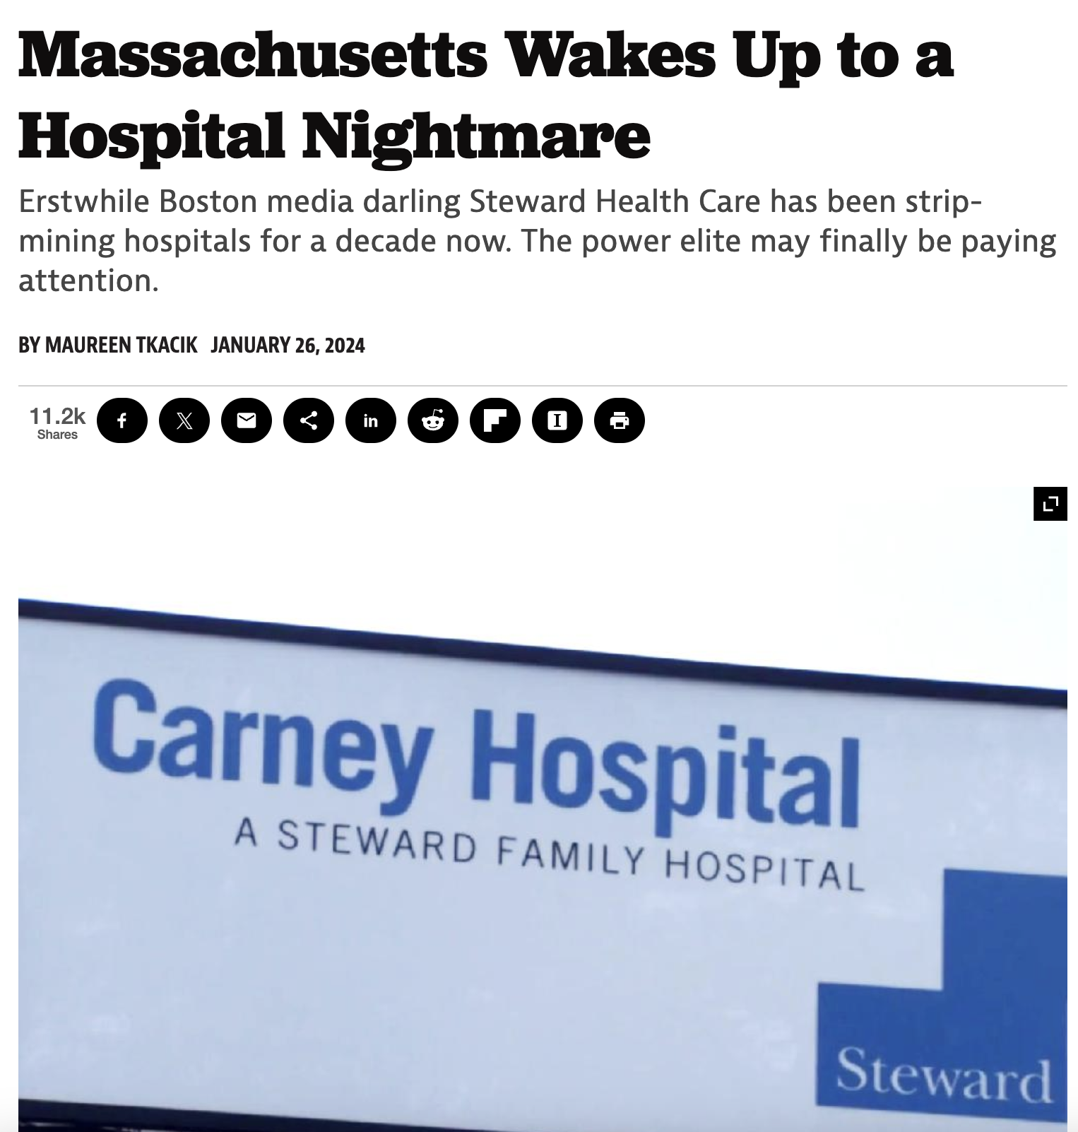
Steward Healthcare: How PE Loots Communities

Slide 36
Steward Healthcare: How PE Loots Communities
2010
Boston Archdiocese sells its hospitals to Cerebrus against opposition from community
Sells medical office buildings; closes a pediatric ward;
Sells off laboratory testing / cytology business; mostly closes Quincy Medical Center
2010-2016
Sells off its real estate to Medical Properties Trust (MPT) Real Estate Investment Trust (REIT), generating $1.2 billion payoff and $484 million in dividends to investors.
Hospitals saddled with unaffordable rent.
2016
Buys up distressed hospitals outside MA to 37-hospital system.
Closes 2 of these soon after.
2017
Note: Cerebrus is a for-profit private equity firm
Drawn from: PE Stakeholder Project. “The Pillaging of Steward Health Care.” Private Equity Stakeholder Project PESP, June 26, 2024. https://pestakeholder.org/reports/the-pillaging-of-steward-health-care/.

Slide 37
Steward Healthcare: How PE Loots Communities
More debt acquisition allows Cerebrus to sell off Steward to new physician owners, including CEO Ralph de la Torre.
Cerebrus made $800 million+ off the system.
New owners receive $111 million in dividends.
CEO Ralph de la Torre buys a $40 million yacht.
2020
Spiraling finances, deteriorating care, unpaid bills, equipment shortages, hospital closures, understaffing
2020-2024
Files for bankruptcy in Texas
$9 billion in liabilities mostly lease liabilities, $90 million in unpaid compensation
2024
Drawn from: PE Stakeholder Project. “The Pillaging of Steward Health Care.” Private Equity Stakeholder Project PESP, June 26, 2024. https://pestakeholder.org/reports/the-pillaging-of-steward-health-care/.

Slide 38
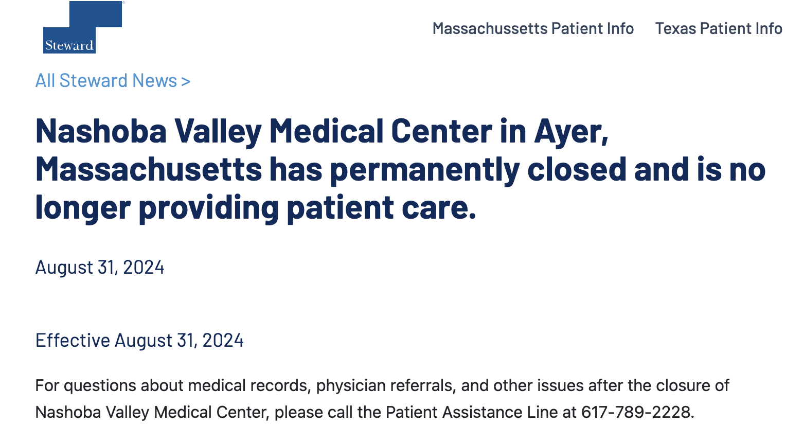
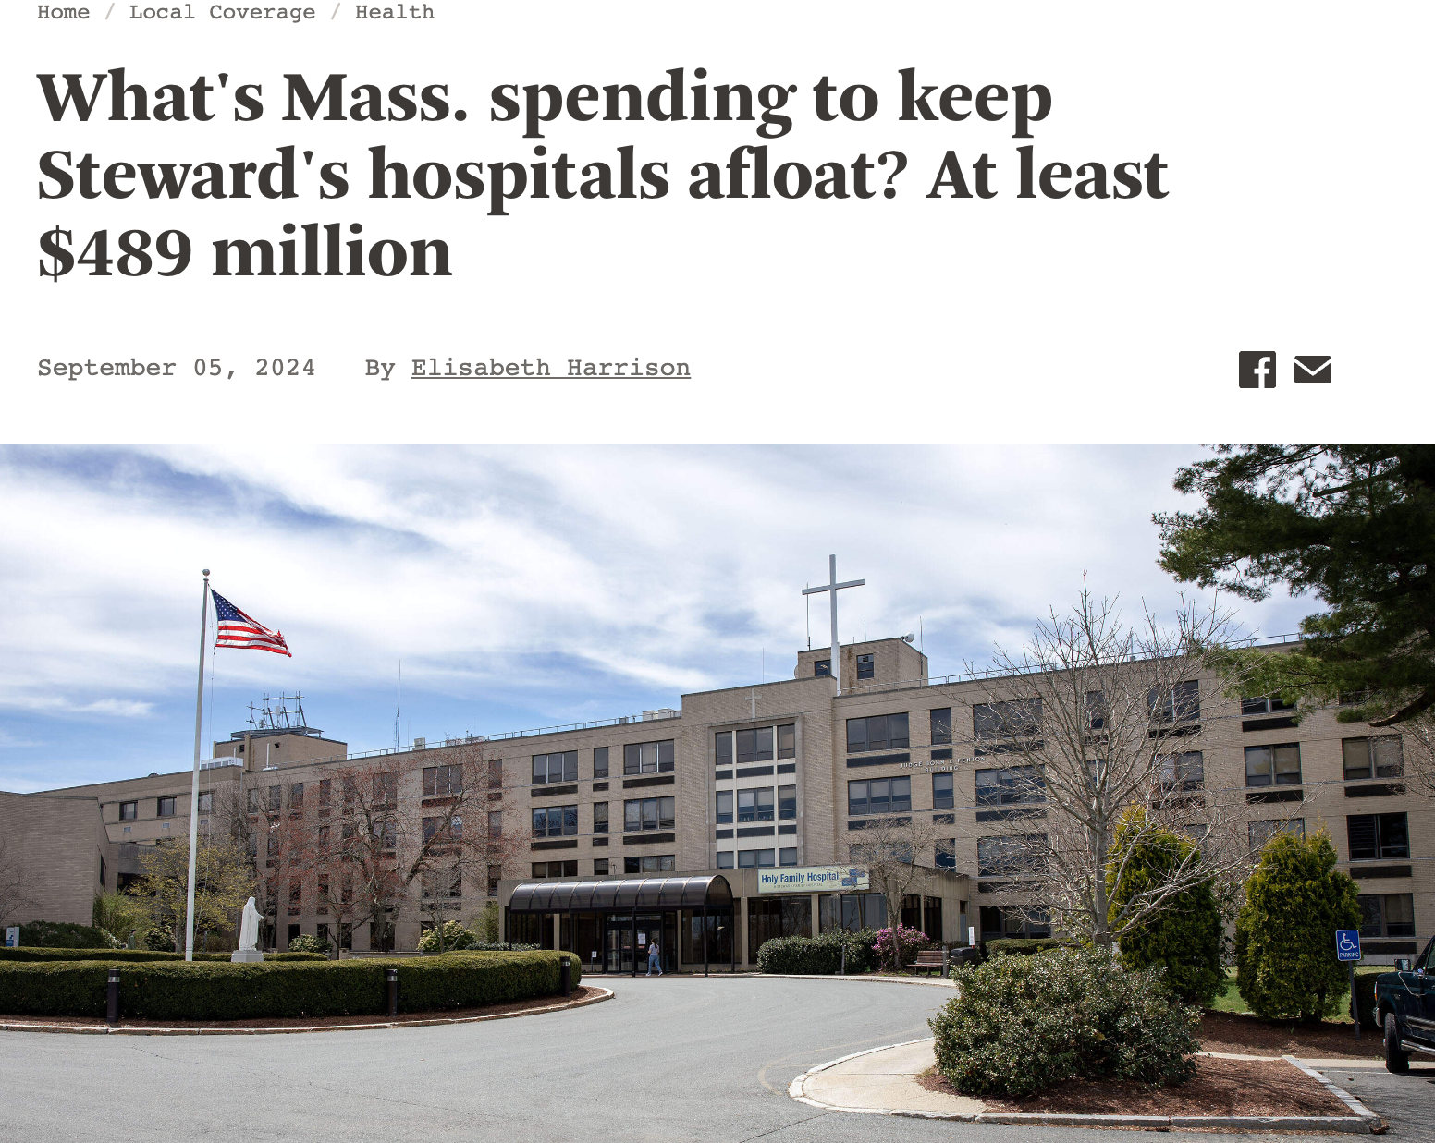
Steward Healthcare: How PE Loots Communities

Slide 39
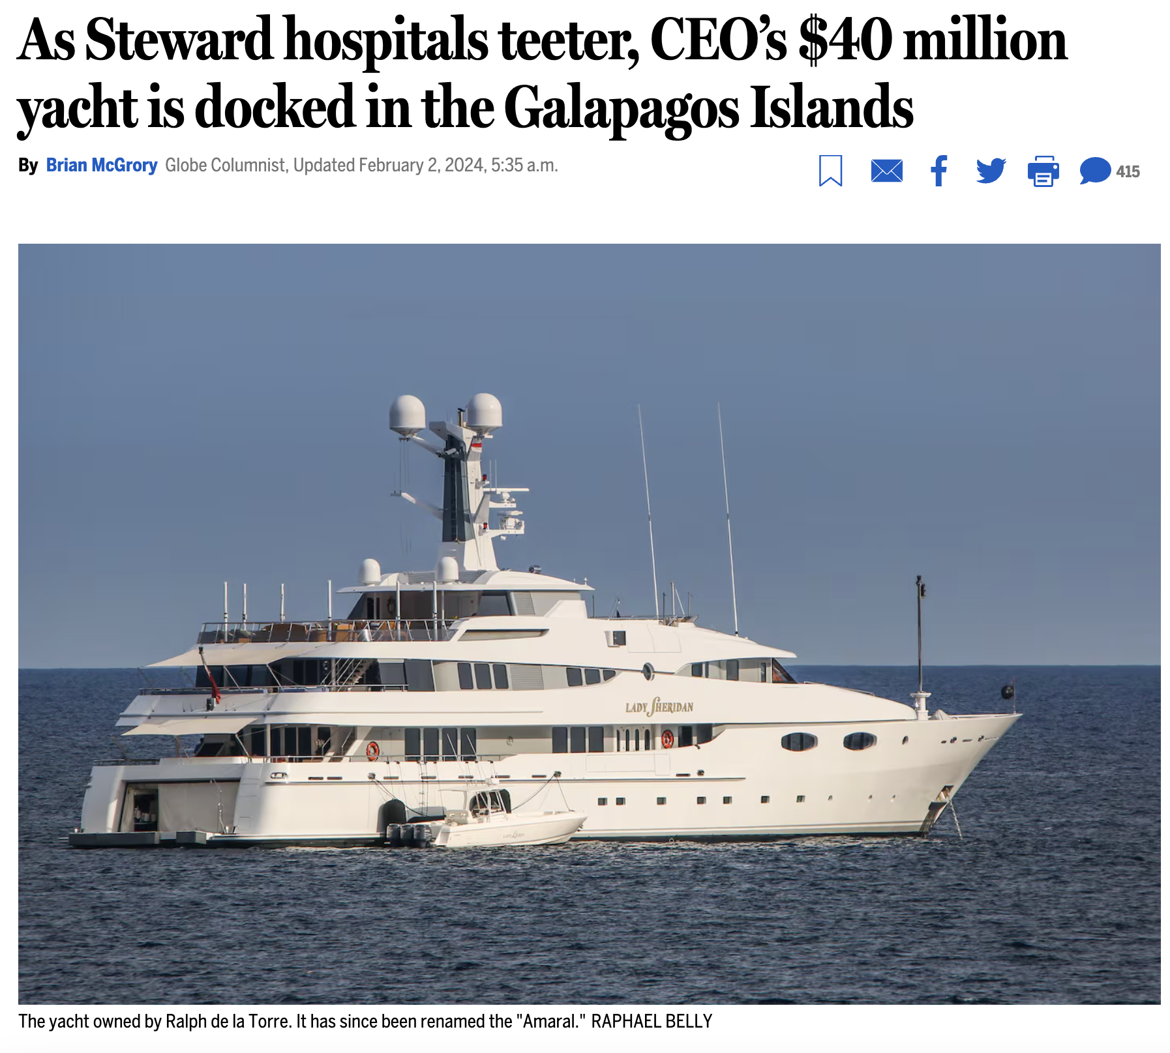
Steward Healthcare: How PE Loots Communities

Slide 40
In the two years following PE acquisition, Hospitals Lost 24% of their Capital
$150,000,000
$125,000,000
$100,000,000
$75,000,000
$50,000,000
$25,000,000
0
Mean capital assets
Matched controls
Lost capital
Private equity
-10 | -9 | -8 | -7 | -6 | -5 | -4 | -3 | -2 | -1 | 0 | 1 | 2 | 3 | 4 | 5
Year relative to PE acquisition
Schrier, Elizabeth, Hope E. M. Schwartz, David U. Himmelstein, Adam Gaffney, Danny McCormick, Samuel L. Dickman, and Steffie Woolhandler. “Hospital Assets Before and After Private Equity Acquisition.” JAMA, July 30, 2024. https://doi.org/10.1001/jama.2024.13555.

Slide 41
After Private Equity acquisition, Hospitals See Sharp Rise in Complication Rates
Percentage increase after PE acquisition
Kannan S, Bruch JD, Song Z. Changes in Hospital Adverse Events and Patient Outcomes Associated With Private Equity Acquisition. JAMA 2023;330(24):2365–75.

Slide 42
2020-2023: PE Has Been Rapidly Acquiring Cardiology
2013 – 2022: PE Acquired
41 Cardiology Practices
2013 – 2022: PE Acquired Cardiology Practices Across 342 Clinic Sites
50
40
30
20
10
0
250
200
150
100
50
0
342 sites =
2.9% of all
cardiology clinic sites
2013 | 2015 | 2017 | 2019 | 2021 | 2023
2013 | 2015 | 2017 | 2019 | 2021 | 2023
Bartlett VL, Liu M, Ati S, Yeh RW, Zheng Z, Wadhera R. Private Equity Acquisitions of Outpatient Cardiology Practices in the United States, 2013-2023. Journal of the American College of Cardiology [Internet] [cited 2024 Jul 2];0(0). Available from: https://www.jacc.org/doi/10.1016/j.jacc.2024.06.011

Slide 43
“PE firms acquire and grow physician practices through add-on consolidation, Generating Outsized Returns on the Sale of the Acquisition”
Frazier Healthcare Partners | 33%
ABRY Partners | 105%
HIG Capital | 130%
Revelstoke Capital Partners | 177%
Chicago Pacific Founders | 267%
Waud Capital Partners | 340%
Pantheon Ventures | 392%
Audax Private Equity | 910%
Shore Capital Partners | 3,000%
595% median increase
in practice sites before PE exit
3-8 years after acquisition
“Private Equity's abbreviated investment timeline and exit incentives may deter long-term investments in care delivery and workforce needed for high-quality care.”
Data from: Singh Y, Reddy M, Zhu JM. Life Cycle of Private Equity Investments in Physician Practices: An Overview of Private Equity Exits. Health Affairs Scholar 2024;qxae047.
https://www.shorecp.com/industry/healthcare Accessed Nov 25 2024

Slide 44
2,806 Behavioral Health Facilities Were acquired by PE 2010-2021
Deal Class
Private Equity
Other For-Profit
Total represents 7% of all behavioral health facilities
Figure reproduced from: Thornburg B, McGinty EB, Eddelbuettel J, Kennedy-Hendricks A, Braun RT, Eisenberg MD. Acquisitions of behavioral health treatment facilities from 2010 to 2021. Health Affairs Scholar 2024;2(7):qxae080.

Slide 45
124 Hospices Were taken over by 47 PE-firms (2015-2022)
Data source: Aldridge, Melissa D., Lauren J. Hunt, Zelle Halloran, and Krista L. Harrison. “Private Equity Acquisitions Of Hospices Are Increasing; Ownership Remains Opaque.” Health Affairs 43, no. 9 (September 2024): 1306–10.

Slide 46
Communities and the public
— not profiteers and corporations —
should be the owners of
our vital healthcare infrastructure.
- Adam Gaffney MD

Slide 47
Administrative Waste

Slide 48
Administrative Spending as a Share of NHE Total public + private administrative spending = $334 billion in 2022
Private
Public
Source: CMS’ Historical National Health Expenditures Accounts, 1960-2022. “Private” includes publicly-sponsored private plans, e.g., Managed Care Medicaid and Medicare

Slide 49
The VA Employs Relatively Few Administrators
Percentage of healthcare workforce in administrative occupations
Source: Woolhandler, Steffie, Andrew Toporek, Jian Gao, Eileen Moran, Andrew Wilper, and David U. Himmelstein. “Administration’s Share of Personnel in Veterans Health Administration and Private Sector Care.” JAMA Network Open 7, no. 1 (January 18, 2024): e2352104.

Slide 50
Single-payer reform
– and not other reforms –
would allow full re-purposing of
hundreds of billions of dollars
of administrative waste into care.

Slide 51
Pharmaceuticals

Slide 52
Medicare Drug Negotiation achieved Reduced Prices for 10 Negotiated Drugs
Calculated from Negotiated and List prices estimated/provided in: Rome, Benjamin N., Aaron S. Kesselheim, and William B. Feldman. “Medicare’s First Round of Drug-Price Negotiation — Measuring Success.” New England Journal of Medicine. 2024.

Slide 53
Semaglutide: Prices Are High in the US Orders of magnitude higher than the cost of production
Country’s lowest market prices per month (US$)
Sustainable cost-based price (estimated)
Cost, US$
Barber, Melissa J., Dzintars Gotham, Helen Bygrave, and Christa Cepuch. “Estimated Sustainable Cost-Based Prices for Diabetes Medicines.” JAMA Network Open 7, no. 3 (March 27, 2024): e243474. Cost is estimated monthly cost.

Slide 54
Publicly-financed
drug development
could allow drug provision
close to the cost of production.

Slide 55
Reproductive Healthcare

Slide 56
Distance To Closest Abortion Provider Before and after Dobbs, January 2009 – October 2024
100
75
50
25
0
Mean driving distance (miles)
2009 | 2011 | 2013 | 2015 | 2017 | 2019 | 2021 | 2023
24
Driving distance calculated by Caitlin Myers; data accessed from the Myers Abortion Facility Database.
Caitlin Myers, 2024. County-by-month travel distances to nearest abortion provider, Vintage (11,01,2024).
Retrieved from osf.io/pfxq3
Means calculated by Adam Gaffney with weights = 2010 census population

Slide 57
Post-Dobbs Change in Infant Mortality Overall and with Congenital Anomalies (through June 2023)
Source: Singh, Parvati, and Maria F. Gallo. “National Trends in Infant Mortality in the US After Dobbs.” JAMA Pediatrics, October 21, 2024.

Slide 58
Catastrophic Health Expenditures for Abortion Care and Related Expenses
Expenditures are considered “catastrophic” when they consume
at least 40% of monthly income
after food and housing.
They are associated with
anxiety and depression.
Three state survey. Related expenses = travel, for example
CHE defined as >= 40% of monthly income after food/housing. Wasser, Ortal, Lauren J. Ralph, Shelly Kaller, and M. Antonia Biggs. “Catastrophic Health Expenditures for In-State and Out-of-State Abortion Care.” JAMA Network Open 7, no. 11 (November 8, 2024): e2444146.

Slide 59
The Coming Era of Trump 2

Slide 60
Projected impact of policies that may be enacted During the Second Trump Administration
 | Number of people losing coverage | Additional deaths (annual)
Weakening of ACA Regulations | 1,569,000 | 3,244
Expiration of Enhanced Premium Tax Credits | 3,800,000 | 7,857
Repeal of ACA | 22,000,000 | 45,485
Sources for coverage losses: (a) Coverage losses among non-elderly adults during first Trump administration, from 2016-19, according to the American Community Survey (see: Gaffney A, Himmelstein D, Woolhandler S. How Much Has The Number of Uninsured Risen Since 2016 — And At What Cost To Health And Life? Health Affairs Blog. October 29, 2020. (b) Congressional Budget Office. Budgetary Outcomes Under Alternative Assumptions About Spending and Revenues. Published online May 2024. Accessed November 12, 2024. https://www.cbo.gov/system/files/2024-05/60114-Budgetary-Outcomes.pdf. (c) CBO’s projections of impacts of the Senate’s 2017 ACA repeal bill, Senate’s 2017 Better Care Reconciliation Act (BRCA). To estimate number of deaths projected to follow from each policy, we abstracted or derived the “number needed to insure” (NNI) to prevent one death annually from three quasi-experiment analyses that examined the effect of ACA or pre-ACA coverage expansions on mortality; we then divided coverage losses by the NNI from each study. Finally, to produce the death estimates provided above, we averaged these three death estimates. Sommers BD. State Medicaid Expansions and Mortality, Revisited: A Cost-Benefit Analysis. American Journal of Health Economics. 2017;3(3):392-421; Miller S, Johnson N, Wherry LR. Medicaid and Mortality: New Evidence From Linked Survey and Administrative Data*. The Quarterly Journal of Economics. 2021; Sommers BD, Long SK, Baicker K. Changes in mortality after massachusetts health care reform: A quasi-experimental study. Annals of internal medicine. 2014;160(9):585-593.

Slide 61
More than 100 environmental rules rolled back During Trump’s First Administration
Popovich N, Albeck-Ripka L, Pierre-Louis K. The Trump Administration Rolled Back More Than 100 Environmental Rules. Here’s the Full List. [Internet]. The New York Times. 2021. From: https://www.nytimes.com/interactive/2020/climate/trump-environment-rollbacks-list.html,

Slide 62
The need to fight back against the degradation of healthcare, and the broader threats to health, is urgent.
But defense – alone – is a losing battle.

