Slide 1
Making Legislative Action Real
Ed Weisbart MD
Daniel Doyle MD
Stephan Ramdohr

Slide 2
Single Payer
“Don’t sign the pro-MA letter”
“Do sign onto the MA accountability letters”
If we can only get one thing: MOOP.
Limit out-of-pocket expenses for people in TM
PNHP’s “Triple Aim”
End Profiteering
Improve Traditional Medicare

Slide 3
2025: A Cascade of Advocacy Targets
1st Quarter
2nd Quarter
3rd Quarter
4th Quarter
Meet with the newly elected
Jan: Congressional letters demanding MA accountability
By Feb 6: CMS draft of MA rates
Q1: AHIP letters from Congress in support of MA
Q1: End-of-year MA earnings report
By Apr 7: CMS finalizes rates
Q2: new MFA bills filed
June 30: completion of 3,000 surveys on Moral Injury
Ongoing target: Build more relationships with legislators
July: Mid-year MA earnings report
August: Equity Report finished
“Level the Playing Field” bill filed (date TBD)
Ongoing target: PNHP base building
September: Equity Report published
Oct. 15 – Dec 7: MA Open Enrollment
November: Moral Injury Report published
PNHP annual meeting (APHA will be in DC)

Slide 4
As the landscape shifts, Our Goals Can Be More Aggressive
2022
Progressives were signing the pro-MA AHIP letter as a matter of routine
Even signed by many who had endorsed MFA
2023
House asked for minor changes in AHIP letter, got turned down, no letter!
New emergence of dueling letters (pro-MA vs critical of MA)
2024
Congressional leaders began whipping against AHIP letter
October 29 bicameral leadership letter creates a new tool for us in 2025
https://www.finance.senate.gov/imo/media/doc/102924_wyden_neal_pallone_letter_to_cms_about_ma.pdf
https://prospect.org/health/2023-04-11-insurance-lobbyists-medicare-advantage/

Slide 5
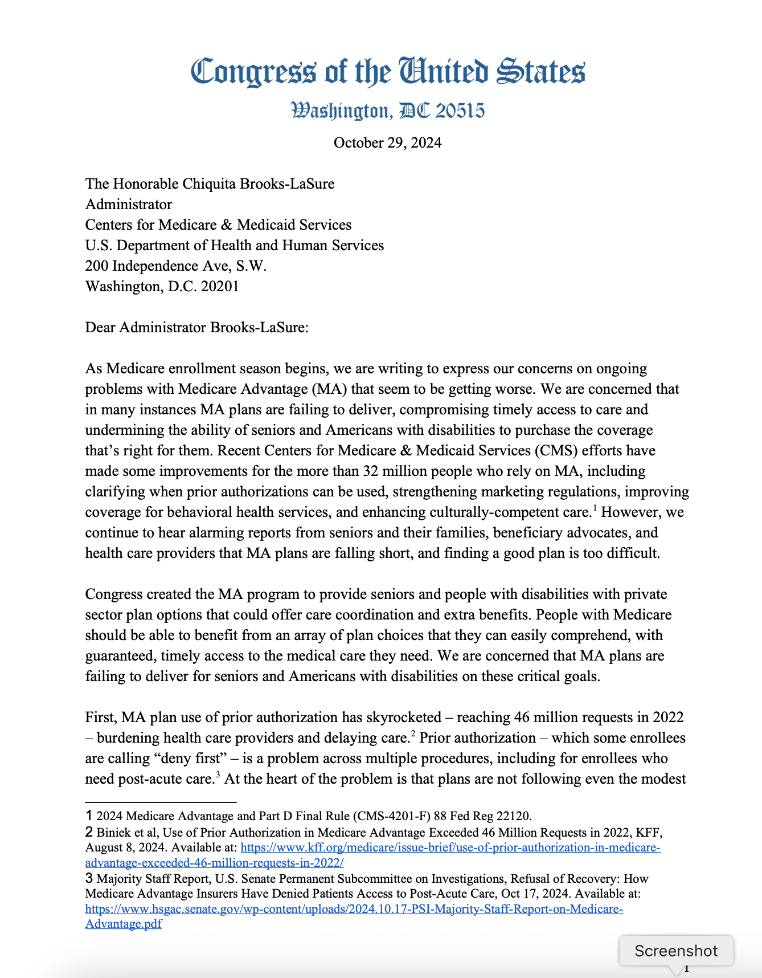
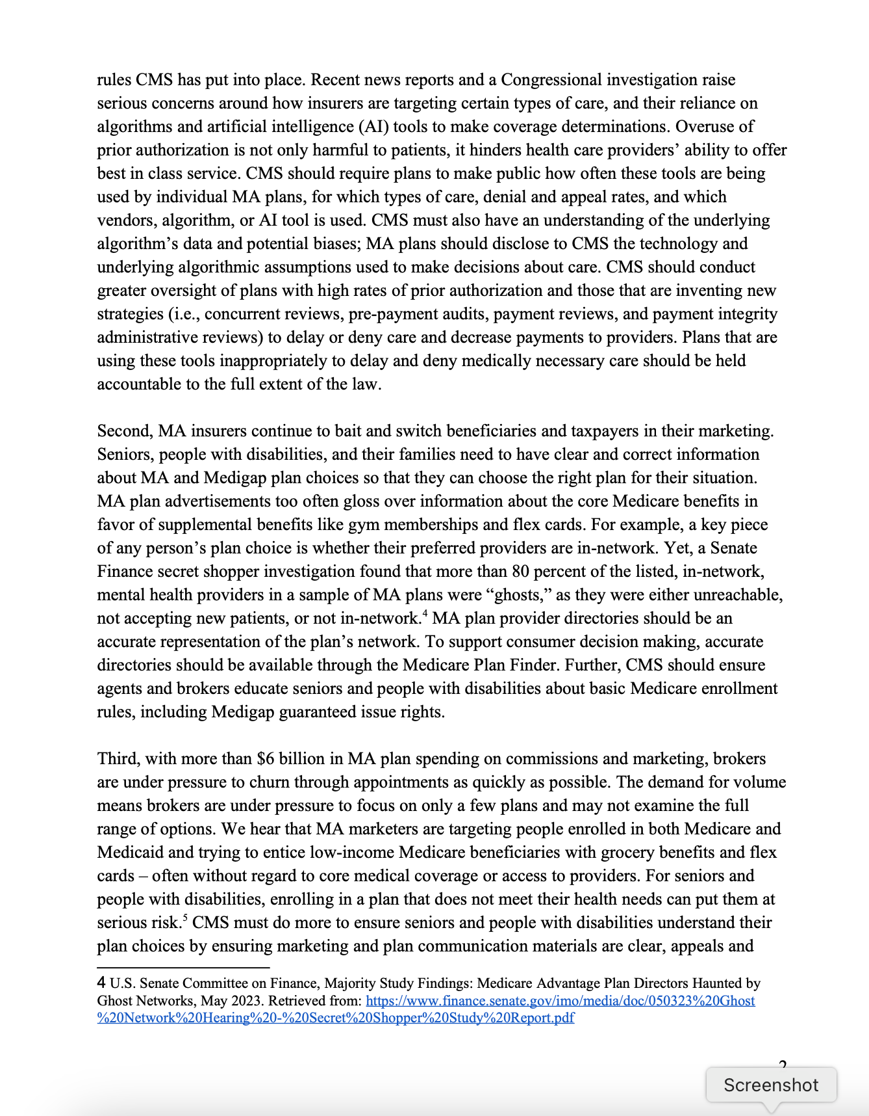
Oct. 29, 2024: Bicameral Congressional leadership released a Powerful New Letter / 2025 Advocacy Tool
“MA plans are failing to deliver, compromising timely access to care....
“MA plans are falling short….
“MA plans are failing to deliver….
“Not even following the modest rules CMS has put in place.”
Even without calling for an end to MA, demanding accountability
is key to upending the MA business model
https://www.finance.senate.gov/imo/media/doc/102924_wyden_neal_pallone_letter_to_cms_about_ma.pdf
https://prospect.org/health/2023-04-11-insurance-lobbyists-medicare-advantage/

Slide 6
Advocacy works: Congressional letters influence CMS’ strength at setting MA rates Let’s Amplify Our Work in 2025
2025 Goal
Repeat 2023 and no letter
2025 Goal:
Basic: <30
Stretch: 0
2025 Goal:
100 (threshold for media)
2025 Goal:
Bipartisan signatures
https://www.ahip.org/news/press-releases/more-than-60-senators-are-clear-medicare-advantage-should-be-protected
https://www.ahip.org/news/press-releases/over-340-house-members-stand-together-to-strengthen-and-improve-medicare-advantage
https://www.ahip.org/resources/bipartisan-ma-letters-signed-by-302-house-members-and-66-senators
2023-2024 data gathered by Be A Hero. Goals are preliminary.

Slide 7
Success in 2025 will look different than it did in 2024 but Our Work Is Even More Important Now
2024
PNHP members led 29 legislative visits about MA payment rates
PNHP members joined our allies in another 15.
2025
How do we increase our power with the 44 MOCs we visited in 2024?
How many more MOCs can we commit to visiting in 2025?
Whom will you invite to your next meetings?
Think about what tools and skills you need to develop.
Take the skills-building workshop that will most help you.
Disperse your group into as many skill-building workshops as you can.

Slide 9
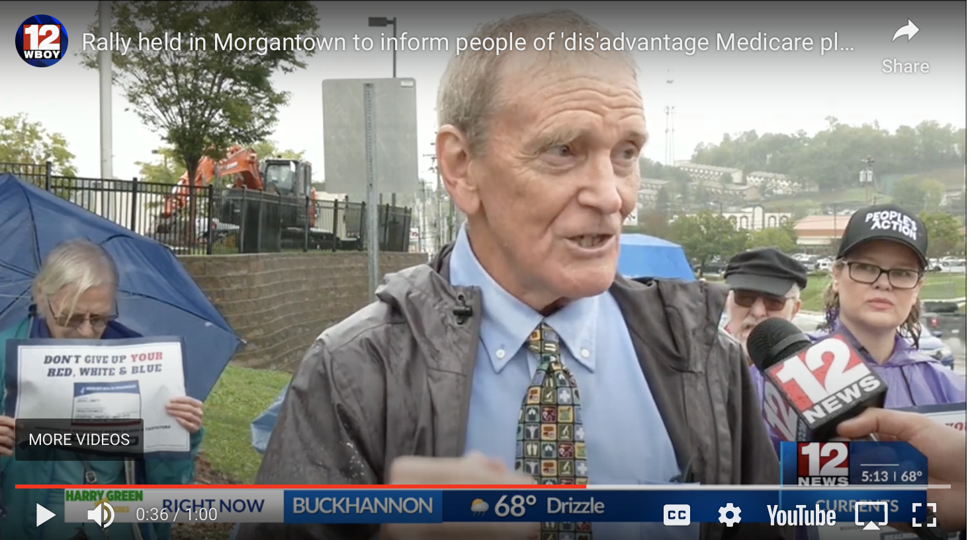
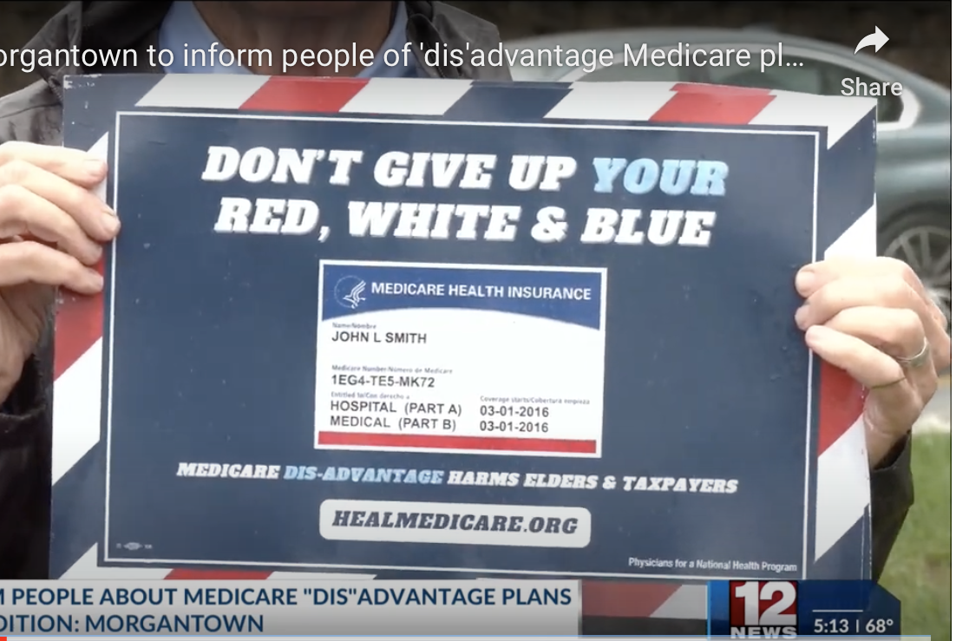
PNHP West Virginia Has Been In the News!
https://youtu.be/MXiW1AcYyg4

Slide 10
Why – and How – to Meet Legislators
Why?
Build Our Power
How?
Several Tasks
Show legislators that you’re present in their district
Show them you have allies in their district.
Show them our power is growing.
Identify the legislators with whom you can commit to meeting.
Determine whom will you bring to those meetings.
Determine what other organizations you will bring to the meetings.

Slide 11
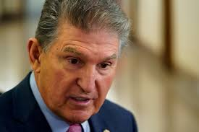
West Virginia used this model in PNHP’s 2024 MA Letter Campaign

Slide 12
Despite us, Sen. Manchin signed onto the pro-MA letter But This Was Still of Great Value
We are building skills
Finding our way through the maze to securing meetings
Planning and organizing meetings
Communicating with elected officials
Action builds chapters
Energizes existing members
Attracts new members
Builds new community partnerships for future work

Slide 14
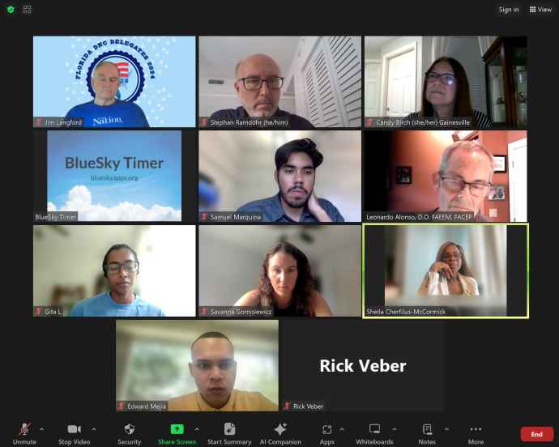
Case Study: Florida
Rep. Sheila Cherfilus-McCormick

Slide 15
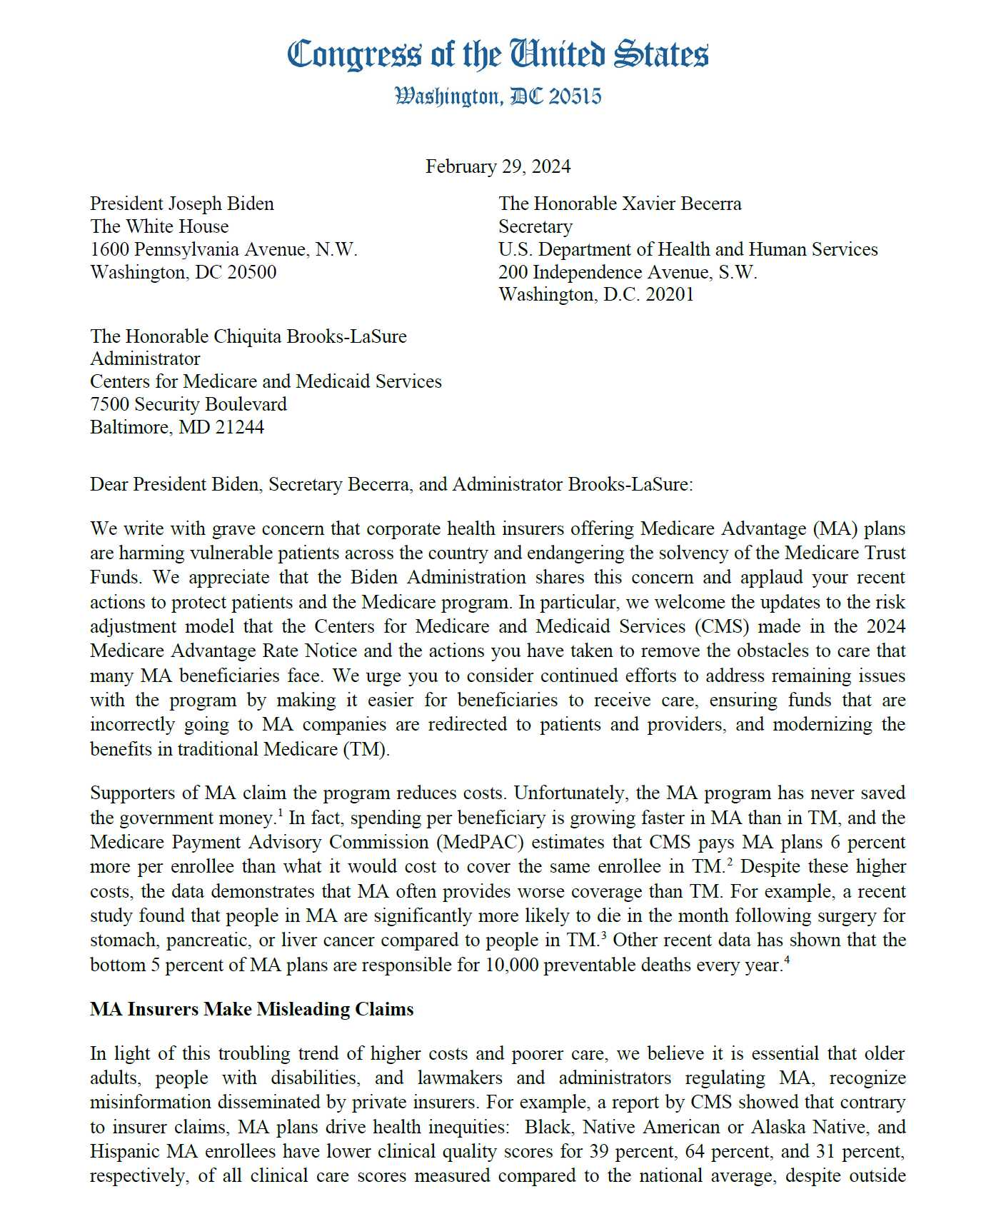
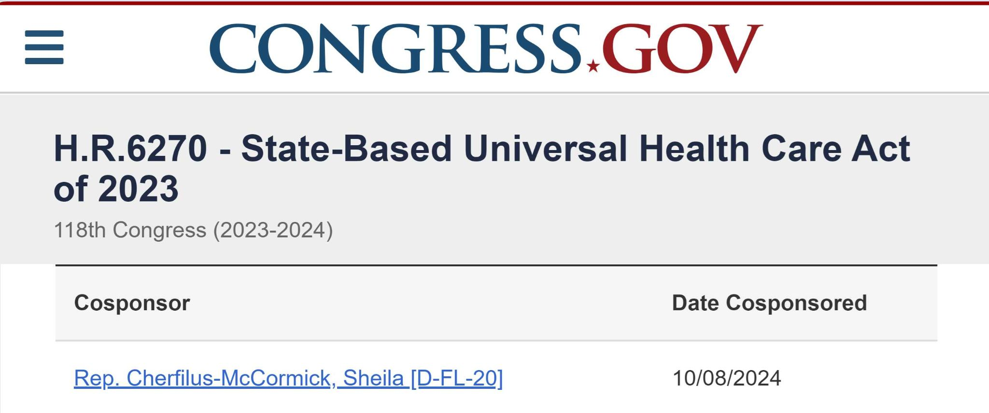

Slide 17
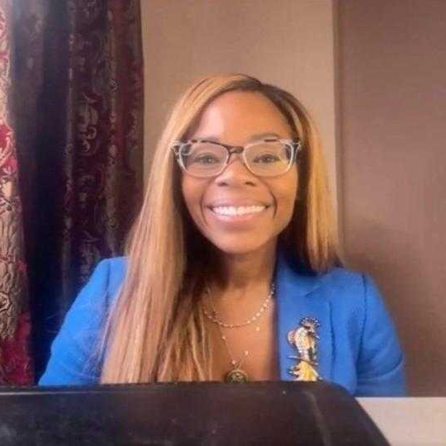
I urge you to join me in my fight to make sure that we can actually get Medicare for All passed and implemented.”
- Rep. Cherfilus-McCormick

Slide 18
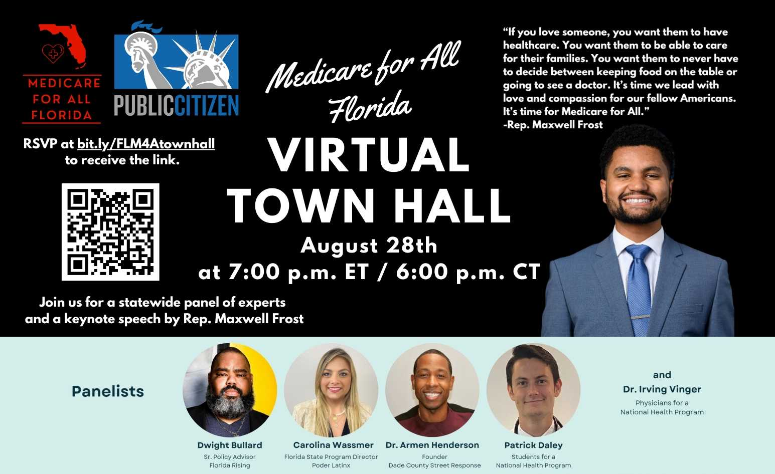

Slide 19
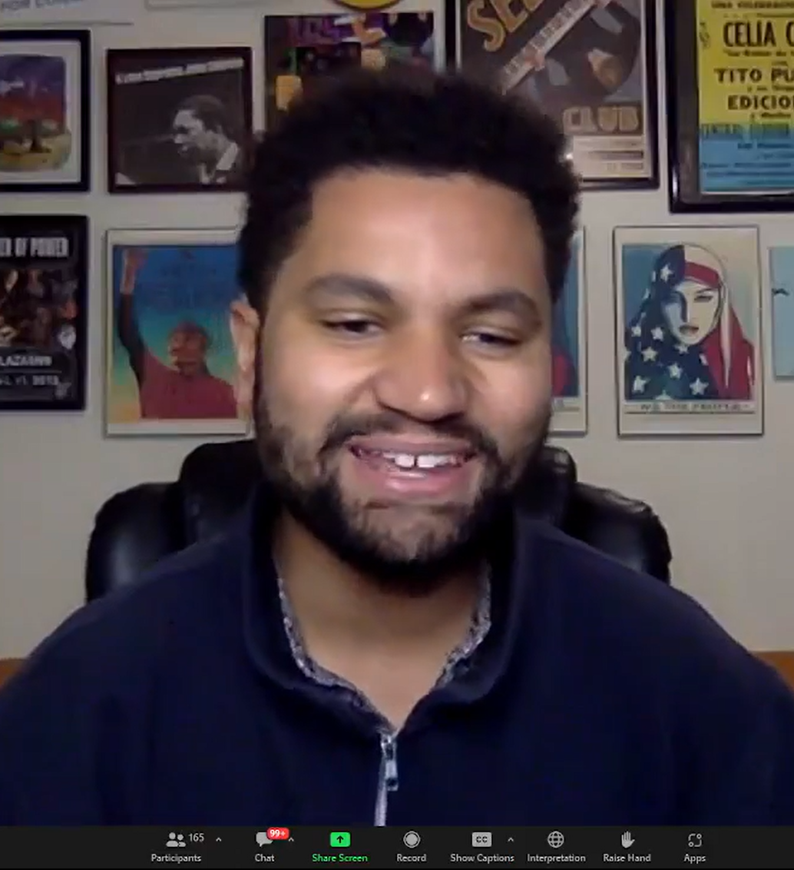
"We have to get rid of one of the greatest scams that exists in the government: Medicare Advantage.
They are trying to privatize Medicare.
“And don't let the word 'Medicare' in Medicare Advantage fool you: it is not Medicare.
“It's incredibly lucrative for HMOs that are scamming the government and then giving poor service, spending way less than what we gave them....
“As we fight for Medicare for All, we also
have to get rid of Medicare Advantage.”
US Rep. Maxwell Frost
(D-FL)

Slide 20
Dozens of organizations cosponsored Florida’s
Medicare for All Virtual Town Hall June 20, 2024

Slide 22
North Central IL, IN, IA, KS, MI, MN, MO, NE, ND, OH, PA (West), SD, WI | Northeast CT, DE, ME, MD, MA, NH, NJ, NY, PA (East), RI, VT
West AK, AS, AZ, CA, CO, GU, HI, ID, MT, NV, NM, MP, OR, UT, WA, WY | South AL, AR, DC, Fl, GA, KY, LA, MS, NC, OK, PR, SC, TN, TX, VI, VA, WV

Slide 23
3 Key Questions to Report Back
1. With which legislator(s) are you committing to meeting?
2. Which new people will you invite to attend that meeting?
(Can be either PNHP members or coalition representatives.)
3. What is a barrier you need to overcome to get them to attend? Is there a knowledge or skill gap?

Slide 24
North Central IL, IN, IA, KS, MI, MN, MO, NE, ND, OH, PA (West), SD, WI | Northeast CT, DE, ME, MD, MA, NH, NJ, NY, PA (East), RI, VT
West AK, AS, AZ, CA, CO, GU, HI, ID, MT, NV, NM, MP, OR, UT, WA, WY | South AL, AR, DC, Fl, GA, KY, LA, MS, NC, OK, PR, SC, TN, TX, VI, VA, WV

Slide 25
add a clock?

Slide 26
3 Key Questions to Report Back
1. With which legislator(s) are you committing to meeting?
2. Which new people will you invite to attend that meeting?
(Can be either PNHP members or coalition representatives.)
3. What is a barrier you need to overcome to get them to attend? Is there a knowledge or skill gap?

Slide 27
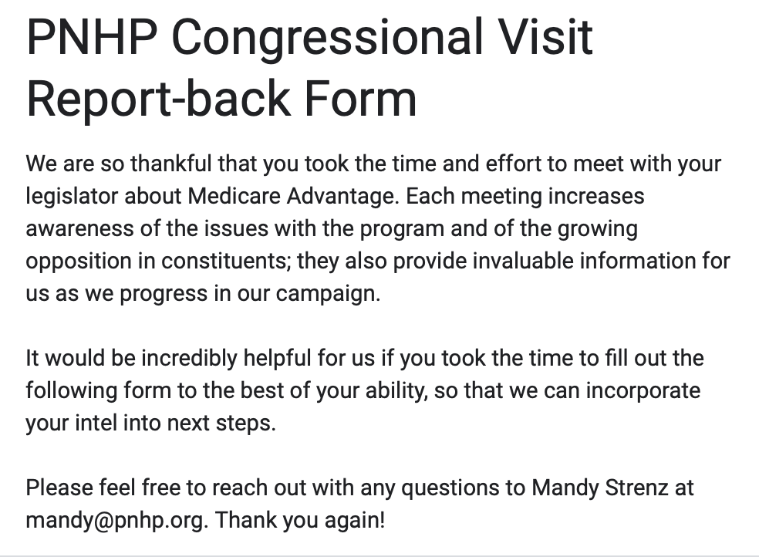
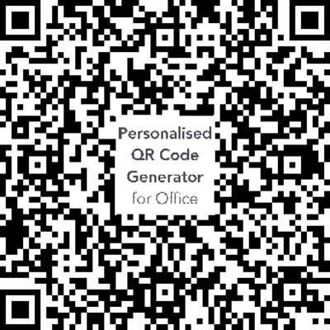
Help Us Track Our Progress
PNHP
Report Backs

