Slide 1
Talking About Moral Injury & Physician Autonomy & Advocating for Single Payer
Diljeet K Singh, MD, DrPH
Integrative Gynecologic Oncology

Slide 2
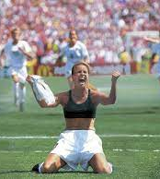
Goals
For TODAY
  Demonstrate connections between physicians' professional struggles, financialization of healthcare & Single Payer as Solution
  Provide language/definitions, data, references
    Well-being, Burnout, Moral Distress, Moral Injury
    Corporatization, Privatization, Financialization
  Provide structure for giving talks/grand rounds on Financialization/Moral Injury/Reclaiming our Profession etc…
For TOMORROW & Beyond
  Building Power by Building Membership
  Achieving Universal Healthcare Free of Profit-Driven Conflicts of Interest
Notes:
accept

Slide 3

Thoughts from RWJF-PNHP focus groups
Profession has been – taken over, ruined decimated
We are all complicit in a racist system – that’s the dirty part
Feel exhausted, helpless, useless. Unsustainable for me
Always pressured to churn
Have to do more with less – less time, less support staff, more patients
if patient wants to talk about anything outside of preventive care, they get unexpectedly billed...I hide clinical info that isn’t preventive care so patient doesn’t get billed
Employees of a corporate beast
System exploits fact that we care; an abusive relationship
Institutions cut resources & staff & then milk docs for more labor
Corporate incentives are destroying the practice of medicine
Profit incentives are so strong that it’s literally burning out an entire generation of physicians
System says we are lacking…when really we are chronically over-functioning

Slide 4
Connections – Moral Injury, Financialization & Single Payer
Understanding consequences of societal & medical profession's acceptance of healthcare as a for-profit business
Hypothesize that significant proportion of physician moral distress & injury is 2^{ary} to
  Trying to take care of patients with inadequate/no coverage for their healthcare needs
  Struggling to get prior authorization, deal with insurance care denials etc
  Limitations placed on the time we have to spend with our patients
  System demands of documentation needed for billing & upcoding
  Inability to provide best care – best drug, best procedure, best diagnostic study because insurance companies are trying not to pay etc
  Conflicts of interest – “A conflict of interest (COI) is a situation in which a person or organization is involved in multiple interests, financial or otherwise, & serving one interest could involve working against another”
THE SOLUTION = Single Payer/M4A - UNIVERSAL HEALTHCARE FREE OF PROFIT-MOTIVES
https://en.wikipedia.org/wiki/Conflict_of_interest

Slide 5
Background – Defining Corporatization, Privatization & Financialization
“Corporatization” — increasing role of large organizations that leverage market power to maximize profits
Health care corporatization is consequence of both horizontal integration (e.g., hospital chains acquiring smaller hospitals) & vertical integration (e.g., health systems buying physician practices) among both for-profit & nonprofit entities
“Privatization,” refers to ownership status of firms & describes growing role of private-sector actors in provision of healthcare resources, such as rising prominence of private insurance companies in the Medicare program under Medicare Advantage
The Financialization of Health in the United States Joseph Dov Bruch, Ph.D., Victor Roy, M.D., Ph.D., & Colleen M. Grogan, Ph.D New England Journal of Medicine Volume 390 • Number 2 • January 11, 2024 Pages: 178-182. https://www.nejm.org/doi/pdf/10.1056/NEJMms2308188

Slide 6

Definition of Financialization – Healthcare as Commodity NOT Social Good
Consequence of acceptance of healthcare as a for-profit business
“Financialization” builds on, but also departs from corporatization & privatization”
“Involves transformation of public, private, & corporate healthcare entities into salable & tradable assets from which financial sector may accumulate capital”
“Financialization captures new forms of financial-sector ownership & control in US healthcare system, as well as demands of financial markets for short-term profit growth & the distribution of this growth to financial actors that are external to healthcare entities & US households “
“Healthcare entities operate under “shareholder primacy,” a corporate governance strategy that prioritizes the interest of shareholders over other stakeholders”
The Financialization of Health in the United States Joseph Dov Bruch, Ph.D., Victor Roy, M.D., Ph.D., & Colleen M. Grogan, Ph.D New England Journal of Medicine Volume 390 • Number 2 • January 11, 2024 Pages: 178-182. https://www.nejm.org/doi/pdf/10.1056/NEJMms2308188

Slide 7

Harms of Financialization
RESOURCE: TAKING ADVANTAGE: HOW CORPORATE HEALTH INSURERS HARM AMERICAS SENIORS
“Best evidence available demonstrates that current private-capital investors in health services are increasing costs to patients & payers without consistently delivering improved care”
“Financialization in hospital industry has been linked to problematic operational strategies such as aggressive mergers & acquisitions, anticompetitive behavior, & fraudulent billing”
“Evidence from financialization of US pharmaceutical sector has also demonstrated shift in operational strategies, away from population health needs or even the long-term sustainability of companies & toward short-term creation of shareholder or investor value”
HEALTH AFFAIRS FOREFRONT. Impact Of Private Capital & Financialization On Health Equity: A Response To Enekwechi. Jessica L. Andersen January 3, 2024. https://www.healthaffairs.org/content/forefront/impact-private-capital-and-financialization-health-equity-response-enekwechi
https://pnhp.org/taking-advantage/#executive-summary

Slide 8
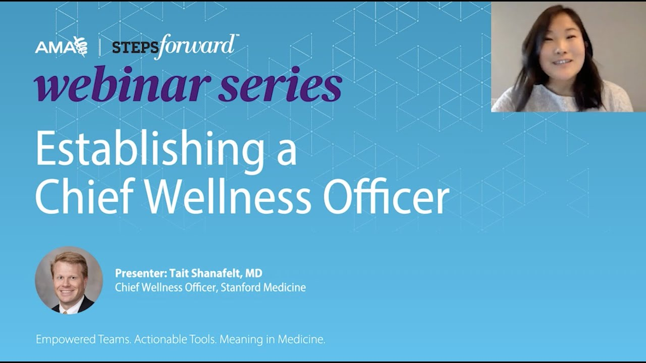
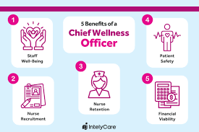
Consequences of Corporatization/Financialization for Physicians
“Physician Well-Being”
  Recognizing Burnout
  More recently - moral distress & injury
  Believe problem is based in individuals, teams &/or hospitals
Proposed Solutions – Take classic corporate approaches
  Focused on fixing individual or, at most, local system
  Proliferation of “wellness” programs
  What we really need is a Chief Wellness officer???

Slide 9
“Diminished Well-Being” among Physicians
“Characterized through several constructs, including acute & chronic stress, trauma, moral distress, moral injury, 2nd victim syndrome, burnout, & depression”¹
“Associated with poor outcomes for physicians & patients they treat”¹
”Excessive workload, administrative burdens, & profit motives of insurance & pharmaceutical companies & health care systems are intractable barriers to improving patients’ lives in ways the physicians had envisioned.^{”2}
“Physicians shoulder heavy responsibility but increasingly are limited by low autonomy & low decisional authority” ²
1 Burnout, Depression, & Diminished Well-Being among Physicians. Constance Guille, M.D., & Srijan Sen, M.D., Ph.D. October 23, 2024. N Engl J Med 2024;391:1519-1527 DOI: 10.1056/NEJMra2302878
2 Simon T, Wendy D. Physicians aren’t ‘burning out.’ They’re suffering moral injury. Boston Globe, August 5, 2018 (https://www.bostonglobe.com/ideas/2018/08/04/physicians-aren-burning-out-they-suffering-moral injury/xGsJTQBHBzHdM2CvrWLa0M/story.html).

Slide 10
“Diminished Well-Being” among Physicians – Depression & Suicide
“Physicians’ distress affects healthcare system through diminished quality of care, medical errors, high physician turnover, & attrition from medical field.”¹⁻⁴
“Poor well-being among physicians results in enormous burden on individual physicians, through career & family consequences, poor health, & , most tragically, suicide.” ¹⁻⁴
Physician Depression & Suicide in US
  300 - 400 physicians die by suicide every year
  Suicide rate among male physicians is 1.41 times higher than general male population.
  Suicide rate among female physicians is 2.27 times greater than general female population
  Medical students have rates of depression 15-30% higher than general population
  Women physicians have a higher rate of major depression than age-matched women with doctorate degrees
1 Burnout, Depression, & Diminished Well-Being among Physicians. Constance Guille, M.D., & Srijan Sen, M.D., Ph.D. October 23, 2024. N Engl J Med 2024;391:1519-1527 DOI: 10.1056/NEJMra2302878
2 Hamidi MS, Bohman B, Sandborg C, et al. Estimating institutional physician turnover attributable to self-reported burnout & associated financial burden: a case study. BMC Health Serv Res 2018;18:851-851.
3 Shanafelt T, Goh J, Sinsky C. The business case for investing in physician well-being. JAMA Intern Med 2017;177:1826-1832.
4 Han S, Shanafelt TD, Sinsky CA, et al. Estimating the attributable cost of physician burnout in the United States. Ann Intern Med 2019;170:784-790.
5 https://www.acep.org/life-as-a-physician/wellness/wellness/wellness-week-articles/physician suicide#:~:text=Each%20year%20in%20the%20U.S.,times%20more%20often%20than%20females.
Notes:
Suicide deaths are 250 - 400% higher among female physicians when compared to females in other professions

Slide 11
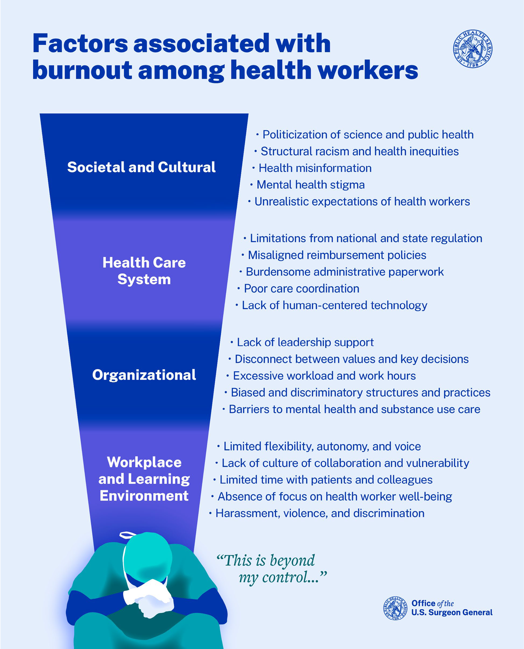
Burnout
Long-term stress reaction marked by emotional exhaustion, depersonalization, & lack of sense of personal accomplishment
Most often measured using Maslach burnout inventory though no clear consensus on scoring & weighting of 3 aspects
80% of physicians experience some aspect of burnout: 86% emotional exhaustion, 90% depersonalization, 87% low personal accomplishment
Based on different definitions range is 0-80.5%
Is this worth arguing about?
Martha Hostetter & Sarah Klein, Responding to Burnout & Moral Injury Among Clinicians (Commonwealth Fund, Aug. 2023). https://doi.org/10.26099/k72x-t469
graphic was published in Addressing Health Worker Burnout: The U.S. Surgeon General’s Advisory on Building a Thriving Health Workforce
https://www.hhs.gov/sites/default/files/health-worker-wellbeing-advisory.pdf (2022)
Burnout, Depression, & Diminished Well-Being among Physicians Constance Guille, M.D., & Srijan Sen, M.D., Ph.D. October 23, 2024, N Engl J Med 2024;391:1519-1527 DOI: 10.1056/NEJMra2302878

Slide 12
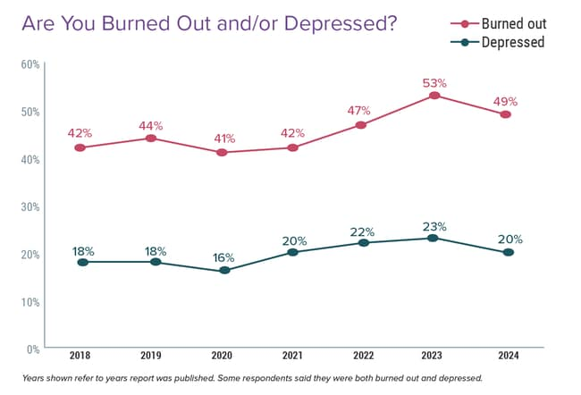
Medscape Physician Burnout & Depression Report 2024: 'We Have Much Work to Do' Jon McKenna | January 26, 2024. https://www.medscape.com/slideshow/2024-lifestyle-burnout-6016865?icd=login_success_email_match_norm#1

Slide 13
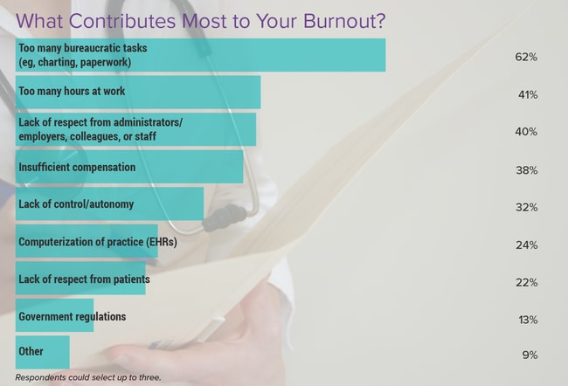
Medscape Physician Burnout & Depression Report 2024: 'We Have Much Work to Do' Jon McKenna | January 26, 2024. https://www.medscape.com/slideshow/2024-lifestyle-burnout-6016865?icd=login_success_email_match_norm#1

Slide 14
Doctors Spend Twice as Much Time on
Electronic Billing Record as With Patients
Source: Sinsky et al. Ann Int Med 9/6/2016 – based on time/motion observation + home diary
Note: Figures are percent of office hours – exclude the 1-2 hrs/night of home EHR/desk work

Slide 15
EPIC EHR Notes Count
Number of Institutions
USA
Canada, UK, Australia,
Netherlands, Singapore,
United Arab Emirates
Average Number of Characters per Ambulatory Note in Epic
Source: Ann Intern Med 2018; 169:51
13 international organizations represent 140,000 notes
254 organizations within the United States represent 10 million notes.
Notes:
Not prolific, fulfilling needs of electronic billing records

Slide 16
Concept of Moral Injury
Term moral injury was born in PTSD/Military context
In 1990s, Jonathan Shay, psychiatrist observed that PTSD did not accurately describe what some Vietnam vets suffered with & described instead a wound they carried termed moral injury
He described 3 requirements for moral injury:
  There has been a betrayal of what is morally right
  By someone who holds legitimate authority
  In high-stakes situation
Characterized by feelings of powerlessness leading to helplessness & hopelessness & feelings of guilt or shame
Čartolovni A, Stolt M, Scott PA, Suhonen R. Moral injury in healthcare professionals: A scoping review & discussion. Nurs Ethics. 2021 Aug;28(5):590-602. doi: 10.1177/0969733020966776. Epub 2021 Jan 11. doi: 10.1177/0969733020966776

Slide 17

Moral injury can occur when someone engages in, fails to prevent, or witnesses acts that conflict with their values or beliefs
-National Center for PTSD
Examples of events that may lead to moral injury include:
Having to make decisions that affect survival of others or where all options will lead to negative outcome
Doing something that goes against your beliefs (referred to as act of commission)
Failing to do something in line with your beliefs (referred to as act of omission)
Witnessing or learning about such an act
Experiencing betrayal by trusted others
https://www.ptsd.va.gov/professional/treat/cooccurring/moral_injury_hcw.asp

Slide 18
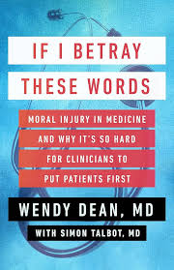
Moral Injury defined in HealthCare - Wendy Dean
“Moral injury is this sense that clinicians … know what their patients need, & they cannot get it for them because of constraints outside of their control & what that does is it causes us to wonder whether we can be the doctors that we thought we could be.”
“We made a promise to society that we would heal & that we would put our patients before all else & yet as soon as we go out into practice, we realize that there are so many barriers in the way between what we know we should do & what we're able to do.”

Slide 19
Continuum from moral distress to moral injury
While burnout was being explored in medical literature, moral distress was being studied in nursing literature defined at patient, unit & hospital system levels
Moral Distress
  When someone knows right thing to do, but feels powerless to take that action due to institutional constraint
  Repeated events can lead to moral injury
Moral Injury
  Profound sense that you’ve betrayed your own ethical code (or were unable to follow it because of external factors) or that people you trusted have betrayed some fundamental obligation
  Linked to feelings of guilt, shame, & anger
  Can lead to depression, post-traumatic stress disorder, & suicidality
Potentially Morally Injurious Events
Martha Hostetter & Sarah Klein, Responding to Burnout & Moral Injury Among Clinicians (Commonwealth Fund, Aug. 2023). https://doi.org/10.26099/k72x-t469
Cynda Hylton Rushton; Transforming Moral Suffering by Cultivating Moral Resilience and Ethical Practice. Am J Crit Care 1 July 2023; 32 (4): 238–248. doi: https://doi.org/10.4037/ajcc2023207

Slide 20
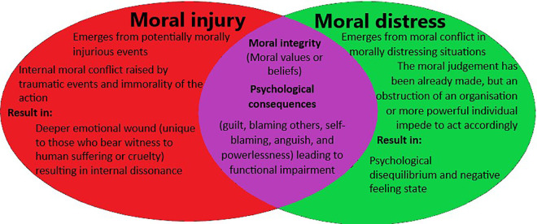
Moral Distress to Injury – A Continuum
Čartolovni A, Stolt M, Scott PA, Suhonen R. Moral injury in healthcare professionals: A scoping review & discussion. Nurs Ethics. 2021 Aug;28(5):590-602. doi: 10.1177/0969733020966776. Epub 2021 Jan 11. doi: 10.1177/0969733020966776

Slide 21
Fallacy of Physician Autonomy
GOOGLE AI says
“Physician autonomy refers to ability of doctors to make decisions about patient care without being limited by organizational, financial, or managerial concerns.
It's a key part of medical ethics & a well-functioning healthcare system.
Physician autonomy includes:
Clinical work freedom
Patient selection
Professional judgment
Self-regulation
Advocacy
Physician autonomy is a basic principle of medical ethics, & it's recognized by the American Medical Association”
Clearly, Google AI doesn’t go to medical staff meetings.
Model of physicians as “their own boss”
Guided by
  Our oath to patients
  Science
  Medical guidelines
Eroded by
  Insurers that dictate care
    Limit access to testing, medications, treatments
    Framed as efficiency/cost saving
    Shown to be profit maximization
  Hospital systems
    Limit time with patients
    Micromanage coding/billing
    Maximize profit & “patient satisfaction”
https://www.merriam-webster.com/dictionary/autonomy
Notes:
Physician autonomy refers to ability of doctors to make decisions about patient care without being limited by organizational, financial, or managerial concerns.
It's a key part of medical ethics and a well-functioning healthcare system.
Physician autonomy includes:
Clinical work freedom
Doctors can decide how to provide care without being limited by organizational procedures, financial concerns, or managerial control.
Patient selection
Doctors can choose who to serve, with whom to associate, and the environment in which to provide medical care.
Professional judgment
Doctors can use their professional judgment to make clinical decisions that best meet the needs of patients.
Self-regulation
Doctors can engage in self-regulation, continuing professional development, and the formulation and review of standards and guidelines.
Advocacy
Doctors can advocate for the well-being of patients and society.
Physician autonomy is a basic principle of medical ethics, and it's recognized by the American Medical Association

Slide 22
Is their any Sanctity left to Patient-Physician Relationship
The AMA says,
“The relationship between a patient and a physician is based on trust, which gives rise to physicians' ethical responsibility to place patients' welfare above the physician's own self-interest or obligations to others, to use sound medical judgment on patients' behalf, and to advocate for their patients' welfare.”
https://www.ama-assn.org/system/files/protecting-patient-physician-relationship-issue-brief.pdf
TRUST based on physicians’ putting patients’ best interest 1st
Idea that conversations are private
Eroded by
  Insurers that have access to all aspects of care
  Employers/workplaces have access to significant data
  Reproductive Healthcare accessed by legal/carceral systems
  Insurers, Hospitals, medical practices place significant pressure on physicians to maximize billing, limit use of expensive studies & treatments that are in patients best interest
  Conflict of interest when physician salaries are dependent on the productivity of the practice

Slide 23
OB/ GYN - Case Study in Violation of Sanctity of Patient-Physician Relationship & Loss of Autonomy
Government mandated counseling betrays principles of informed consent by requiring information that is irrelevant or misleading
  5 states require patients be told that personhood begins at conception
  8 states require medically inaccurate information about medication abortion
  3 states, written materials inaccurately portray risk of future fertility
  5 states include info that inaccurately asserts link between abortion & increased risk of breast cancer
Legislators limiting pregnancy care (miscarriage, ectopic care) with no understanding of anatomy or pathophysiology
Fear of Litigation & Loss of License changing how physicians counsel & care for pregnant women
Criminalization at bedside/Carceral care
  Between 2014 & 2016, Tennessee prosecuted >120 women for fetal assault, crime defined as in-utero transmission of narcotics with over 90% of charging documents including info obtained in medical setting
  Research suggests limited health benefits for patient &/or fetus associated with majority of drug testing
Bach WA, Terplan M. Stopping Criminalization at the Bedside. Journal of Law, Medicine & Ethics. 2023;51(3):533-537. doi:10.1017/jme.2023.91. https://www.guttmacher.org/state-policy/explore/counseling-and-waiting-periods-abortion

Slide 24
Studying Moral Distress & Moral Injury
RWJF PNHP Survey
Numerous tools have evolved
After reviewing literature we choose to expand Measure of Moral Distress for Healthcare Professionals (MMD-HP)
  They only sought to address 3 levels of root causes - patient, unit, system (hospital)
  We adapted & added societal & national policy/system-related issues
  Added physician-centric components
This initial work will hopefully help validate the tool to allow ongoing work
Epstein, E. G., Whitehead, P. B., Prompahakul, C., Thacker, L. R., & Hamric, A. B. (2019). Enhancing Understanding of Moral Distress: The Measure of Moral Distress for Health Care Professionals. AJOB Empirical Bioethics, 10(2), 113–124. https://doi.org/10.1080/23294515.2019.1586008

Slide 25
How do we talk about physician well-being to facilitate meaningful change?
Our fractured, profit-driven non-system of healthcare is often acknowledged as a problem in passing , but idea of fixing problems at this level rarely addressed
  Moral distress tools NOT designed to explore big picture
  No studies of larger systemic contributors to moral distress & moral injury among physicians & healthcare workforce
What can we use when we help our colleagues make these connections
  RWJF PNHP study of harms of financialization in healthcare
  Acknowledge the crisis among physicians – validate the pain, suffering, betrayal, helplessness
  Understand & use academic language & definitions
  DRAW THE CONNECTIONS

Slide 26
What can you do?
Get your colleagues to take the survey and/or agree to be interviewed
Educate & Support our colleagues about what is happening to our profession & what they can do about it
JOIN the Moral Injury Working Group
Also join the Reproductive Justice Member Interest Group

