Slide 1
Single Payer
PNHP’s “Triple Aim”
Medicare “Advantage”
(the exemplar
of profiteering)
Out-of-pocket max
Careful expansion
of hearing, vision, and dental benefits
Long term care
End Profiteering
Improve Traditional Medicare

Slide 2
Single Payer
Membership
growth
Fundraising
and grants
Legislative relationships
Advocacy
alliances
PNHP POWER
PNHP
POWER
PNHP
POWER
PNHP
POWER
PNHP
POWER

Slide 3
Single Payer
Single Payer
Membership
growth
Membership growth
Fundraising
and grants
Fundraising
and grants
Legislative relationships
Legislative relationships
Advocacy
alliances
Advocacy alliances
PNHP POWER
Even more PNHP POWER
PNHP
POWER
PNHP
POWER
PNHP
POWER
PNHP
POWER

Slide 4
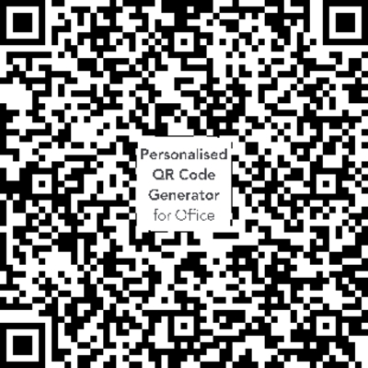
PNHP’s strategy has allowed us to boldly go Where PNHP Has Never Gone Before
End Profiteering
Broadest political appeal, enables new allies
Improve TM
Not all supporters of Traditional Medicare
are aligned with single payer
Our grant to study the
Moral Injury
reaches beyond
the single payer crowd
and builds PNHP’s power
Single Payer
PNHP’s True North
Moral Injury Survey
Improving TM is also the best way to defend TM:
Create a maximum to out-of-pocket expenses for patients

Slide 5
Building More Power Is The Obvious Start but Not the End
Rep. Jayapal Keynote
Our board meeting tomorrow will be focused on applying what we all are learning today.
More to come.
Skills workshops
Campaign workshops
Panels
Plenaries

Slide 6
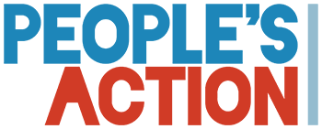
PNHP’s advocacy work has allowed us to “Coalesce” with Great Allies
These are your allies too – and your natural partners for local activism.
Show up for them and they’ll show up for you!

Slide 7
Reminder:
Tell us about your experience with the Moral Injury of dealing with health insurance corporations.
Moral Injury Survey

Slide 9
Jim Kahn MD, Aug 15, 2024:
“Project 2025 will weaken Medicare, Medicaid, and even private insurance for everyone.
“Insurance companies will do just fine, with a big boost to profits.”
https://healthjusticemonitor.org/2024/08/15/project-2025-health-policy-critique-redux/
https://static.project2025.org/2025_MandateForLeadership_FULL.pdf

Slide 10
Attacks on Medicaid include:
Block grants
More harsh eligibility determinations
Give patients the “responsibility to contribute to their health care costs”
Add work requirements
Targeted time limits or lifetime caps
Eliminate benefit mandates that exceed those in the private market
https://static.project2025.org/2025_MandateForLeadership_FULL.pdf

Slide 11
Attacks on gender-related care
Permanently codify Hyde and Weldon
Defund training for abortion care
Reverse FDA’s approval of abortion medications
Prohibit abortion travel funding
Prohibit all abortion providers from receiving Medicaid funds
Not support gender reassignment coverage
https://static.project2025.org/2025_MandateForLeadership_FULL.pdf

Slide 12
Explicitly calls for the repeal of Medicare’s new authority to negotiate the prices of drugs.
https://static.project2025.org/2025_MandateForLeadership_FULL.pdf

Slide 13
We need to turn defense into offense
We need to defend TM
We need to defend drug price negotiations
Should we also defend parts of the ACA?
We need to defend against P2025
while building the power to
tear down the wall against single payer.
https://static.project2025.org/2025_MandateForLeadership_FULL.pdf

Slide 14
Single Payer
Single Payer
Membership
growth
Membership growth
Fundraising
and grants
Fundraising
and grants
Legislative relationships
Legislative relationships
Advocacy
alliances
Advocacy alliances
PNHP POWER
Build even more PNHP POWER
PNHP
POWER
PNHP
POWER
PNHP
POWER
PNHP
POWER

