Slide 1
2025 Data Update
Physicians for a National Health Program
Annual National Conference
Adam Gaffney, MD MPH
Assistant Professor, Harvard Medical School
Pulmonary and Critical Care Medicine, Cambridge Health Alliance

Slide 2
I. US Health and Health Spending

Slide 3
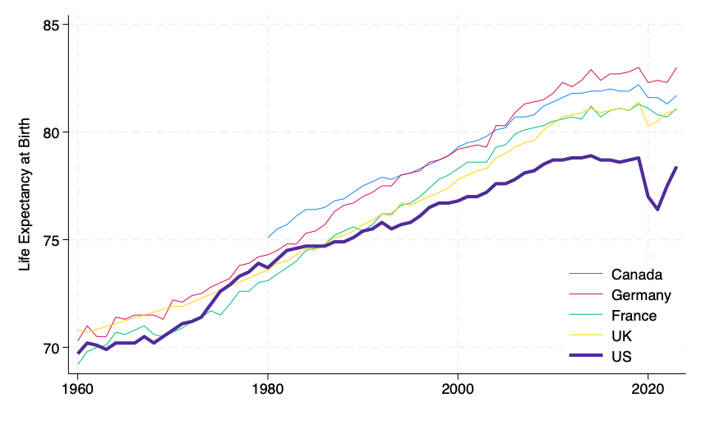
Life Expectancy in Five Wealthy Nations US falling further behind even in pandemic’s wake
85
80
75
70
Life Expectancy at Birth
Canada
Germany
France
UK
US
1960 | 1980 | 2000 | 2020
Data source: OECD Data Explorer, downloaded 10-31-2025.
https://data-explorer.oecd.org/vis?fs%5b0%5d=Topic%2C1%7CHealth%23HEA%23%7CHealth%20status%23HEA_STA%23&pg=0&fc=Topic&bp=true&snb=16&vw=tb&df%5bds%5d=dsDisseminateFinalDMZ&df%5bid%5d=DSD_HEALTH_STAT%40DF_LE&df%5bag%5d=OECD.ELS.HD&df%5bvs%5d=1.0&dq=GBR%2BDEU%2BFRA%2BCAN%2BUSA.A.LFEXP..Y0._T.......&pd=1960%2C2023&to%5bTIME_PERIOD%5d=false&ly%5bcl%5d=TIME_PERIOD&ly%5brw%5d=REF_AREA

Slide 4
“Medical” causes contribute probability of death from non-communicable disease by age 80 Now Highest in US vs. 4 Peer Nations
Probability
of death by age 80
Data shown for men, disparities also among women. Data from: Bennett JE, O’Driscoll ON, Stevens GA, et al. Benchmarking progress in non-communicable diseases: a global analysis of cause-specific mortality from 2001 to 2019. The Lancet. 2025. “Chronic disease” = all non-communicable diseases.

Slide 5
US Has Stark Gradient in Mortality by Wealth Larger gradient than Western Europe; mortality among richest Americans similar to poorest West Europeans
Hazard ratio for death by year 8
“There was no evidence of a difference in survival between the wealthiest participants in the US and the poorest participants in northern and western Europe.”
Data: Machado S, Kyriopoulos I, Orav EJ, Papanicolas I. Association between Wealth and Mortality in the United States and Europe. New England Journal of Medicine 2025;392(13):1310–9.
https://www.nejm.org/doi/10.1056/NEJMsa2408259?url_ver=Z39.88-2003

Slide 6
Healthcare spending among 5 high-income nations US Spending Projected to Rise >20% GDP in Next 10 Years
Healthcare spending as a percent
of GDP
Source: Data for all nations is from the OECD Data Explorer, downloaded July 29, 2025. Estimates for US from 2024 onward, however, are drawn from the Center for Medicare and Medicaid Services’ latest projected National Health Expenditure Accounts.
https://www.cms.gov/data-research/statistics-trends-and-reports/national-health-expenditure-data/projected

Slide 7
Health and health spending
continues to widen
between US and other wealthy nations

Slide 8
II. Health Coverage and the Uninsured

Slide 9
Uninsured in the US, 1963 to 2024 27 Million Remain Uninsured Today
Source for data before 2010: Council of Economic Advisers, “Methodological Appendix: Methods Used to Construct a Consistent Historical Time Series of Health Insurance Coverage,” 2014, https://obamawhitehouse.archives.gov/sites/default/files/docs/longtermhealthinsuranceseriesmethodologyfinal.pdf.
Source for data from 2010 – 2024: Early Release Estimates from the National Health Interview Survey, multiple years. Note that there have been changes in survey methodology over time.
https://obamawhitehouse.archives.gov/sites/default/files/docs/longtermhealthinsuranceseriesmethodologyfinal.pdf

Slide 10
Estimated insurance status from birth to age 18: 42% of Children Have at Least One Insurance Lapse
A microsimulation study. “Private” = employer-based coverage. Data from: Shen Y, Sommers BD, Hatfield LA, Hayes C, Pandya A, Menzies NA. Insurance Dynamics During Childhood in the Fragmented US Health System. JAMA 2025; published online Sept 24.

Slide 11
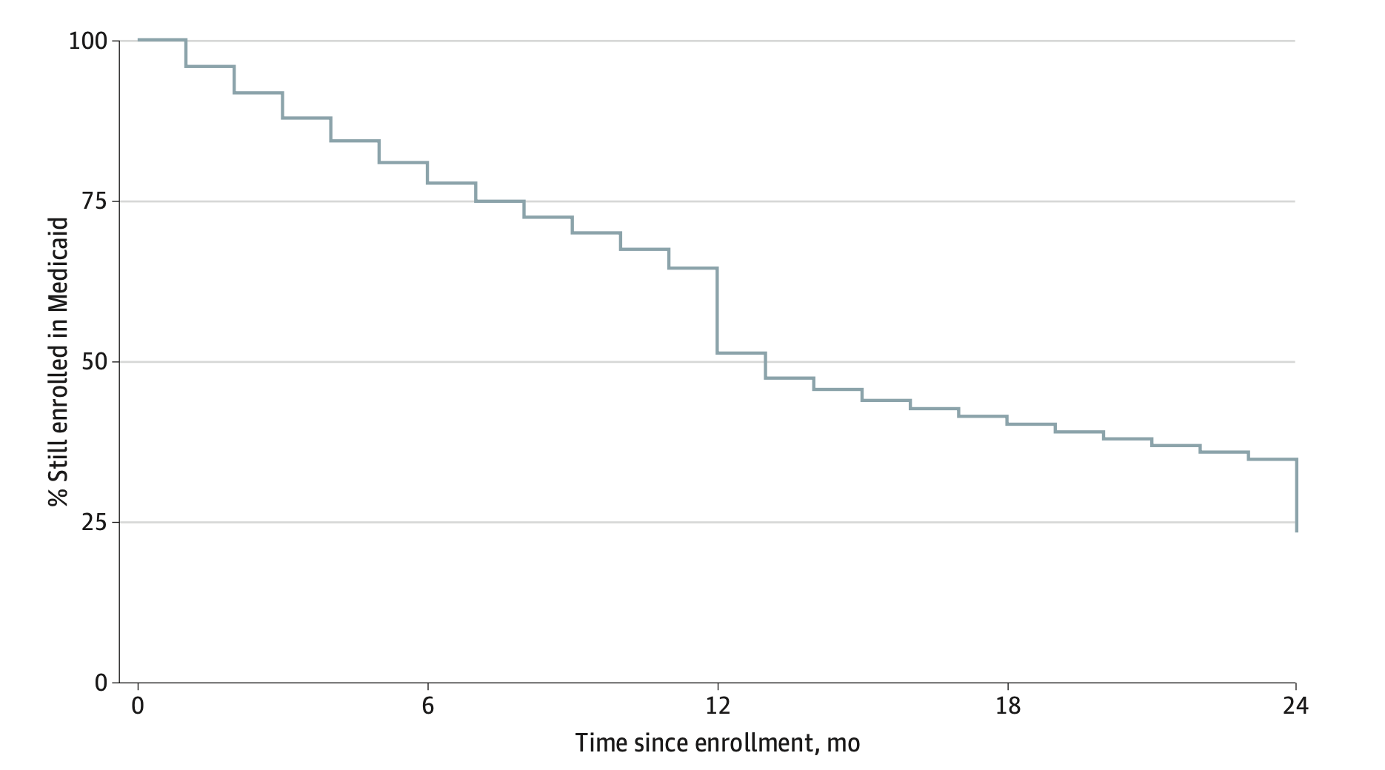
~75% Medicaid attrition over 2 years in Wisconsin 20% Lose Coverage at 12-Month Renewal Point
100%
75%
50%
25%
% still enrolled in Medicaid
20% lose coverage at the 12-month renewal (13 pct. points)
0 | 6 | 12 | 18 | 24
Time since enrollment (months)
Figure reproduced from: Dague L, Myerson R. Loss of Medicaid Coverage During the Renewal Process. JAMA Health Forum 2024; 5: e240839. Study population included non-elderly, non-disabled, non-pregnant individuals.

Slide 12
Major OBBBA Provisions
Medicaid | End streamlined Medicaid/CHIP enrollment End streamlined Medicare Savings Programs enrollment Increase frequency of eligibility redeterminations to 2/year End eligibility for some legally-present immigrants Lower FMAP for Emergency Medicare for some immigrants End incentive for new ACA expansion Restrict “provider taxes” and state-allowable direct payments Work requirements Copays required expansion population up to $35 Block nursing home staffing regulation
ACA | End eligibility for premium tax credits for some immigrants No ACA auto-enrollment No grace period for premium tax credits pending verifying documentation submission Reduce eligibility for PTCs for enrollment during SEP 100% claw-back of PTCs if income higher than expected
Medicare | End eligibility for some some legally-present immigrants

Slide 13
10 Million Projected to Become Uninsured from the OBBBA
ACA Marketplaces
2.1 million
Medicare Policies
100,000
Medicaid Policies
7.5 million
Source of estimates: Congressional Budget Office, available at: https://www.cbo.gov/publication/61367

Slide 14
OBBBA plus expiration of enhanced ACA subsidies set to cause Uninsurance to Surge 50% by 2034
45
40
35
30
25
20
15
10
5
Millions of Uninsured
Uninsured (OBBB Impacts without Enhanced Premium Tax Credit Extension)
Uninsured (CBO Baseline without Enhanced Premium Tax Credit Extension)
Uninsured (CBO Baseline with Enhanced Premium Tax Credit Extension)
2025 | 2026 | 2027 | 2028 | 2029 | 2030 | 2031 | 2032 | 2033 | 2034
Analysis of multiple estimates from the Congressional Budget Office (CBO).
OBBBA = One Big Beautiful Bill Act; PTC = Premium Tax Subsidy

Slide 15
Fall in Medicaid and Rise in Uninsurance in Arkansas: Similar magnitude due to work requirements suggest very few found alternative coverage
5.4% drop
5.2% increase
Data from: Gangopadhyaya, Anuj, and Michael Karpman. “The Impact of Arkansas Medicaid Work Requirements on Coverage and Employment: Estimating Effects Using National Survey Data.” Health Services Research: e14624. https://doi.org/10.1111/1475-6773.14624.

Slide 16
Among 2018 Medicaid disenrollees in Arkansas in work requirements target population High Rates of Healthcare Financial Strain
Sommers, Benjamin D., Lucy Chen, Robert J. Blendon, E. John Orav, and Arnold M. Epstein. “Medicaid Work Requirements In Arkansas: Two-Year Impacts On Coverage, Employment, And Affordability Of Care.” Health Affairs 39, no. 9 (September 2020): 1522–30. https://doi.org/10.1377/hlthaff.2020.00538.

Slide 17
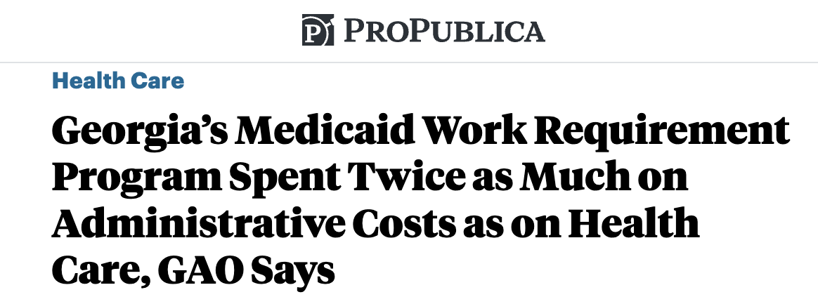
Georgia “Pathways to [Non]Coverage”
https://www.propublica.org/article/georgia-pathways-medicaid-work-requirement-gao-report

Slide 18
Arkansas work requirements had very high administrative costs More than $4,000 per Enrollee “Appropriately” Disenrolled
Gaffney A, Himmelstein D, McCormick D, Woolhandler S. Recent Experience Shows National Medicaid Work Requirements Would Create Enormous Administrative Inefficiencies. Health Affairs Forefront 2025. Estimates draw on administrative spending and enrollee estimates from “Medicaid Demonstrations: Actions Needed to Address Weaknesses in Oversight of Costs to Administer Work Requirements,” U.S. Government Accountability Office (GAO). Number disenrollments = 18,164. Beneficiaries “appropriately” disenrolled = 5% of total beneficiaries subject to work requirements (115,000), based on Sommers BD, Goldman AL, Blendon RJ, Orav EJ, Epstein AM. Medicaid Work Requirements - Results from the First Year in Arkansas. N Engl J Med 2019; published online June 19. DOI:10.1056/NEJMsr1901772.

Slide 19
Effect of Gaining Medicaid on Healthcare and Health Findings from the Oregon Health Insurance Experiment (OHIE)
Data from: Finkelstein A, Taubman S, Wright B, et al. The Oregon health insurance experiment: evidence from the first year. Q J Econ 2012;127(3):1057–106.

Slide 20
Among subgroup most likely to benefit in the Oregon HIE Medicaid Led to Blood Pressure Reduction
Data: Inoue K, Athey S, Baicker K, Tsugawa Y. Heterogeneous effects of Medicaid coverage on cardiovascular risk factors: secondary analysis of randomized controlled trial. BMJ 2024;386:e079377.

Slide 21
Number Needed To Insure (NNI) to Prevent One Death Across 5 Studies of Coverage Expansion
References: Sommers BD, Long SK, Baicker K. Changes in mortality after massachusetts health care reform: A quasi-experimental study. Ann Intern Med. 2014;160(9):585–93; Sommers BD. State Medicaid Expansions and Mortality, Revisited: A Cost-Benefit Analysis. Am J Health Econ. 2017 May 11;3(3):392–421; Miller S, Johnson N, Wherry LR. Medicaid and Mortality: New Evidence From Linked Survey and Administrative Data. Q J Econ. 2021 Aug;136(3):1–47.; Finkelstein A, Taubman S, Wright B, Bernstein M, Gruber J, Newhouse JP, et al. The Oregon health insurance experiment: evidence from the first year. Q J Econ. 2012 Aug;127(3):1057–106; Borgschulte M, Vogler J. Did the ACA Medicaid expansion save lives? J Health Econ. 2020 Jul 1;72:102333. Note: For pre-ACA Medicaid Expansion, estimate is midpoint of provided range. For ACA Medicaid Expansion (individual-level), NNI was calculated by calculating the average treatment effect for the age 19-64 population by dividing the intention-to-treat effect on 339 mortality by the first stage effect on gaining insurance coverage (“any insurance”), provided in Appendix Table A13. Effect of mortality in the Oregon Health Insurance Experiment was non-significant.

Slide 22
Projected Health and Healthcare Impacts of Medicaid Cuts in the “One Big Beautiful Bill”
Gaffney A, Himmelstein DU, Woolhandler S. Projected Effects of Proposed Cuts in Federal Medicaid Expenditures on Medicaid Enrollment, Uninsurance, Health Care, and Health. Ann Intern Med 2025; published online June 17. DOI:10.7326/ANNALS-25-00716.

Slide 23
TennCare disenrollment (2005) led to a ~25% Relative Increase in Evictions
Outcome is relative increase in county-level eviction filings or completed evictions in vs. other southern states after vs. before 2005. Source: Ali MM, Bradford AC, Maclean JC. TennCare Disenrollment Led To Increased Eviction Filings And Evictions In Tennessee Relative To Other Southern States. Health Affairs 2024;43(2):269–77.

Slide 24
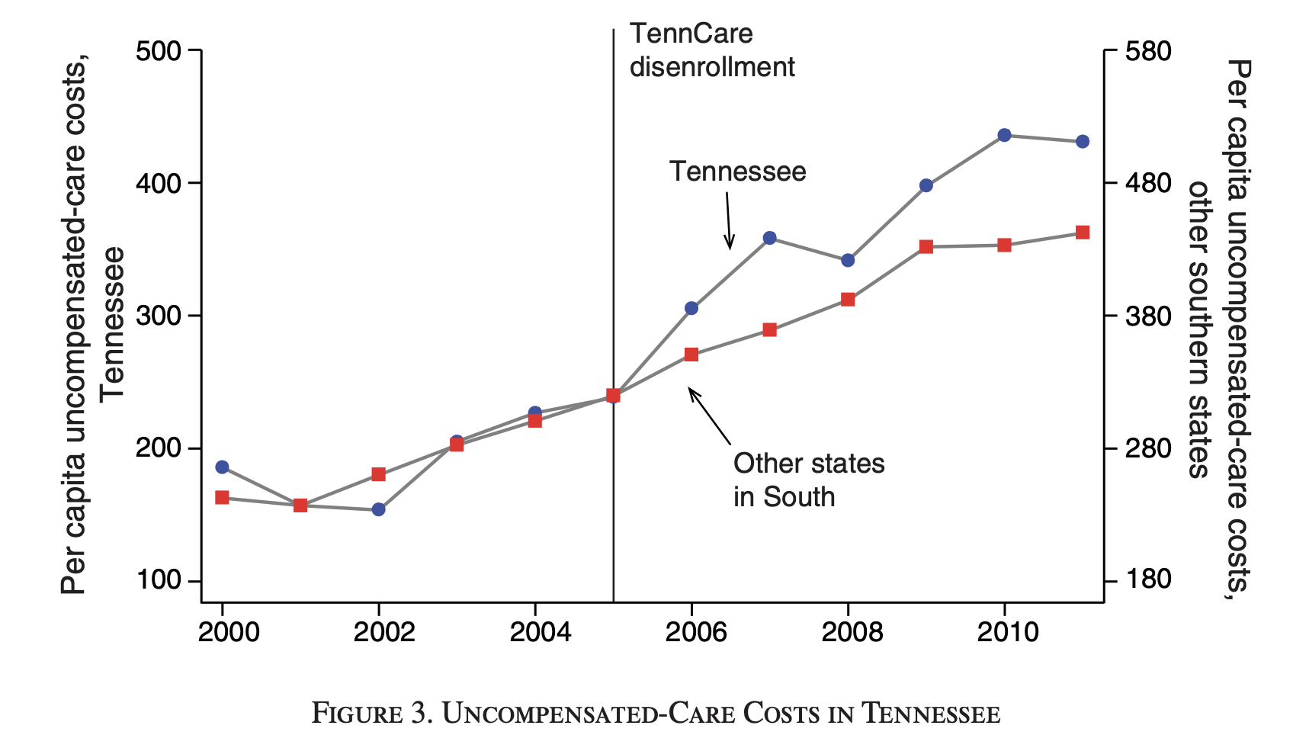
TennCare Disenrollment Drove Up Uncompensated Care Costs at Hospitals
Figure reproduced from: Garthwaite C, Gross T, Notowidigdo MJ. Hospitals as Insurers of Last Resort. American Economic Journal: Applied Economics 2018; 10: 1–39.

Slide 25
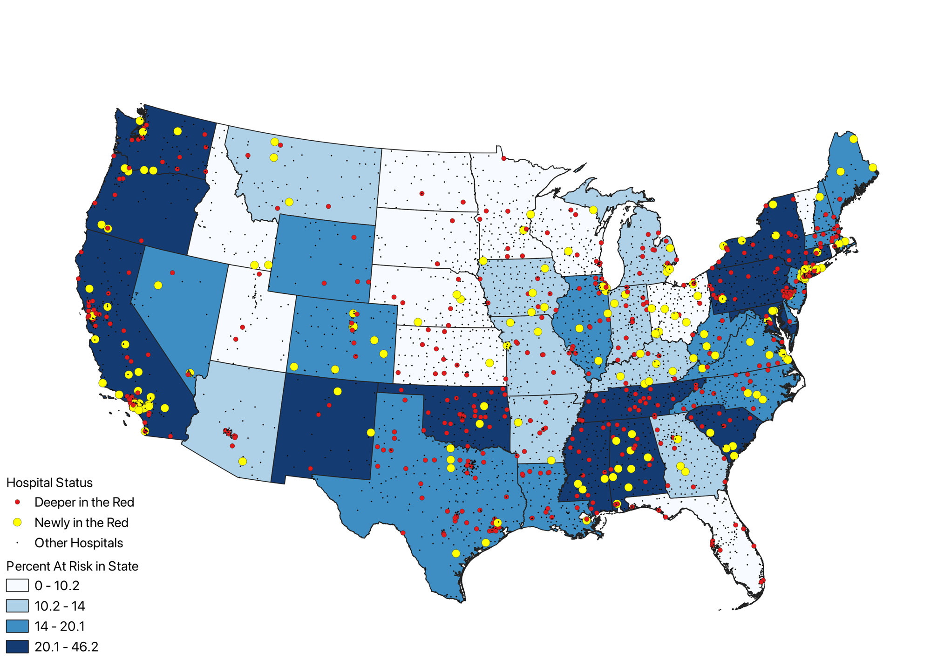
Medicaid Cuts in the OBBBA Could Put 714 Hospitals “In the Red” – or “Deeper in the Red”
Gaffney, A. Unpublished analysis of Medicare Cost Report data

Slide 26
Uninsurance, already harming the health of millions of Americans, is rising — and is set to surge with the OBBBA.
Thousands more medically preventable deaths
will ensue, in addition to already occurring due to inadequate care.

Slide 27
III. Underinsurance

Slide 28
For families with employer-sponsored coverage Deductibles Are Rising for All Plan Types
HDHP: $5,095
HMO: $3,285
PPO: $3,118
HDHP=high-deductible health plan; PPO = preferred provider organization; HMO=Health Maintenance Organization. Data source: KFF 2025 Employer Health Benefits Survey

Slide 29
ACA Marketplace Plan Deductibles, 2025
Data from: https://www.kff.org/affordable-care-act/deductibles-in-aca-marketplace-plans/

Slide 30
Women Who Give Birth Have 35% Higher Risk of Catastrophic Health Expenditures vs. other Women
Data from: Catastrophic health spending defined as family-level OOP spending >= 20% family income. Peterson, Jessica A., Benjamin B. Albright, Haley A. Moss, and Angela Bianco. “Catastrophic Health Expenditures With Pregnancy and Delivery in the United States.” Obstetrics and Gynecology 139, no. 4 (April 1, 2022): 509–20. https://doi.org/10.1097/AOG.0000000000004704.

Slide 31
1 in 7 Insulin Users Face Catastrophic Insulin Costs Driven by costs among those in bottom income quartile
Percent facing catastrophic insulin costs (defined as >40% of annual household income less food and housing costs)
Bakkila, Baylee F., Sanjay Basu, and Kasia J. Lipska. “Catastrophic Spending On Insulin In The United States, 2017–18.” Health Affairs 41, no. 7 (July 2022): 1053–60.

Slide 32
Quirk in Law Creates Natural Experiment That Shows That Loss of Subsidized Drug Coverage Kills Those who lose Medicaid early vs. late in calendar year lose Medicare Part D Low Income Subsidies (LIS) earlier and are more likely to die
Natural experiment arises because Medicare beneficiaries who lose Medicaid January – June retain Medicare Part D Low Income Subsidy through the following December that calendar year (i.e. 6-11 months more coverage), whereas those who lose Medicaid July-December retain LIS through December of the following calendar year (i.e. 12-17 months more coverage). Analysis compared early (Jan-June) vs. late (July-December) disenrolleers. Before LIS Loss = 6 months after Medicaid loss; After LIS Loss = 17 months after Medicaid loss. Data: Roberts ET, Phelan J, Schwartz AL, et al. Loss of Subsidized Drug Coverage and Mortality among Medicare Beneficiaries. New England Journal of Medicine 2025; 392: 2025–34.

Slide 33
Underinsurance affects
more Americans over time
than previously estimated —
and kills

Slide 34
IV. Privatization of Public Insurance

Slide 35
MA Growth Has Far Surpassed Expectations Penetration hit 54% in 2025; projected to reach 63.5% by 2034
Historical Data: KFF, https://www.kff.org/medicare/medicare-advantage-enrollment-update-and-key-trends/
Projections calculated as managed care enrollment / Part B Enrollment, from: CBO Baseline Projections, Medicare, June 2024, https://www.cbo.gov/system/files/2024-06/51302-2024-06-medicare.pdf.
2010 CBO Projections are MA enrollment as percent of Part A Enrollment, from: https://www.cbo.gov/sites/default/files/recurringdata/51302-2010-08-medicare.pdf

Slide 36
MA Overpayments = $84 billion in 2025 Approximately half from favorable selection, half from coding
Report to the Congress: Medicare Payment Policy. 2025; published online March. https://www.medpac.gov/wp-content/uploads/2025/03/Mar25_MedPAC_Report_To_Congress_SEC.pdf.

Slide 37
MA overpayments and excess Medicaid Managed Care overhead = More than $100 Billion in Waste a Year $1.9 trillion in projected added costs for taxpayers from 2025-34
$ Billions
Gaffney, McCormick, Woolhandler, and Himmelstein. The Real Fraud, Waste, and Abuse: Medicare and Mediaid Privatization. Health Affairs Forefront, Nov. 7i 2025.
https://www.healthaffairs.org/content/forefront/real-fraud-waste-and-abuse-medicare-and-medicaid-privatization

Slide 38
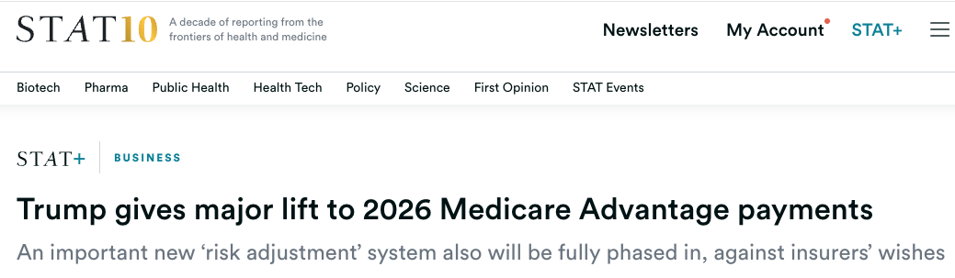
Trump Raised MA Benchmarks by 5.1% Instead of Biden’s Proposed 2.2%
https://www.statnews.com/2025/04/07/medicare-advantage-payment-rate-2026-cms-trump/

Slide 39
Nearly 1 in 5 MA Claims Are Initially Denied Many denials are overturned but still translate into 7% net loss in provider revenue
Initial claims denied are weighted by claims dollars. Denials sustained is dollar share of original denials, and is calculated as 100% - 56.6% denial overturn share reported in study. 7.2% provider loss = denials sustained * initial claims denied (16.6%). Vabson B, Hicks AL, Chernew ME. Medicare Advantage Denies 17 Percent Of Initial Claims; Most Denials Are Reversed, But Provider Payouts Dip 7 Percent. Health Affairs 2025; 44: 702–6.

Slide 40
MA enrollees with difficulty getting care are 33% More Likely to Leave their MA Plan, and 262% More Likely to Switch to Traditional Medicare
Data: Hoffman GJ, Lei L, Alam I, et al. Medicare Advantage Plan Disenrollment: Beneficiaries Cite Access, Cost, And Quality Among Reasons For Leaving. Health Affairs 2025;44(6):684–92.

Slide 41
Medicare Advantage Is Far More Restrictive
OB-Gyn
Allergy
Dermatology
Oncology
Endocrinology
Rheumatology
Psychiatry
Urology
Cardiology
34.5%
Providers seen by MA patients as share of predicted that would be seen absent network restrictions
58.6%
0 | 10% | 20% | 30% | 40% | 50% | 60%
Network Restrictiveness (O/E Ratio)
Figure reconstructed from: Feyman Y, Figueroa J, Garrido M, Jacobson G, Adelberg M, Frakt A. Restrictiveness of Medicare Advantage provider networks across physician specialties. Health Services Research 2024; 59: e14308.

Slide 42
Seniors with Medicare Advantage Significantly Less Likely to Have Complex Cancer Surgery at High Quality Hospital
Percent Having Procedure at High Quality Hospital
Maganty A, Liu X, Dall C, et al. Surgery at High-Quality Hospitals Among Medicare Advantage Beneficiaries Undergoing Cancer Surgery. JAMA Surg 2025; published online Oct 15. DOI:10.1001/jamasurg.2025.4320.

Slide 43
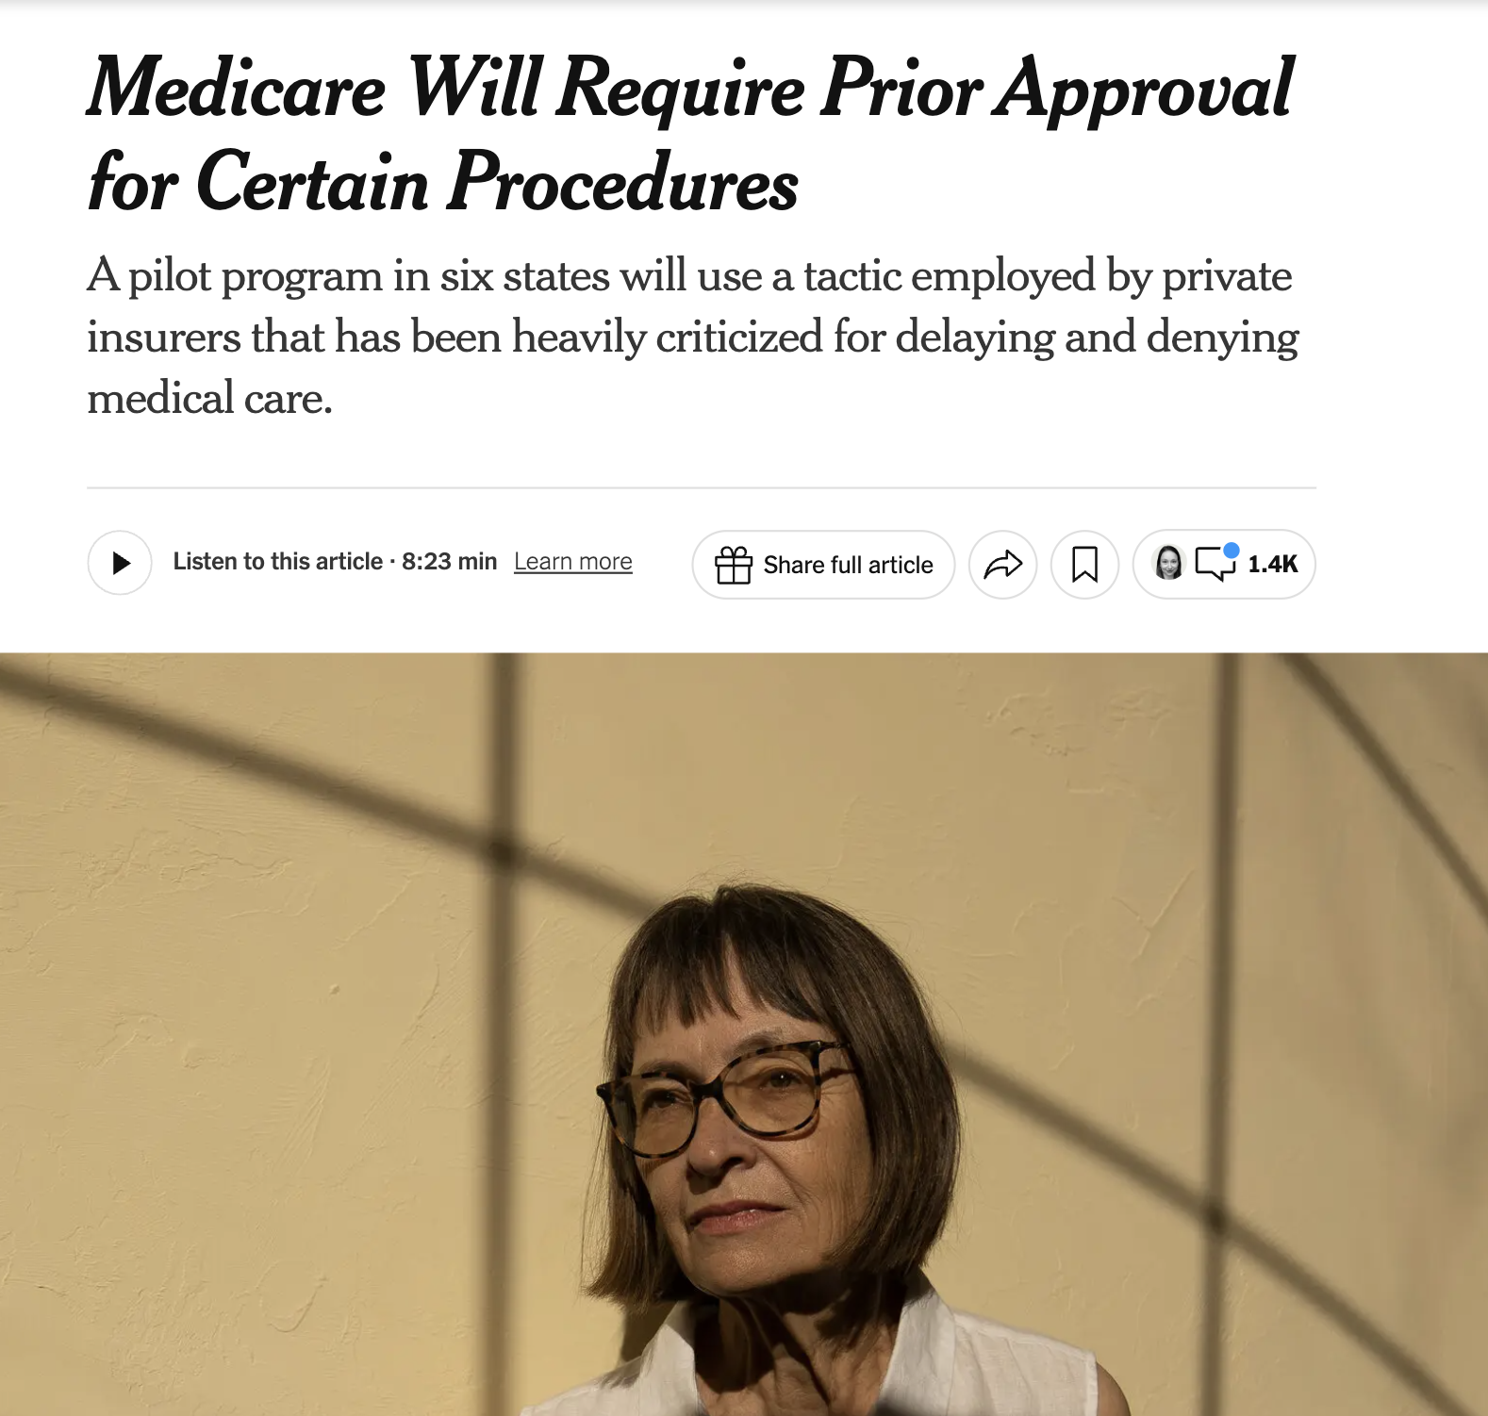
https://www.nytimes.com/2025/08/28/health/medicare-prior-approval-health-care.html

Slide 44
The corporate takeover of
Medicare and Medicaid continues — endangering patients and
the financial future of the program.

Slide 45
V. Supply

Slide 46
Percent change in Physician Supply per 1,000 Population
Specialists
PCPs
Authors adjusted AMA Masterfile data to account for likely retirees. PCP exclude hospitalists. “Other Physicians” are all non-PCP physicians. Adam Gaffney created per capita rates by dividing authors’ estimates by intercensal population estimates from the US Census, and calculated change over time. Data: Bazemore AW, Petterson SM, McCulloch KK. US Primary Care Workforce Growth: A Decade of Limited Progress, and Projected Needs Through 2040. J GEN INTERN MED 2025;40(2):339–46.

Slide 47
Annual Attrition of Doctors Has Increased from 19,000 (3.5%) in 2013 to 28,021 (4.9%) in 2019 A 40% increase in the rate of dropout from 2013 to 2019
Data from Supplement Table 3 of: Rotenstein LS, He Z, Dziura J, et al. Trends in and Predictors of Physician Attrition From Clinical Practice Across Specialties. Ann Intern Med 2025; published online Oct 7.

Slide 48
Community Health Center (CHC) Closure Leads to An Increase in County-Level Mortality: 2011-2019 Four years after CHC closure mortality is 4/100,000 Higher
Effects Mediated by Loss of Doctors, Decline in Visits. Basu S, Phillips R, Hoang H. Impact of Community Health Center Losses on County-Level Mortality: A Natural Experiment in the United States, 2011–2019. Health Services Research 2025; 60: e14648.

Slide 49
Global Healthcare Private Equity Deals Resurged in 2024 to $115 Billion
Figures from 2001-2021 are from: Bain & Company. Global Healthcare Private Equity and M&A Report 2023 [Internet]. [cited 2023 Nov 6]. Figures from 2022-2024 are from Bain & Company. Global Healthcare Private Equity Report 2025; the 2024 figure is annualized.

Slide 50
After PE Acquisition of Retinal Specialists, Retinal Detachment Surgery Falls by 20% Possible reduction in share of patients with hypertension, diabetes
All results are from difference-in-difference models. Estimates above were statistically significant in linear models. Using Callaway and and Sant-Anna estimator, however, changes in % patients with hypertension and diabetes no longer significant. Data from: Singh Y, Cardenas GB, Torabzadeh H, Whaley CM, Borkar D. Private Equity–Owned Physician Practices Decreased Access To Retinal Detachment Surgery, 2014–22. Health Affairs 2025; : 10.1377/hlthaff.2024.01204.

Slide 51
After PE-Acquisition, Hospitals See 3%-21% Reduction in Staffing Despite Increase in Charges
Kannan S, Song Z. Variation In Hospital Salary Expenditures And Utilization Changes After Private Equity Acquisition, 2005–19. Health Affairs 2025;44(2):206–14.

Slide 52
PE Acquisition Reduced ED and ICU Staffing Mortality in EDs rose by 13%
*
0%
*
*
* = significant. Relative change as calculated as adjusted difference-in-difference effect divided by PE-acquired hospitals pre-acquisition mean. ICU Death estimate not statistically significant. Data from: Kannan S, Bruch JD, Zubizarreta JR, Stevens J, Song Z. Hospital Staffing and Patient Outcomes After Private Equity Acquisition. Ann Intern Med 2025; published online Sept 23. 2025

Slide 53
PE Acquisition Increases Postoperative Mortality After 4 Common Surgical Procedures Driven by mortality following complications, or “failure to rescue”
Percent change is relative increase, calculated by authors by dividing effect estimate (percentage point change) by preintervention mean. Failure to rescue is defined as mortality following a complication. Data: Diaz A, Mead M, Rohde S, Kunnath N, Dimick JB, Ibrahim AM. Hospitals Acquired By Private Equity Firms: Increased Postoperative Mortality For Common Inpatient Surgeries. Health Affairs 2025; 44: 554–62.

Slide 54
For-Profit Hospices Spend Less on Direct Patient Care Private Equity hospitals spend the least, and have highest profits
Data: Soltoff A, Williams D, Braun RT. Private Equity–Owned Hospices Report Highest Profits, Lowest Patient Care Spending Compared With Other Ownership Models. Health Affairs 2025; 44: 1235–43. This analysis also found PE more likely to have patients in nursing homes, and achieve highest margins compared to other ownership types.

Slide 55
Corporate takeover of healthcare delivery
is escalating rapidly —
including by pernicious private equity actors
Communities — not corporations —
should own our precious healthcare resources

Slide 56
VI. Immigrants and Health

Slide 57

https://abcnews.go.com/US/illinois-files-lawsuit-block-deployment-national-guard/story?id=126253079

Slide 58
Immigrant Coverage: OBBBA and Rule Making
The OBBA | Medicaid and CHIP | ACA Subsidies | Medicare
Retain eligibility | Legal Permanent Residents, Cuban/Haitian entrants, COFA migrants
 | Lawfully-residing children and pregnant women (state option)
Lose coverage | Refugees, asylees, some survivors of abuse/trafficking, Indians born in Canada, conditional entrants < 1980, withholding of deportation/removal, paroled into US 1+ year.
 |  | Temporary protected status, humanitarian parole, work visas, special immigrant juveniles, some asylum applicants, and other groups
Regulatory Action |  | ACA
Lose coverage |  | DACA recipients
Adopted from: Pillai D, Artiga S. Recent Trump Administration Policies that Impact Health Coverage and Care for Immigrant Families [Internet]. KFF. 2025 [cited 2025 Oct 29];Available from: https://www.kff.org/immigrant-health/recent-trump-administration-policies-that-impact-health-coverage-and-care-for-immigrant-families/

Slide 59
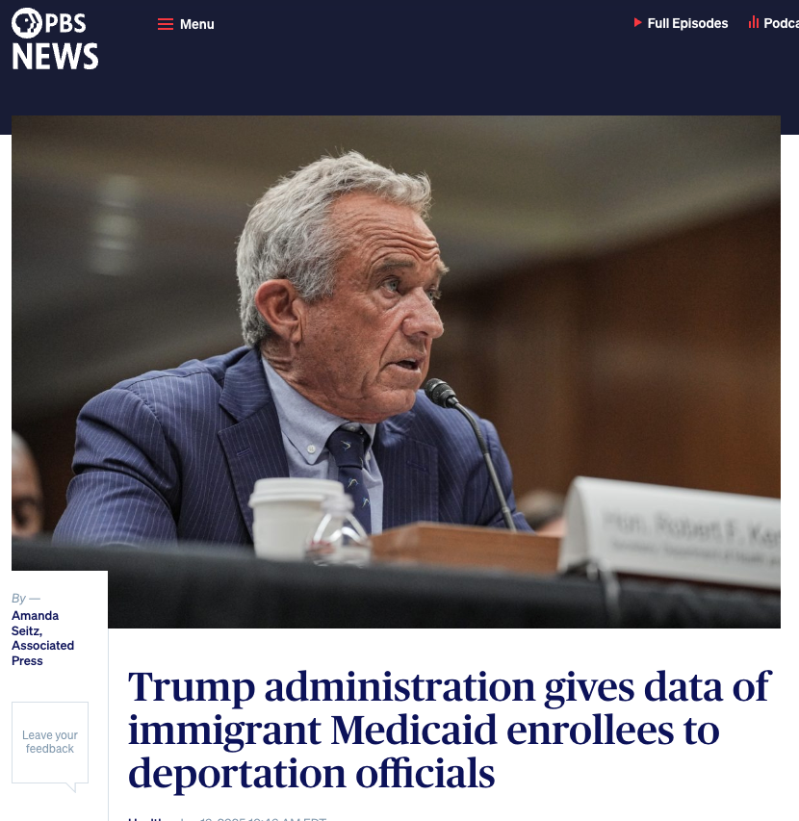

Slide 60
More Than 1 Million Non-Citizen Immigrants Are Healthcare Workers Across Care Settings Approximately 1/3 are undocumented
Data: Azaroff LS, Woolhandler S, Touw S, Bor D, Himmelstein DU. Deporting Immigrants May Further Shrink the Health Care Workforce. JAMA 2025;333(22):2018–20.

Slide 61
VII. Resistance — and Advance

Slide 62
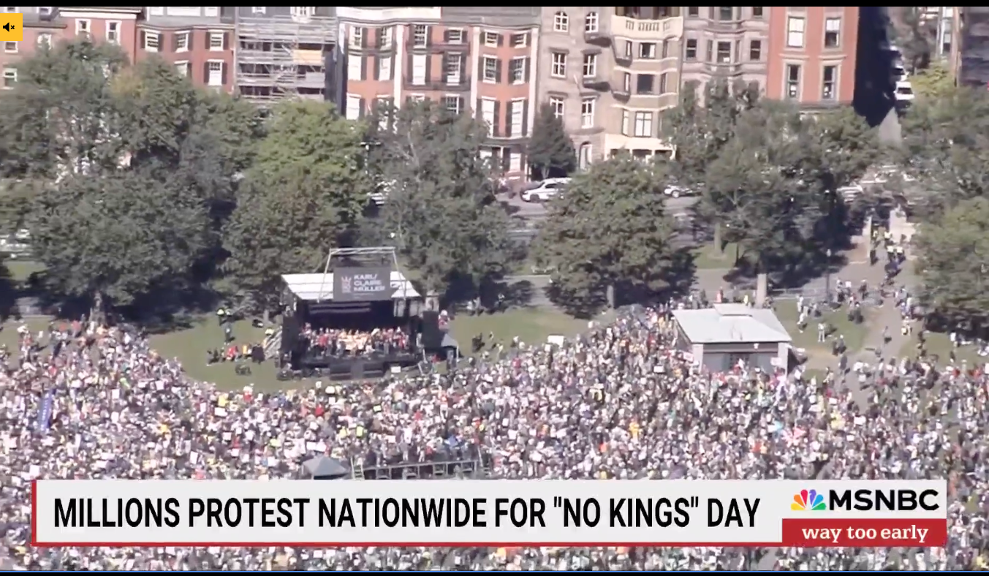

Slide 63
Americans Have Very Unfavorable View of OBBBA And share with unfavorable view surges after hearing impacts
Data from: Kirzinger A, Lopes L, Presiado M, Motalvo III J, Brodie M. KFF Health Tracking Poll: Views of the One Big Beautiful Bill [Internet]. KFF. 2025 [cited 2025 Oct 31];Available from: https://www.kff.org/medicaid/kff-health-tracking-poll-views-of-the-one-big-beautiful-bill/

Slide 64
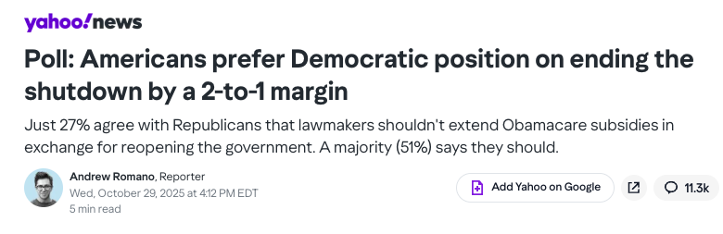

Slide 65
Americans Views on Whether Doctors and Health Insurance Companies Have Too Little or Too Much Influence on Health Policy Debates
Data from: Yam GP and E. Americans’ Views on Who Influences Health Policy and Which Health Issues To Prioritize [Internet]. Pew Research Center. 2025 [cited 2025 Oct 31];Available from: https://www.pewresearch.org/science/2025/07/10/americans-views-on-who-influences-health-policy-and-which-health-issues-to-prioritize/. These two categories had the highest and lowest share of respondents answering “too much” influence. Doctors had second highest share reporting “not enough” (after health scientists), and health insurance companies had the least.. I summed “not enough” and “right amount” answers for presentation

Slide 66
July 2025: Most Americans Support M4A Including about 9 in 10 Democrats and 1 in 3 in Republicans
Data: Economist/Yougov poll, July 2025, available from: https://d3nkl3psvxxpe9.cloudfront.net/documents/econTabReport_haeOEK5.pdf

