Slide 1



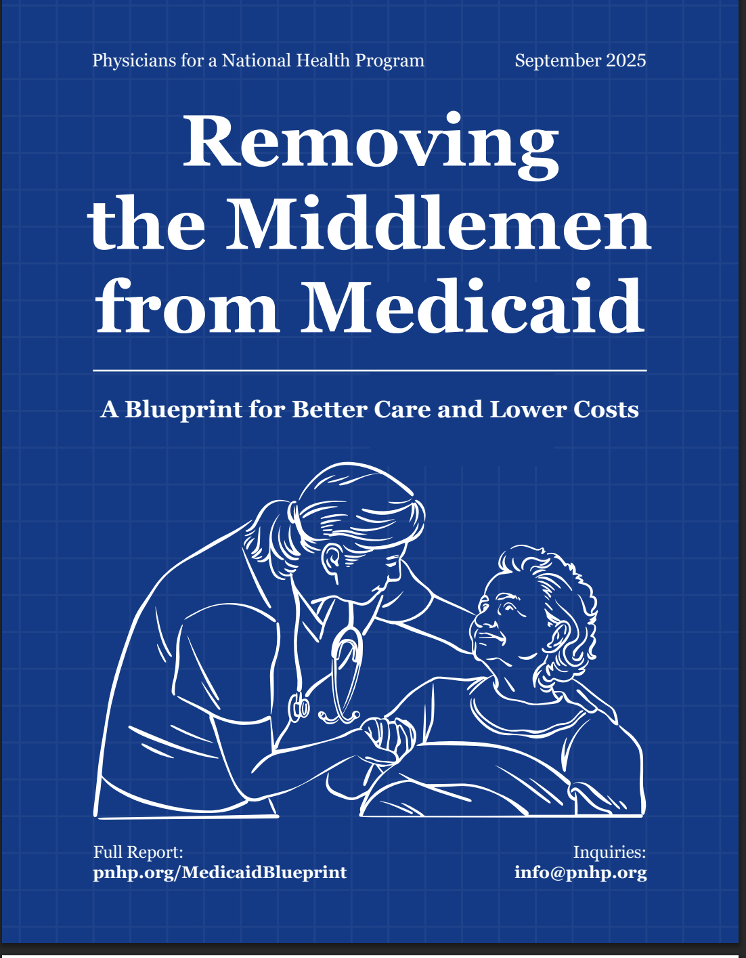
Elevator Advocacy
for Universal Healthcare
Diljeet K. Singh, MD, DrPH
Integrative Gynecologic Oncology
President, PNHP
diljeetksingh@gmail.com
Physicians for a National Health Program
29 E Madison Suite 602, Chicago, IL 60602
(312) 782-6006 info@pnhp.org www.pnhp.org

Slide 2
WHAT?
Guaranteed Universal Health Care
Free of Profit-Motivated Conflicts of Interest
Free of Co-pays
Free of Deductibles
Free of Prior Authorization
Free from the threat of medical bankruptcy
Free of ties to an employer

Slide 3
WHY? Not having healthcare is life-threatening
We are only developed nation without Universal Healthcare
25 million uninsured – will increase by 10 -16 million with Republican budget
Tens of Thousands die every year from lack of insurance
  ~1,200 die for every million uninsured
  ~31,000- 52,000 die every year
Woolhandler & Himmelsetin. Ann Int Med 2017;167:424
Based on best estimate from multiple studies of 1 death per 769 uninsured/year and number of uninsured at the time of the survey
Modified version of slides prepared by Drs. Steffie Woolhandler and David Himmelstein. Originals available at https://www.citizen.org/article/updated-powerpoint-presentations-on-health-policy-issues-relevant-to-health-care-reform-and-a-national-single-payer-health-system/ (accessed Apr 12 2023)
https://www.kff.org/uninsured/issue-brief/key-facts-about-the-uninsured-population/ accessed 4/2024
Notes:
42000 deaths from breast cancer
33000 deaths from prostate cancer
Woolhandler & Himmelsetin. Ann Int Med 2017;167:424
Based on best estimate from multiple studies of 1 death per 769 uninsured/year and number of uninsured at the time of the survey
Modified version of slides prepared by Drs. Steffie Woolhandler and David Himmelstein. Originals available at https://www.citizen.org/article/updated-powerpoint-presentations-on-health-policy-issues-relevant-to-health-care-reform-and-a-national-single-payer-health-system/ (accessed Apr 12 2023)

Slide 4
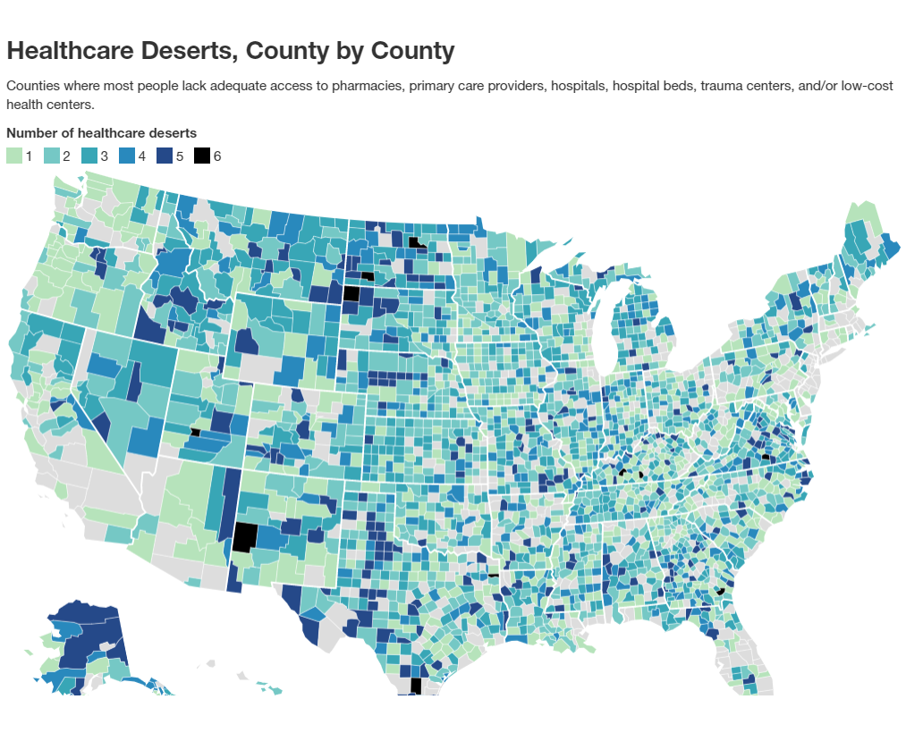
WHY? Having insurance is no guarantee of access to care
Increasing premiums, deductibles & co-pays
Shrinking coverage (underinsurance)
Care Deserts – limited physicians, specialists, hospital
Medical Debt
  66% of personal bankruptcies for medical expense
  80% HAD health insurance when they went bankrupt
https://hitconsultant.net/2021/09/10/healthcare-deserts-goodrx-report/
Notes:
42000 deaths from breast cancer
33000 deaths from prostate cancer
Woolhandler & Himmelsetin. Ann Int Med 2017;167:424
Based on best estimate from multiple studies of 1 death per 769 uninsured/year and number of uninsured at the time of the survey
Modified version of slides prepared by Drs. Steffie Woolhandler and David Himmelstein. Originals available at https://www.citizen.org/article/updated-powerpoint-presentations-on-health-policy-issues-relevant-to-health-care-reform-and-a-national-single-payer-health-system/ (accessed Apr 12 2023)

Slide 5
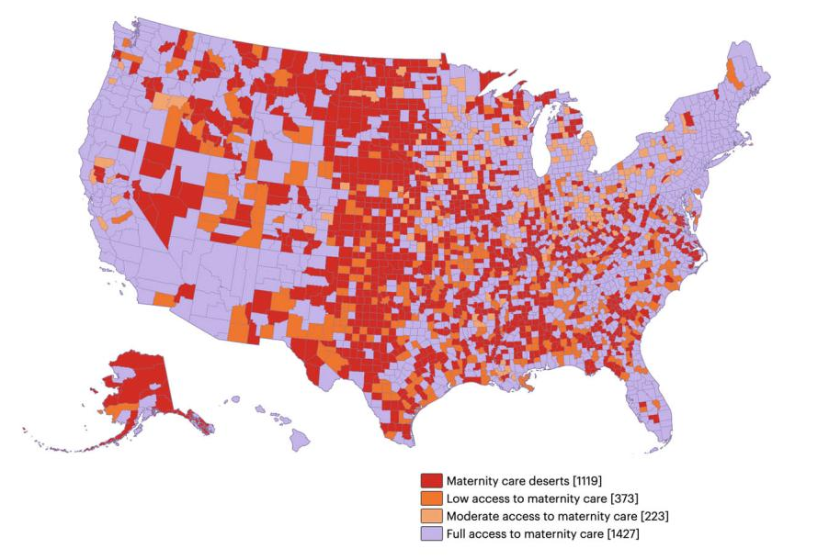
Why? We are LESS healthy
Worse life expectancy
Higher Infant & Maternal Mortality
SPEND TWICE as much as the rest of the world
ttps://www.marchofdimes.org/maternity-care-deserts-report-2022

Slide 6
WHY? WRONG PEOPLE ARE CONTROLLING HEALTHCARE
  Eliminate the middlemen & profit-motivated conflicts of interest that undermine trust & medical decision making
  INHERENT CONFLICT OF INTEREST
    “FIDUCIARY RESPONSIBILITIES”
    Best for the patient versus best for employer
  LOSS of: Autonomy, Sanctity of Physician-Patient Relationship, Patient Trust
  Limited Patient care time
    Burden of record-keeping/documentation for Electronic Billing Record
    Time wasted on complex coding, pre-authorizations, denials
  NOT BURNOUT - IS A BROKEN SYSTEM ➡️ PHYSICIAN MORAL INJURY

Slide 7
How? – Take back wasted money
We spend twice as much on health care as rest of the world, have worse health outcomes & we do NOT cover everyone
Insurance industry wastes 20-35% of every healthcare dollar on profit & bureaucracy
Need HEALTHCARE NOT health insurance
Eliminate UNNECESSARY middlemen
We spend enough now to cover everyone & to add mental health, dental & vision coverage
Notes:
Steffie Woolhandler, Terry Campbell, and David U. Himmelstein, “Costs of Health Care Administration in the United States and Canada,” The New England Journal of Medicine 349 (2003): 768–775, available at https://www.nejm.org/doi/full/10.1056/nejmsa022033.
Here and at other places as noted in this report, historical estimates have been updated to 2018 dollars using the consumer price index for medical care.
Steffie Woolhandler and David U. Himmelstiein, “Single-Payer Reform: The Only Way to Fulfill the President’s Pledge of More Coverage, Better Benefits, and Lower Costs,” Annals of Internal Medicine 166 (8) (2017): 587–588, available at https://annals.org/aim/fullarticle/2605414/single-payer-reform-only-way-fulfill-president-s-pledge-more.
https://www.americanprogress.org/article/excess-administrative-costs-burden-u-s-health-care-system/

Slide 8
How? Political Feasibility – Polls 2024 & 2025
62% of all Americans (90% Democrats, 65% independents & 32% Republicans) believe federal government should ensure health coverage for all
68% believe federal government has a responsibility to provide health insurance to all (90 % Democrats & 45% Republicans)
86% of Gen Z “responsibility of the federal government to make sure all Americans have healthcare coverage” vs. 76% of Millennials, 60% of Gen X, & 51% of Boomers
69% believe healthcare is unaffordable
76% believe that “we need to switch to…system of health insurance” that doesn’t tie coverage to employment (85% Democrats, 65% Republicans & 79% Independents
https://news.gallup.com/poll/654101/health-coverage-government-responsibility.aspx#:~:text=Line%20graph.,low%20was%2042%25%20in%202013.
https://www.pewresearch.org/short-reads/2025/05/06/americans-see-a-role-for-the-federal-government-in-many-domains-but-some-large-partisan-divisions-persist/
https://maristpoll.marist.edu/polls/big-generational-differences-on-legal-weed-climate-change-and-health-care/
https://navigatorresearch.org/wp-content/uploads/2025/04/Navigator-Update-04.25.2025.pdf
https://unduemedicaldebt.org/bipartisan-support-for-policies-that-protect-people-from-medical-debt/

Slide 9
How? “It is too hard”
Every day you do hard things & some days you do the impossible
As physicians we are our patients' best advocates
AMA has lost the forest for the trees

Slide 10
HOW? Can Cover Everyone & Cost Less
“Publicly” Funded & “Privately” Provided
New Expenses:
$325 Billion
Administrative Cost Reductions | $500 Billion
Drug and Device Negotiations | $150 Billion
Total Savings | $650 Billion
New Expenses | $325 Billion
Net Savings | $325 Billion
New Savings:
$650 Billion
Galvani AP. Improving the prognosis of health care in the USA. Lancet. 2020 Feb 15;395(10223):524-533. https://pubmed.ncbi.nlm.nih.gov/32061298/
https://www.kff.org/medicare/analysis-spending-on-health-care-would-drop-by-an-estimated-352-billion-in-2021-if-private-insurance-used-medicare-rates-to-reimburse-hospitals-and-other-health-care-providers/

