Slide 1
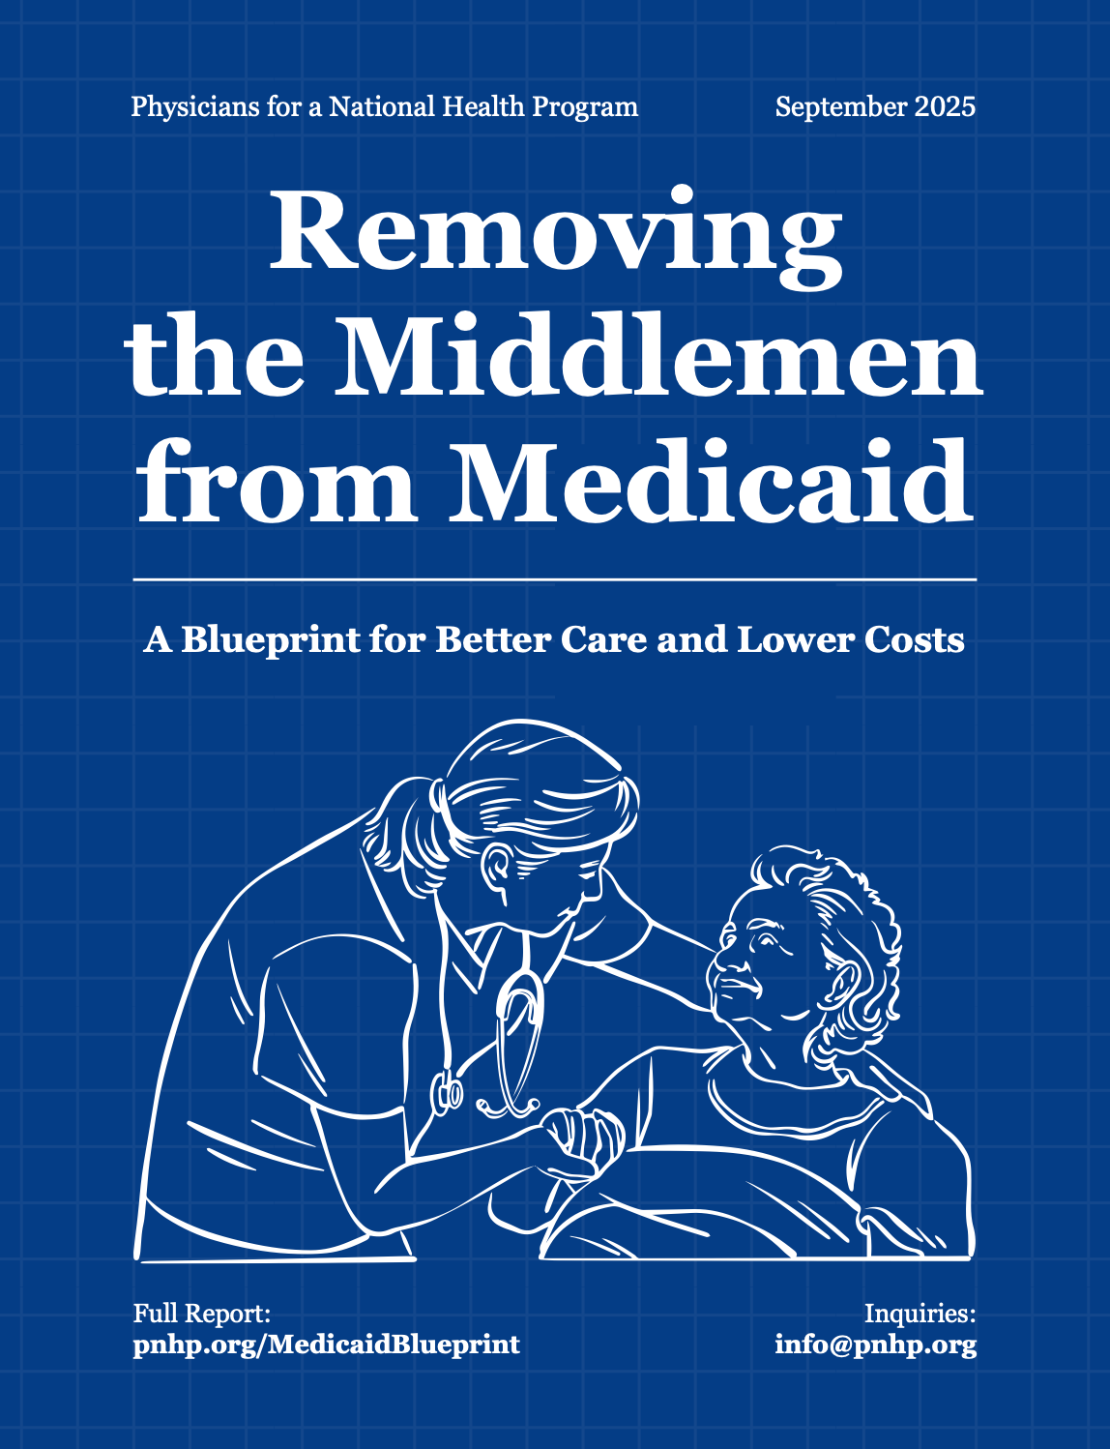

PNHP’s 2nd major anti-profiteering target: Medicaid Managed Care
Amelia Smith, MS and M2
Gita Lakshminarayanan M3/PhD Candidate

Slide 2
Privatization has been capturing Medicaid More Quickly than Medicare
Privatized Fraction
48%
39%
33%
26%
10%
Medicare
https://pmc.ncbi.nlm.nih.gov/articles/PMC4193603/
https://www.kff.org/medicare/medicare-advantage-in-2024-enrollment-update-and-key-trends/#:~:text=More%20than%20half%20of%20eligible,in%202024%20(Figure%201).
https://www.kff.org/medicaid/state-indicator/total-medicaid-mco-enrollment/?currentTimeframe=0&sortModel=%7B%22colId%22:%22Location%22,%22sort%22:%22asc%22%7D
https://www.macpac.gov/wp-content/uploads/2022/03/Managed-care-capitation-issue-brief.pdf

Slide 3
The time is right to remove insurance companies from Medicaid. But States Have “Other Options”
Deprivatize Medicaid
– or –
Cut eligibility
Cut services
Cut reimbursement rates
Reduce funding for other state programs
Raise state taxes

Slide 4
Medicaid deprivatization lead to Earlier Detection of Cancer
66%
64%
62%
60%
58%
56%
54%
52%
Connecticut
Early-Stage Cancer Diagnosis
New Jersey
2012: Elimination of MCOs from CT but not NJ
2007 | 2008-2009 | 2010-2011 | 2012-2013 | 2014-2015 | 2016
https://ascopubs.org/doi/10.1200/OP.23.00297?url_ver=Z39.88-2003&rfr_id=ori:rid:crossref.org&rfr_dat=cr_pub%20%200pubmed
https://cthealthpolicy.org/wp-content/uploads/2020/02/Picture1-2.png

Slide 5
Deprivatization Reduces Spending
Connecticut (2012-2025)
CT Medicaid Spending
per member per month
California
$750
$700
$650
$600
$550
Deprivatized Medicaid in 2012
Immediately began reducing expenses
“Our state has literally saved billions in unnecessary MCO overhead…”
- Christopher G. Donovan,
CT House Speaker, 2009-2013
County mandates
2012-2024 tiny Connecticut
saved $4 Billion
2012 | 2014 | 2016 | 2018
2019
https://cthealthpolicy.org/medicaid-switch-from-mcos-saving-taxpayers-billions/ (average annual 2012 - 2020 propagated to 2025)
https://www.nber.org/system/files/working_papers/w33302/w33302.pdf

Slide 6
Deprivatization Reduces Spending
Connecticut (2012-2025)
California
USA (2004-2015)
Deprivatized Medicaid in 2012
Immediately began reducing expenses
“Our state has literally saved billions in unnecessary MCO overhead…”
- Christopher G. Donovan,
CT House Speaker, 2009-2013
County mandates
Compared 980 counties with MCO mandates for disabled Medicaid enrollees vs 1,305 counties without mandates
Four years after an MCO mandate, costs had increased by 9.8% above counties without MCO mandates
https://cthealthpolicy.org/medicaid-switch-from-mcos-saving-taxpayers-billions/ (average annual 2012 - 2020 propagated to 2025)
https://www.nber.org/system/files/working_papers/w33302/w33302.pdf

Slide 7
We grounded our projections on Milliman’s 2025 Report of Medicaid MCOs
MCO Medical Loss Ratio averaged 87% for ten years.
Overhead (administration + profits) is the inverse: 13%
Palmer, J., Pettit, C., McCulla, I., & Kinnick, C. (2025, June 30). Medicaid managed care financial results for 2024 [Research report; see Figure 3, p. 5]. Milliman. https://edge.sitecorecloud.io/millimaninc5660-milliman6442-prod27d5-0001/media/Milliman/PDFs/2025-Articles/6-30-25_Medicaid-managed-care-financial-results-2024.pdf

Slide 8
Depending on what exactly a state decides to do, We Project a Range of Savings
Medicaid MCO overhead (per Milliman) | -13%
Medicaid MCO overhead (per Milliman) | -13%
Net impact on administrative spending by the state | +1 to +2%
Medicaid MCO overhead (per Milliman) | -13%
Net impact on administrative spending by the state | +1 to +2%
Better care coordination, improved access to primary care, and other enhancements typically lead to a decrease in expense over time | -5 to +1%
Medicaid MCO overhead (per Milliman) | -13%
Net impact on administrative spending by the state | +1 to +2%
Better care coordination, improved access to primary care, and other enhancements typically lead to a decrease in expense over time | -5 to +1%
Projected net impact on state Medicaid MCO budget | -17% to -10%
https://pnhp.org/removing-the-middlemen-from-medicaid/

Slide 9
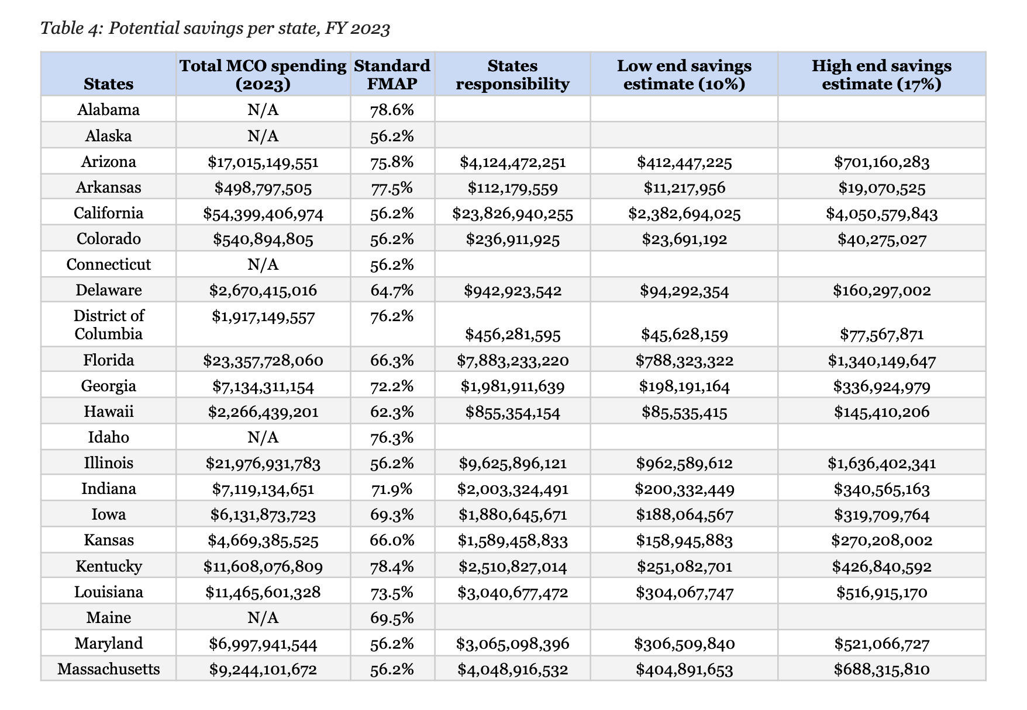
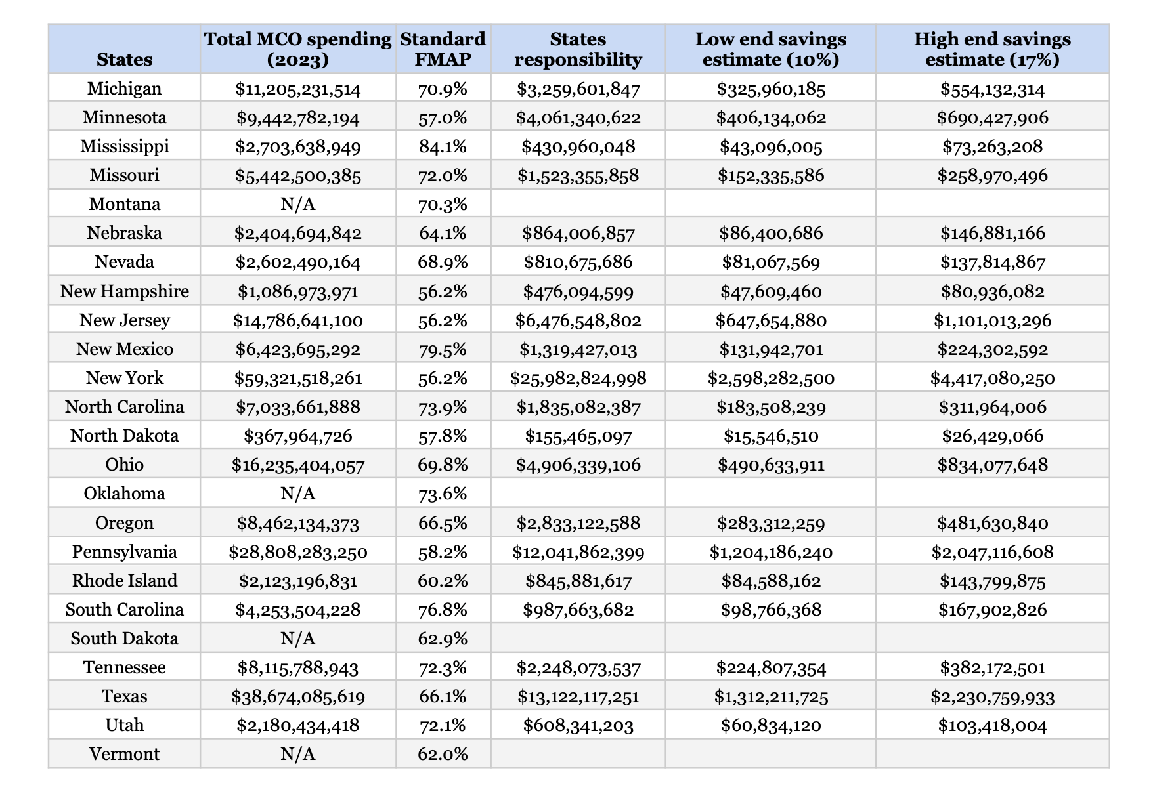
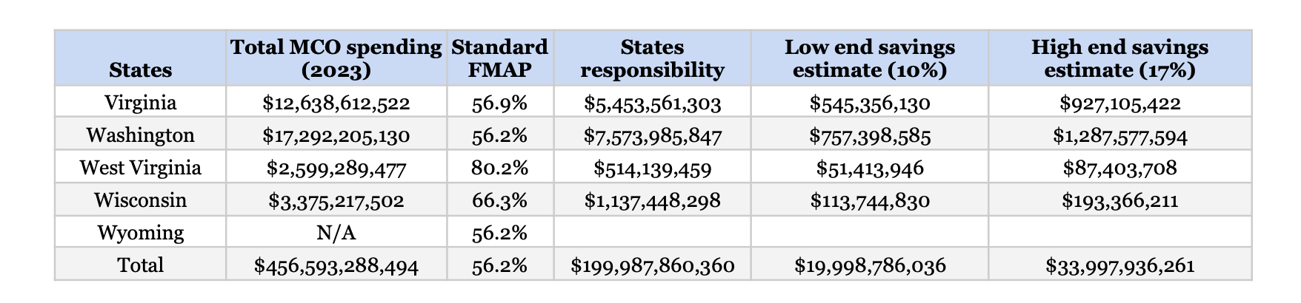
Florida:
Can save up to
$1.3 Billion
per year
Pennsylvania:
Can save up to
$2 Billion
per year
New York:
Can save up to
$4.4 Billion
per year
Most states would each save hundreds of millions of dollars per year.
All state savings combined: up to $34 billion in 2023.
Federal savings: up to $43 billion in 2023.
All states + federal savings: up to $77 billion in 2023.
https://pnhp.org/removing-the-middlemen-from-medicaid/

Slide 10
The “How”
Notes:
Slides 11-Intro to Gita’s section
medicaid historically administered by the state
incremental steps have actually given more power to the medical industrial complex
-e.g. ACA insurance companies got a lot of public funding with very little payoff
things that acutally move us towards single payer
-building public health insfrastructure now
-changing the age (lower and all from 0-18)

Slide 11

Removing insurance companies from Medicaid has More Than a Decade of Proven Success
https://www.connecticutifs.com
Notes:
Slide 12 - Conn
-as of Jan 1 2012 Connecticut successfully deprivitized Medicaid.
Constructed and implemented an organized political campaign. With many components:
-identified state and local legislative cycles. Planned their campaign accordingly.
-Educated all candidates on MCO failings. Advocates in Connecticut also spoke to republican governors - some of them thought it was good
-Riled up the people - fight about the MCOs where is this money going? They don't want to be accountable for the money that we are giving them.
-secret shopper survey: where they effectively proved that the access to care was not at all as expansive as MCOs advertised.
Caveats:
wealthy, small,
HOWEVER:
It is the insurance capital of the world. UHC and ETNA. Etna is headquartered Hartford. Up against powerful lobby. Received significant pushback and concerns that this move might negatively economically impact the state. Amelia showed you otherwise. If this can happen there it can happen anywhere.

Slide 12

Removing insurance companies from Medicaid has More Than a Decade of Proven Success
https://www.connecticutifs.com
Notes:
Slide 12 - Conn
-as of Jan 1 2012 Connecticut successfully deprivitized Medicaid.
Constructed and implemented an organized political campaign. With many components:
-identified state and local legislative cycles. Planned their campaign accordingly.
-Educated all candidates on MCO failings. Advocates in Connecticut also spoke to republican governors - some of them thought it was good
-Riled up the people - fight about the MCOs where is this money going? They don't want to be accountable for the money that we are giving them.
-secret shopper survey: where they effectively proved that the access to care was not at all as expansive as MCOs advertised.
Caveats:
wealthy, small,
HOWEVER:
It is the insurance capital of the world. UHC and ETNA. Etna is headquartered Hartford. Up against powerful lobby. Received significant pushback and concerns that this move might negatively economically impact the state. Amelia showed you otherwise. If this can happen there it can happen anywhere.

Slide 13
Removing insurance companies from Medicaid has More Than a Decade of Proven Success
Important context:
CT is unique
CT organized a robust political campaign
Small state
Relatively wealthy state
One dominant political party (Democratic)
Synchronized with state and local legislative cycles
Educated all candidates about MCO failings
Waged a public campaign
https://www.connecticutifs.com
Notes:
Slide 12 - Conn
-as of Jan 1 2012 Connecticut successfully deprivitized Medicaid.
Constructed and implemented an organized political campaign. With many components:
-identified state and local legislative cycles. Planned their campaign accordingly.
-Educated all candidates on MCO failings. Advocates in Connecticut also spoke to republican governors - some of them thought it was good
-Riled up the people - fight about the MCOs where is this money going? They don't want to be accountable for the money that we are giving them.
-secret shopper survey: where they effectively proved that the access to care was not at all as expansive as MCOs advertised.
Caveats:
wealthy, small,
HOWEVER:
It is the insurance capital of the world. UHC and ETNA. Etna is headquartered Hartford. Up against powerful lobby. Received significant pushback and concerns that this move might negatively economically impact the state. Amelia showed you otherwise. If this can happen there it can happen anywhere.

Slide 14
Removing insurance companies from Medicaid has More Than a Decade of Proven Success
Secret shopper survey
Proved that access to care was not what MCOs advertised
Simple public messages
“Where is all this MCO money going?”
They don’t want to be accountable for the money we’re giving them!”
https://www.connecticutifs.com
Notes:
Slide 12 - Conn
-as of Jan 1 2012 Connecticut successfully deprivitized Medicaid.
Constructed and implemented an organized political campaign. With many components:
-identified state and local legislative cycles. Planned their campaign accordingly.
-Educated all candidates on MCO failings. Advocates in Connecticut also spoke to republican governors - some of them thought it was good
-Riled up the people - fight about the MCOs where is this money going? They don't want to be accountable for the money that we are giving them.
-secret shopper survey: where they effectively proved that the access to care was not at all as expansive as MCOs advertised.
Caveats:
wealthy, small,
HOWEVER:
It is the insurance capital of the world. UHC and ETNA. Etna is headquartered Hartford. Up against powerful lobby. Received significant pushback and concerns that this move might negatively economically impact the state. Amelia showed you otherwise. If this can happen there it can happen anywhere.

Slide 15
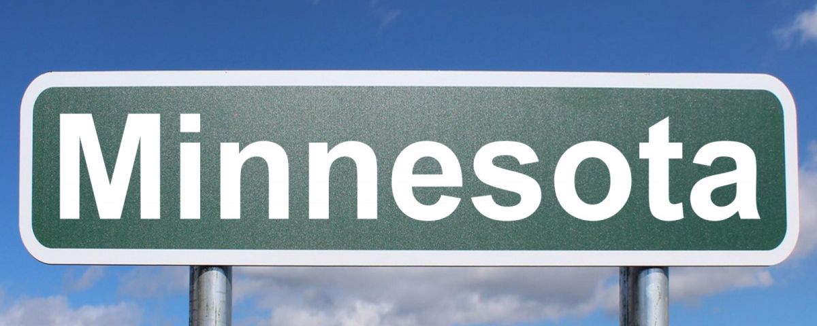
Removing insurance companies from Medicaid has More Than a Decade of Proven Success
https://pix4free.org/photo/4094/minnesota.html
Notes:
-bill passed in 2023 that directed HHS to bring legislature plan options to deprivatize medicaid
-in the process of how to execute this best for the state
-tools they used:
-better care coordination
-physician autonomy
-suggested that this might mitigate rural hospital closures by improving coverage networks and more evenly distributing funds
-tackle medical debt
Caveats:
-minnesota had Democrat in house, senate, and governor in 2023
HOWEVER:
UHC is headquartered in Minnesota

Slide 16
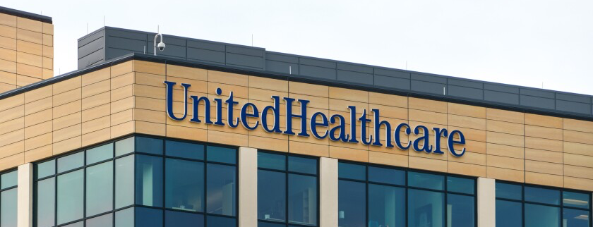
Removing insurance companies from Medicaid has More Than a Decade of Proven Success
https://pix4free.org/photo/4094/minnesota.html
Notes:
-bill passed in 2023 that directed HHS to bring legislature plan options to deprivatize medicaid
-in the process of how to execute this best for the state
-tools they used:
-better care coordination
-physician autonomy
-suggested that this might mitigate rural hospital closures by improving coverage networks and more evenly distributing funds
-tackle medical debt
Caveats:
-minnesota had Democrat in house, senate, and governor in 2023
HOWEVER:
UHC is headquartered in Minnesota

Slide 17
Removing insurance companies from Medicaid has More Than a Decade of Proven Success
MN’s Most
Compelling Arguments
MN’s Legislative Success
Better care coordination
Physician autonomy
Mitigate rural hospital closures
Mitigate personal medical debt
Deprivatization bill enacted in 2023 with Democratic House, Senate, and Governor
Directed HHS to bring options to legislature
Currently in the process of how to best execute deprivatization
https://pix4free.org/photo/4094/minnesota.html
Notes:
-bill passed in 2023 that directed HHS to bring legislature plan options to deprivatize medicaid
-in the process of how to execute this best for the state
-tools they used:
-better care coordination
-physician autonomy
-suggested that this might mitigate rural hospital closures by improving coverage networks and more evenly distributing funds
-tackle medical debt
Caveats:
-minnesota had Democrat in house, senate, and governor in 2023
HOWEVER:
UHC is headquartered in Minnesota

Slide 18
Politics Drives Tactics
Solidly Democratic States
Politically
Mixed States
Solidly Republican States
Build public support
Use tactics from CT, MN, and others in our report
States should fine-tune our economic projections
“More physicians want to take Medicaid; it’s just too hard to work with MCOs.”
Focus on how much money is wasted today
Demand transparency and fiscal accountability
Emphasize the economics
Identify a champion
All states: Collaborate with the wider advocacy community
Notes:
Slide 14 - Application
--> how we bring it to people is the question?
Emphasize that we are not starting from scratch. Model bills. Hawaii is nearly done drafting a bill that we can use.
-on the horizon, website will have model bills for this purpose
-states already have fee-for-service infrastructure
DEMOCRATIC trifecta: public opinion getting a bill written - minnesota bill
Expanded access to care ←soften why this is only in dem states
90% FMAP for the affordable care act expansion population nor the annual FMAP changes. Those data are not publicly available. But each state does have that information
Link to Minnesota bill in the report. And at some point in the future, these bills will be available on the website for you to model yours.
swing state: physician support
Money: total money and how much is wasted ← swing states
Physician support – physicians genuinely want to help people. Medicaid px struggle to get physicians. Access to care. Physicians wont have to work under managed care –Connecticut saw 33% increase in physicians willing to accept Medicaid without increase in fee schedule. Hawaii when it went to go to managed care and physician involvement dropped 30%
REPUBLICAN trifecta: financial support
Accountability ← this might be the best way forward for red states
-target individuals to send the report to before 1on1 meetings
-community groups, faith groups, labor groups co sponsor a town hall about rural hospital closures
PNHP is reconstructing role in advocacy. Our lane is to help. We have an important role, but its collaborative. We don’t have to wait years. We’re not the first group to take this on – it was People’s Action. We are not fighting alone. Engage with groups that know how to do those thins. Be explicit about how you can help and how they can help you.
Developed relationships with media outlets to follow this closely. So that they will publish all of the times that state officials denied you something.
Have to dismantle the idea that privitization/capitalism is always better.
But this is not a private company. We are giving them 100% of the money. We are against fraud waste and abuse.
2 kinds of administrative costs - eligibility process, healthcare delivery
In an MCO, state is still monitoring but doesnt deal with prior auth. 13% from state
Put that money to managed fee for service. Might pay for itself.
ASOs outsource this work 3.8%

Slide 19
Single Payer
PNHP’s “Triple Aim”
Medicare Advantage
Medicaid Managed Care
Out-of-pocket max
Rx, hearing, vision, dental, long-term
care
End Profiteering
Improve Traditional Medicare
Notes:
Punchline:
We can do this. In a time when fed actions are so adversarial. We have the chance to go to legislature with money to give back. Here’s some 100s of millions of dollars a year. As physicians we can say that you can save money and promise that it wont hurt people, in fact it will help people. Hammer home that it can be bipartisan. Go back to triple aim. This isn’t a one-off. That deprivitization saves money and improves outcomes. Now, the federal level might be difficult, but statewide can prove that we can do it federally.
As people in healthcare, with px experience…..(don’t say physicians)
This is an important component of our strategy (don’t say this is future).

Slide 20

Learn more about Removing the Middlemen from Medicaid
Look for a
new email from PNHP
announcing a webinar about Medicaid deprivatization
November 20, 2025
9:00 PM Eastern

