Slide 1
1:1s
Sydney Doe, MD

Slide 2
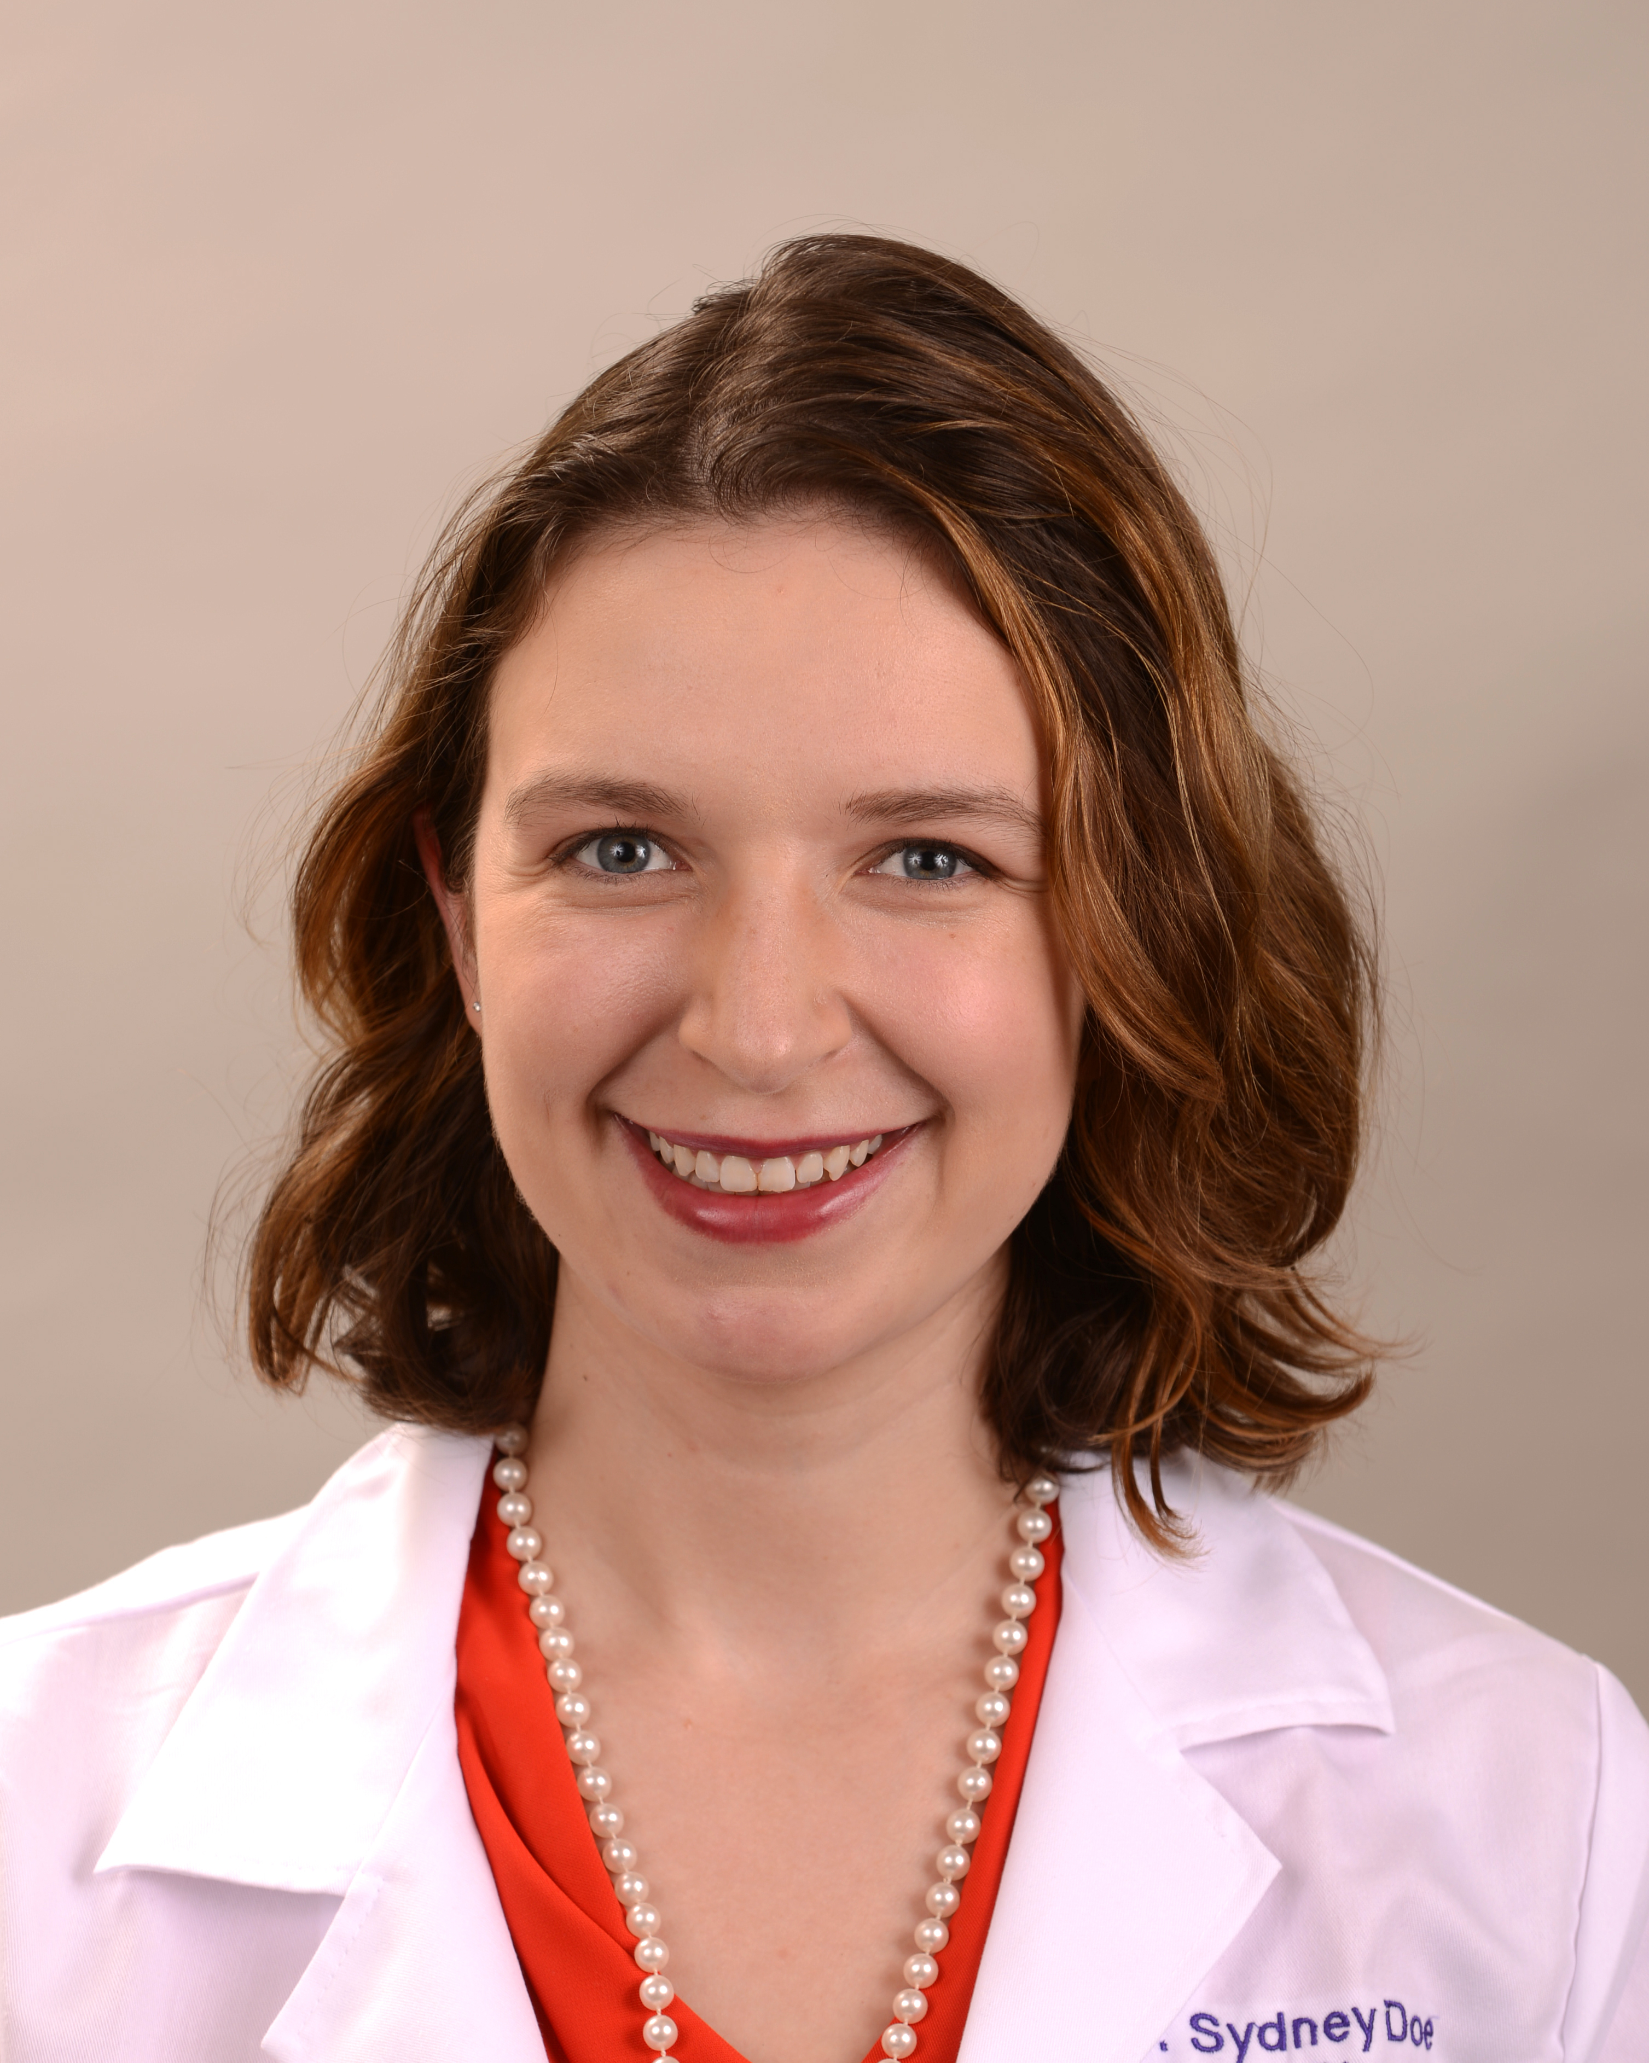
Sydney Doe, MD
Family Physician
Core Faculty, RUSH-Esperanza FM Residency
Assistant Professor, Department of Family and Preventive Medicine, Rush University
Chair, Illinois Chapter PNHP

Slide 3
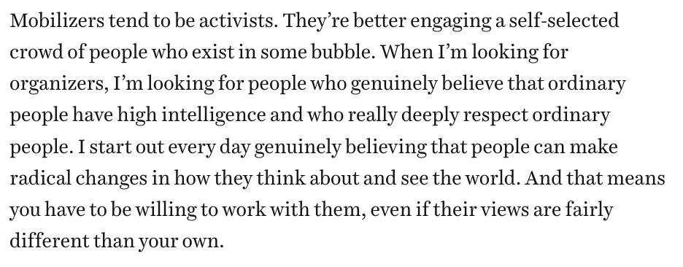
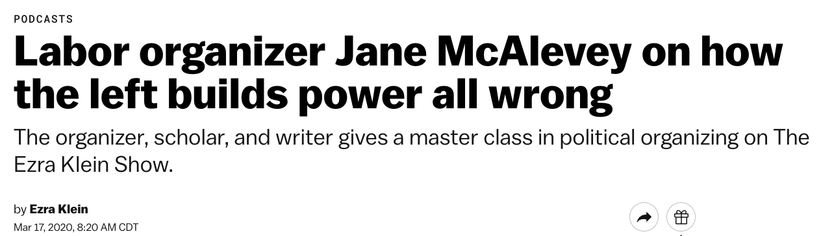

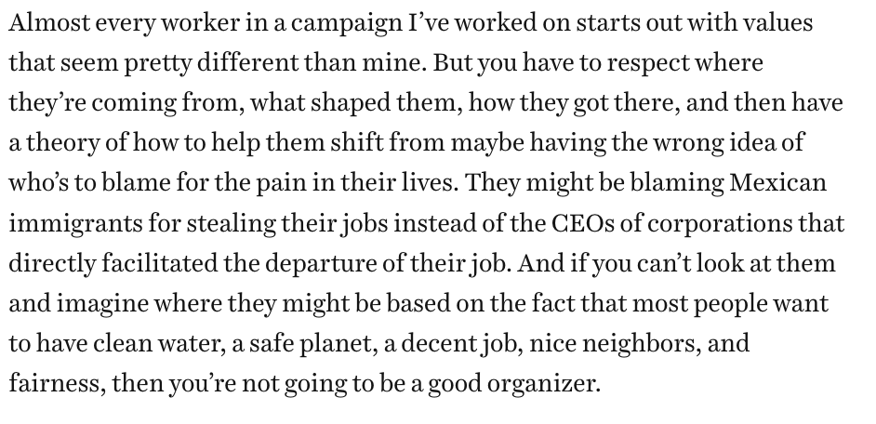

Slide 4
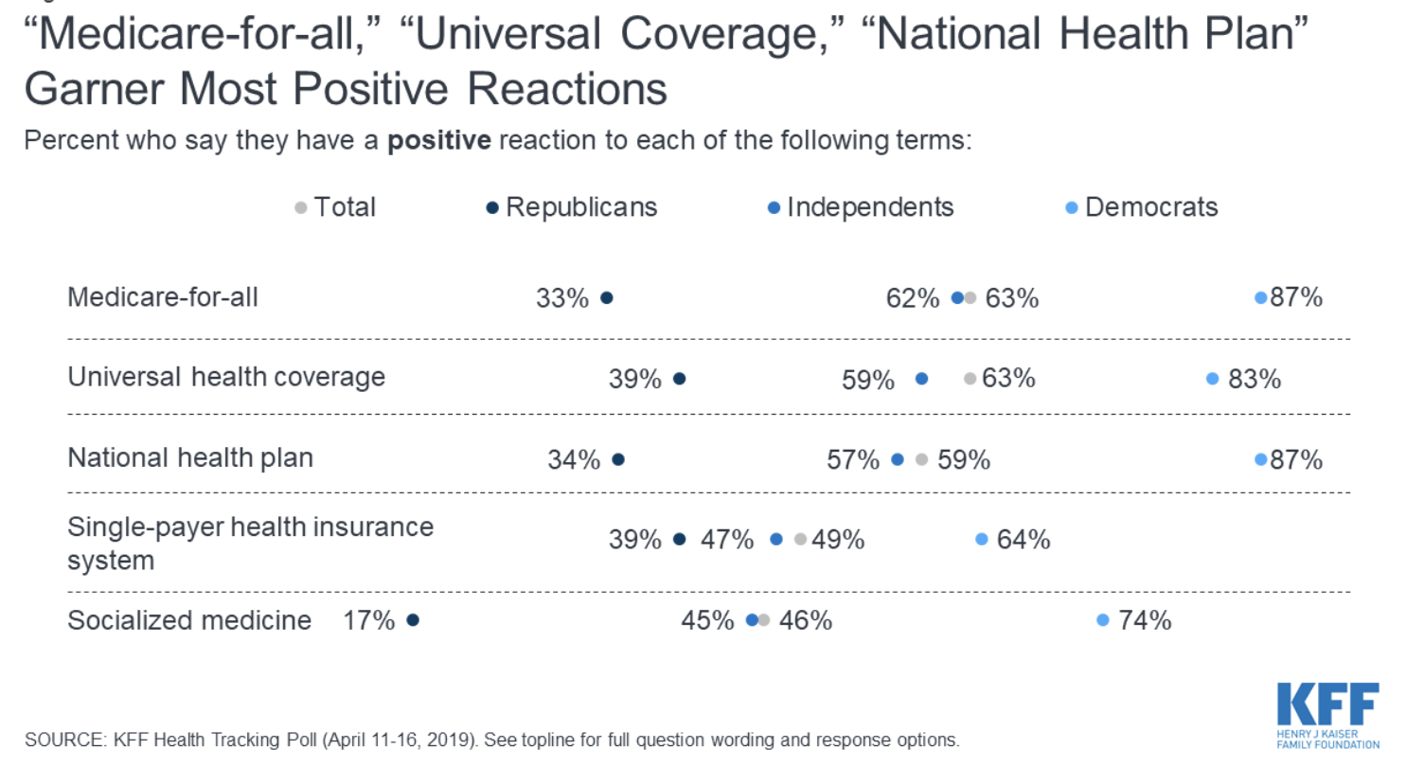

Slide 5
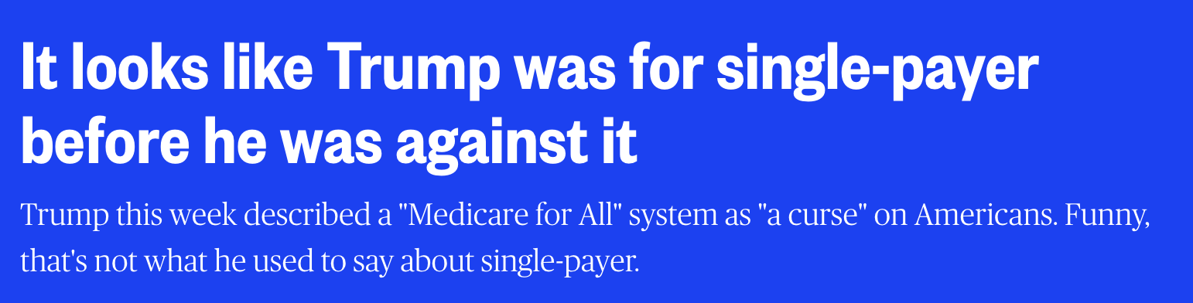

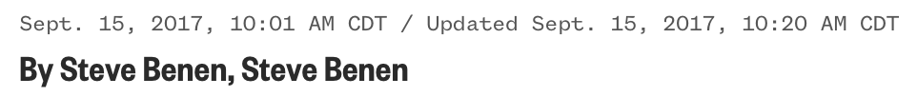
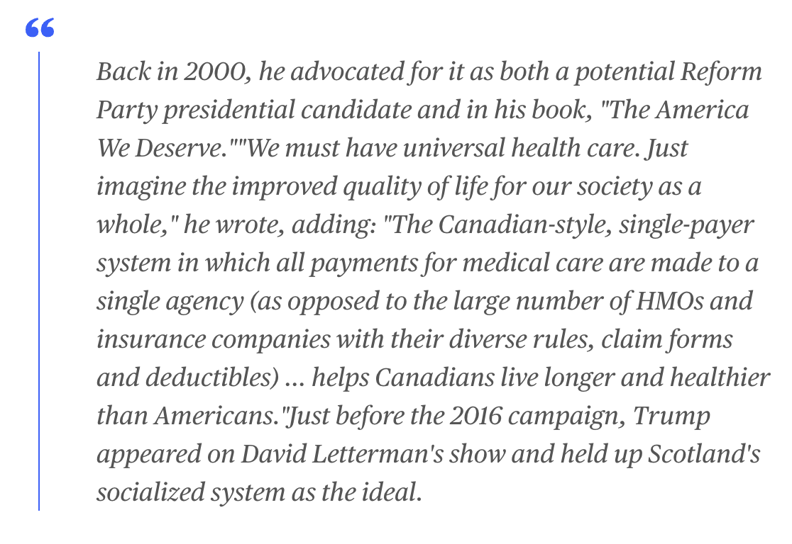

Slide 6
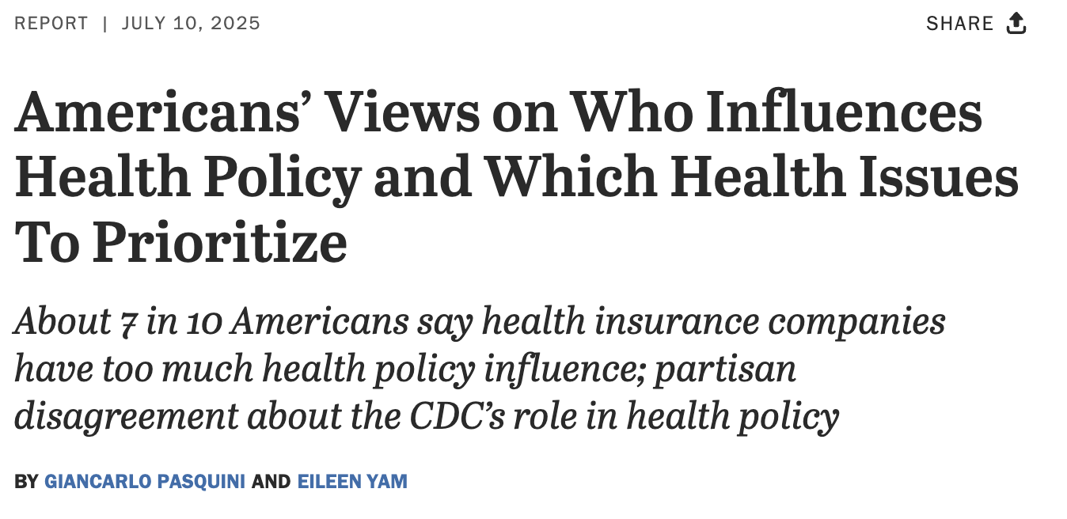

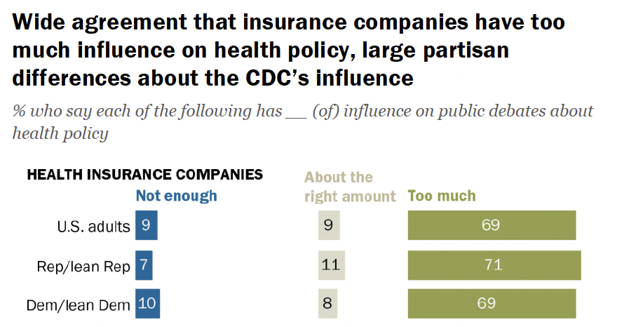

Slide 7

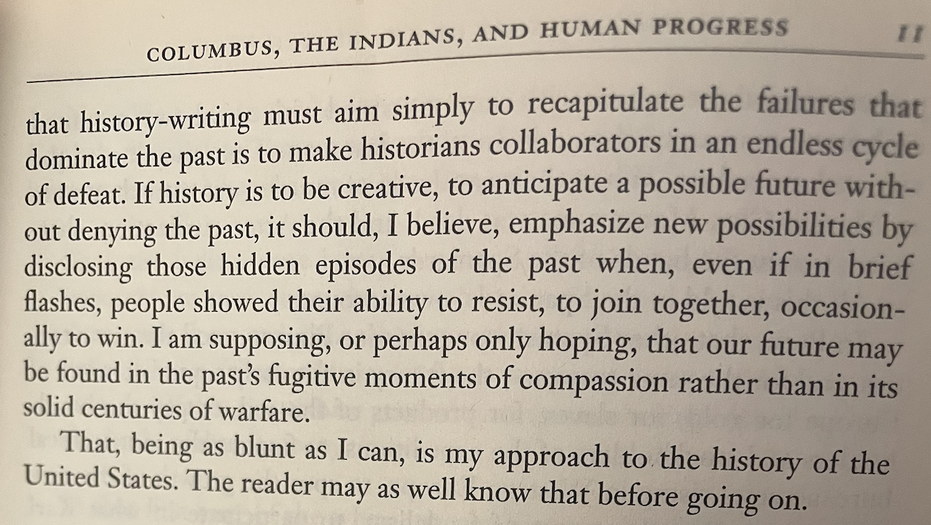

Slide 8
Key points
Be willing to direct the conversation
Be disciplined about time
“One-way” conversation -> you should be listening >80%, talking <20%
The goal is to hear stories
Keep asking “why”

Slide 9
Opinions
Facts
Beliefs
Hopes
Fears
WHY?
STORIES

Slide 10
Ways to ask “why?”
Tell me about…
Why did you…
What were you thinking when…
Notes:
Any others?

Slide 11
A 1:1 is…
45-60 min long
Scheduled in advance
Face to face
Ask respectful but probing questions

Slide 12

A 1:1 is…
45-60 min long
Scheduled in advance
Face to face
Ask respectful but probing questions

Slide 13
A 1:1 is…
A 1:1 is not…
45-60 min long
Scheduled in advance
Face to face
Ask respectful but probing questions
Needs assessment
Survey
Chit-chat
Psychoanalysis
Sales pitch

Slide 14
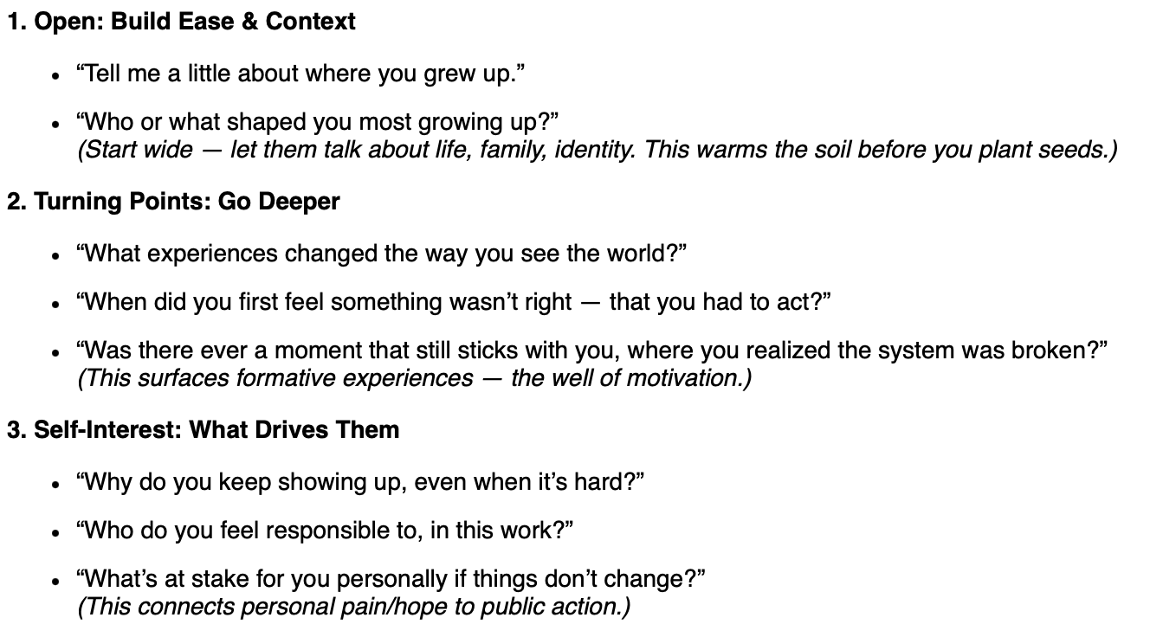

Slide 15
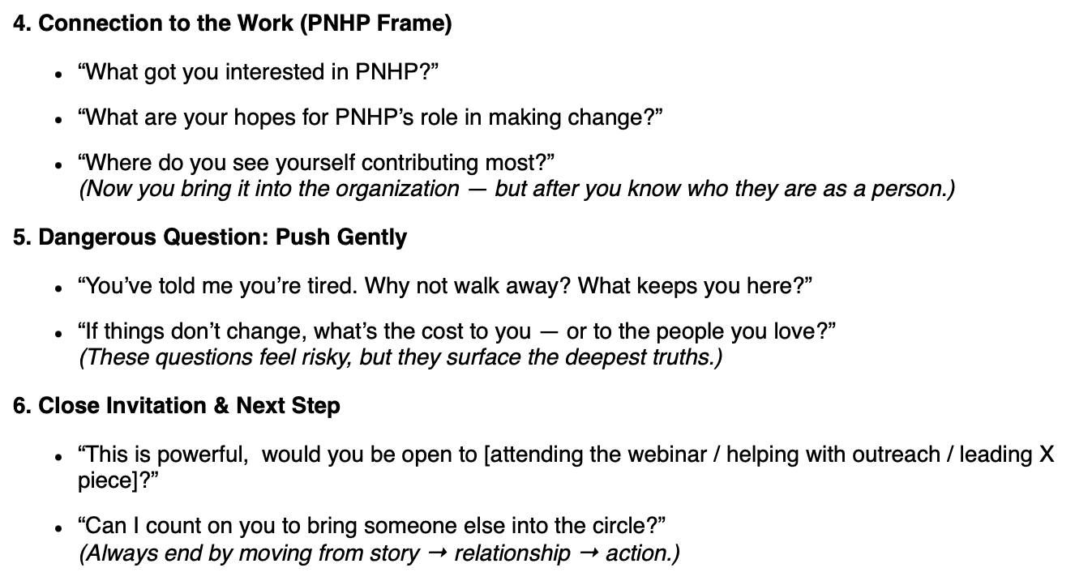

Slide 16
Let’s practice!

Slide 17
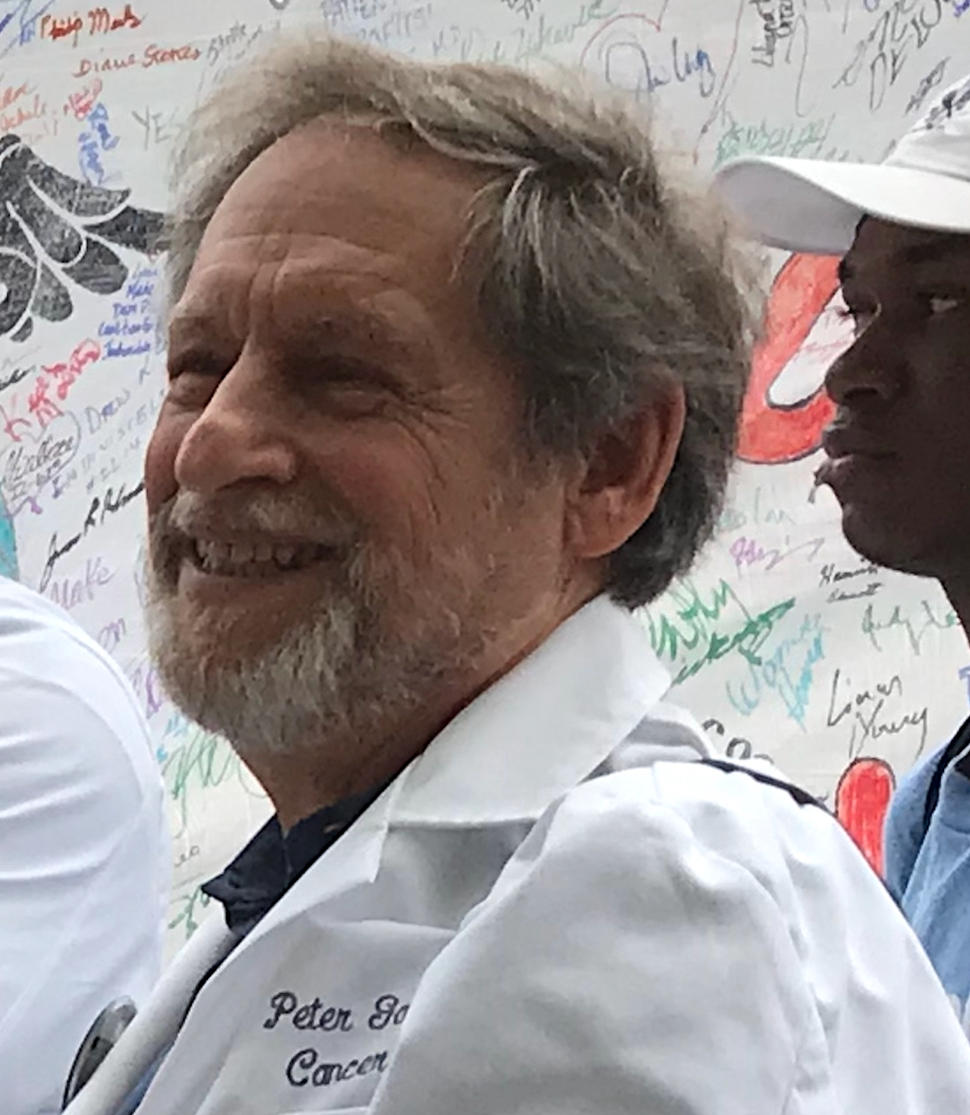
Peter Gann, MD, ScD
Dr. Peter Gann is currently semi-retired as Professor Emeritus in the College of Medicine at the University of Illinois at Chicago. He grew up within walking distance of the NIH campus in Bethesda, MD. He has been involved in campaigns for a just system of universal health care since serving as a summer intern at the Health Policy Advisory Center in New York in 1971. His career experience includes primary care practice, investigation of environmental and occupational hazards in the New Jersey Department of Health, and a stint in the 1980’s as a Project Director
at the National Academy of Sciences. This was followed by decades of work in academia, teaching and conducting research in cancer epidemiology and prevention. He is especially appreciative to have had the opportunity to work with so many dedicated research participants, clinicians, and community activists in collaborative studies to improve population health.
Dr. Gann attended the University of California at San Francisco and received his MD from the University of Pennsylvania, where he also received an MS in epidemiology and biostatistics. He later earned a doctoral degree (ScD) in epidemiology from Harvard. He has served on national advisory committees at the National Cancer Institute, American Cancer Society, the American Urological Association, and the National Comprehensive Cancer Network.

Slide 18
Debrief

Slide 19
Introduce yourself! (10 seconds)

Slide 20
Let’s practice!
Notes:
10 min demo

Slide 21
