Slide 1
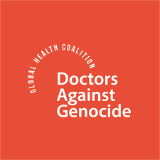
DO NO HARM
THE MORAL DUTY OF HEALTHCARE IN THE FACE OF GENOCIDE
THE ONGOING GENOCIDE
EMMAN HUSSNY MD
DANIA KHALLAD, LMHC
Notes:
Goodafternoon everyone. We are addressing you from the ancestral land of the Piscataway and Nacotchtank (also known as the Anacostan) tribes in Washington DC.
Dania and I are so honored to be here with you today as members of Doctors Against Genocide.
We will be talking about how the medical oath we took to preserve human life, makes it our duty to call out genocide, ideally in its earliest stages, and to treat it as a disease as it spreads within societies. Today we will talk about the healthcare worker's role in genocide prevention, diagnosis and treatment, the UN definition of genocide, DAG's proposed medical definition of genocide, which we believe is a more active definition than the passive legal one, and how we are working on having this definition be adopted by the UN. And lastly, we will talk specifically about the genocide that continues in Gaza, even after the so called Ceasefire.
We also want to acknowledge that there are at least 7 active genocides occuring as we speak, not only in Gaza and the West Bank, but also in Sudan, Congo, Tigray in Ethiopia, Myanmar, Azerbaijan, and China. DAG has been supporting the work of humanitarian workers on the ground in Gaza, Congo, Sudan Tigray and Myanmar .

Slide 2
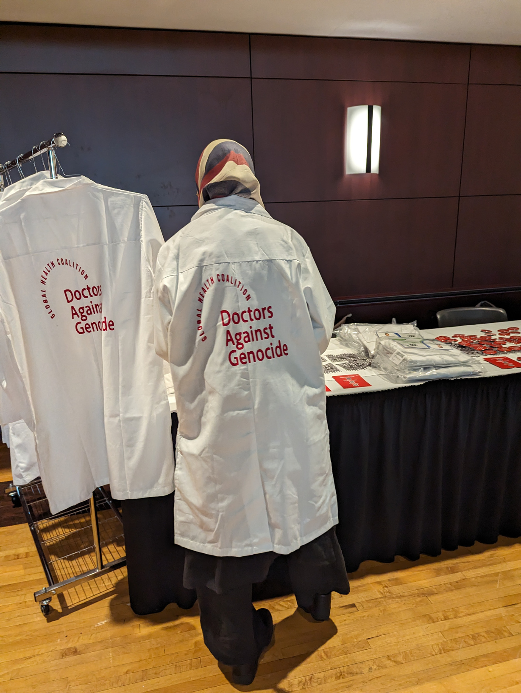
DAG: WHO WE ARE
We are a global grassroots coalition of healthcare workers dedicated to succeeding where global governments have failed in confronting and preventing genocide, war crimes and crimes against humanity. Our membership has grown to over 25,000 globally in just two years.
Notes:
Doctors Against Genocide (known as DAG) is a global grassroots coalition of healthcare workers dedicated to succeeding where global governments have failed in confronting and preventing genocide, war crimes and crimes against humanity. Our membership has grown to over 25,000 globally in just two years.

Slide 3
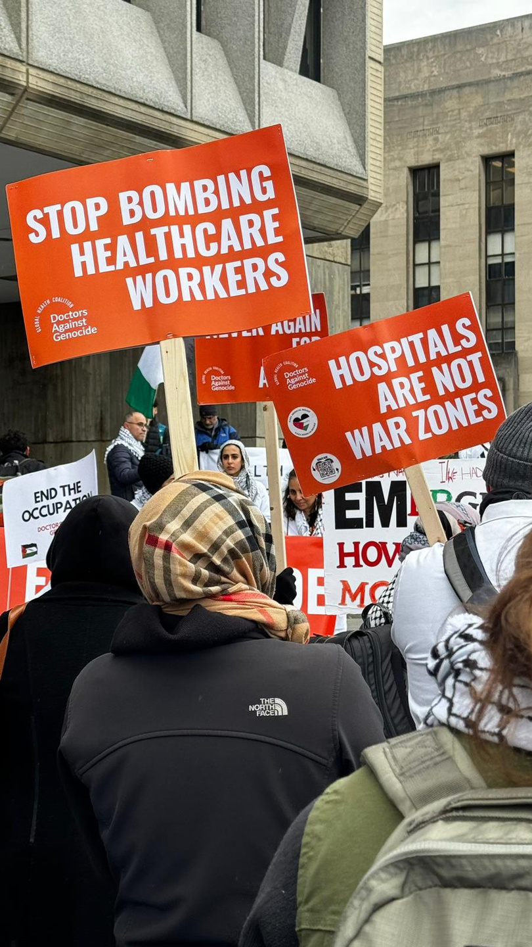

MISSION
As healthcare workers, we swore an oath to “do no harm”.
Our mission is to advocate for the protection of humanity from the devastating effects of war crimes and genocide.
We believe that every life is precious, and our duty is to alleviate suffering and uphold the principles of humanity.
Notes:
As healthcare workers, we swore an oath to “do no harm”.
DAG's mission is to advocate for the protection of humanity from the devastating effects of war crimes and genocide.
We believe that every life is precious, and our duty is to alleviate suffering and uphold the principles of humanity

Slide 4

OUR DUTY TO DIAGNOSE, TREAT AND PREVENT GENOCIDE
The Hippocratic Oath, Declaration of Geneva, and World Medical Association ethics all emphasize:
“I will maintain the utmost respect for human life.”
This extends beyond the clinic. When groups are dehumanized or targeted, when human health and survial are threatened:
Phsycians have a duty to speak
Our silence or neutrality can inadvertently support oppression.
Notes:
Genocide is a disease inflicting our societies globally. It not only negatively affects the people being genocided, but also the perpetrators and the rest of humanity both physically and mentally. If we do not stop it, it metastasizes throughout our societies locally and globally.
Physicians play a profound role in preventing genocide and mass atrocities, because they stand at the intersection of science, ethics, and human dignity.
Physicians hold unique moral and social power. They are trusted authorities. They shape the public's understanding of who is “healthy,” “fit,” or “human.”
Their silence in response to or active participation in atrocities can further legitimize violence.
Unfortunately, throughout history, medicine and science have sometimes been misused to support harmful ideologies, justify discrimination, and perpetrate atrocities. When medical ethics are perverted to serve political goals rather than individual well-being, the results can be devastating.
For example Nazi Germany’s “racial hygiene” programs that were based on the pseudoscientific theory of eugenics, were state-sponsored campaigns of forced sterilization and murder aimed at creating a so-called "pure" Aryan race.
Even in our own country, from 1932 to 1972, the U.S. Public Health Service conducted an experiment on rural Black men in Alabama. Researchers observed the progression of untreated syphilis without the subjects' informed consent. Even after penicillin became the standard treatment for syphilis in 1947, it was withheld from the participants.
And recently, Physicians for Human Rights Israel has alleged that the Israel Medical Association has ignored the participation of Israeli physicians in torture by not thoroughly investigating complaints from Palestinian detainees.
Recognizing these patterns gives healthcare workers an active duty to resist dehumanization wherever it appears and to call out acts of harm to all humans.
The Hippocratic Oath, Declaration of Geneva, and World Medical Association ethics all emphasize that those who take the oath will
“"maintain the utmost respect for human life.”
This oath extends beyond the clinic. When groups are dehumanized or targeted,
physicians have a duty to speak up and shed light on such threats to human health and survival.
Silence or neutrality are not an option as they can inadvertently support oppression.

Slide 5
OUR DUTY TO DIAGNOSE, TREAT AND PREVENT GENOCIDE
The Doctor’s Role in preventing genocide:
Early Warning and Advocacy
Upholding Medical Neutrality
Education and Public Voice
Strengthening Social Determinants of Health
Professional Solidarity
Notes:
So you may ask, what is the doctor’s Role in Preventing Genocide?
1. We need to be early warners of genocide and advocate for those being harmed exipediciously.
Doctors often see the first signs like:
Malnutrition, forced displacement, denial of care, targeted disease outbreaks, or discriminatory health policies rooted in dehumanization. Thus we can pick up on these early signs of potential genocides, ethnic cleansing and war crimes and report them.
But our responsibility doesn't stop at reporting, we must also mobilize our professional organizations, and collectively advocate for the protection of the victims.
2. We must uphold medical neutrality ourselves while also insisting that governments and fighting factions do the same.
Doctors must care for all victims — regardless of ethnicity, religion, or political status. And we must also demand the protection for health workers and facilities in conflict zones. Hospitals, patients and healthcare workers must be protected during conflicts.
3. We must educate the public and be a strong voice of reason in our governments.
Medical professionals can educate the public and policymakers about:
The health impact of violence and discrimination.
And also the importance of empathy, diversity, and social cohesion in public health.
4. We must strengthen the social determinants of health by making society aware that inequality, poverty, and marginalization are root conditions for violence and genocide.
We must drive across the fact that by building equitable health systems and strong social networks we can reduce the risk of mass violence.
5. And lastly we must work together in solidarity with each other and with other healthcare workers.
The medical associations (like the AMA, AAFP, AAP) and international health bodies that we are members of should collectively condemn and intervene when medicine is weaponized or when atrocities occur. Our organizations need to stop politicizing intentional death, starvation and injury.

Slide 6

MEDICAL NEUTRALITY
Medical professionals must provide care to the sick and wounded based solely on their medical needs, without regard to their race, religion, ethnicity, or political point of view.
Healthcare workers and facilities must be allowed to operate without being attacked or misused by any party in a conflict
Medical personnel and facilities are protected by international humanitarian law, and violations can be considered war crimes
Notes:
I need to say a few things about medical neutralitiy as this term has been misinterpreted, often intentionally. In modern conflicts, the concept of medical neutrality is often violated through the "weaponization of healthcare."
Medical neutrality does not mean being silent during a genocide. Medical neutrality refers to the principles and laws that protect healthcare workers and facilities from attack during armed conflict and civil unrest. Medical neutrality is understood not only as a legal and ethical framework protecting medical personnel, but also as a critical mechanism for ensuring that care reaches those most in need during conflict. Crucially, it also safeguards healthcare workers as they deliver care—wherever it is needed—and serves as a shield against targeted violence.
Medical neutrality means that medical professionals must provide care to the sick and wounded based solely on their medical needs, without regard to their race, religion, ethnicity, or political point of view .Healthcare workers and facilities must be allowed to operate without being attacked or misused by any party in a conflict
Medical personnel and facilities are protected by international humanitarian law, and violations can be considered war crimes.
In the BMJ article, "Healthocide and medical neutrality: a call for action and reflection" the authors state:
"Normalising, undermining, or excusing healthocide sets a dangerous precedent—one that emboldens future violators and erodes the principle of medical neutrality, which is essential for ensuring impartial and humane care during conflict, and arguably beyond. Indeed, the consequences are grave. Not only is international humanitarian law at risk of becoming irrelevant, but so is the entire human rights-based framework that emerged in the aftermath of World War II.

Slide 7
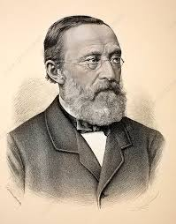
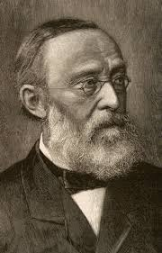
RUDOLF VIRCHOW
“Medicine is a social science and politics is nothing else but medicine on a large scale"
Notes:
So going back to the healthcare worker's role in calling out things that harm a person's health, specifically when it comes to this emphasis on the role of the physician stretching beyond the clinic and hospital, we must mention Dr. Rudolph Virchow. He was a 19th-century German physician. He is known as "the father of modern pathology" AND also as the founder of social medicine.
He argued that social and political factors are a major cause of disease and that doctors have a responsibility to advocate for social reforms to improve public health. He said that "The physician is the natural attorney of the poor.”
thus, physicians are advocates for justice as a determinant of health.
Virchow insisted that medicine and society are inseparable. He believed that social and economic conditions significantly impact health and disease. He had an interdisciplinary approach to health linking politics, economics, and society. He argued that treating disease alone is insufficient; that addressing social inequalities is what prevents disease.
In 1848, Virchow was sent to investigate a typhus epidemic in Upper Silesia, Prussia. He concluded that the epidemic was largely due to poor living conditions, inadequate nutrition, and lack of education, rather than just poor medical care. Health is social: Disease often arises from social inequities, not just pathogens. His report highlighted the need for social reforms to improve health outcomes.
He famously stated, "Medicine is a social science, and politics is nothing else but medicine on a large scale."
Virchow used his influence to advocate for medical education reform and the inclusion of social medicine in medical training.
He actively participated in politics, becoming a member of the Prussian House of Representatives. He used his political platform to push for social and public health reforms.
His work laid the foundation for modern public health and social medicine.

Slide 8
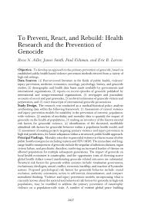
TO PREVENT, REACT, AND REBUILD: HEALTH RESEARCH AND THE PREVENTION OF GENOCIDE- REVA N ADLER, JAMES SMITH, PAUL FISHMAN, ERIC B LARSON PUBLISHED IN 2004
Conclusion: Genocide is one of the most pressing threats to the health of populations in the twenty-first century.
Notes:
Making this same connection between the impact of social issues on health, Adler, Smith, Fishman and Larson published a paper in Health Services Research in 2004, titled: To prevent react and rebuild: health research and the prevention of genocide
What they found was that the mortality rates due to genocidal violence are far in excess of other public health emergencies including malaria and HIV/AIDS. The immediate and long-range health consequences of genocide include the sequelae of infectious diseases, organ system failure, and psychiatric disorders, conferring an increased burden of disease on affected populations for multiple subsequent generations. The impact of genocide on local health economies is catastrophic, and the opportunity costs of diverting scarce global health dollars toward ameliorating genocide related outcomes are substantial.
The researchers found structural risk factors for genocide within societies included: totalitarian government, exclusionary ideologies, armed conflict, economic hardship, and inaction of bystander nations.
In addition they proposed the following psychological risk factors for genocidal behavior: moral exclusion, authority orientation, action in self-interest, desensitization, and compartmentalized thinking.
Their analysis suggests that genocide is one of the most pressing threats to the health of populations in the twenty-first century.
They suggested that recent advances in the public health discipline of violence prevention provide a blueprint for approaches to primary genocide prevention based on epidemiological methods. They also noted that a number of existent global peace building initiatives may serve as models for the design of future prevention initiatives in high-risk, pre-genocide jurisdictions.

Slide 9
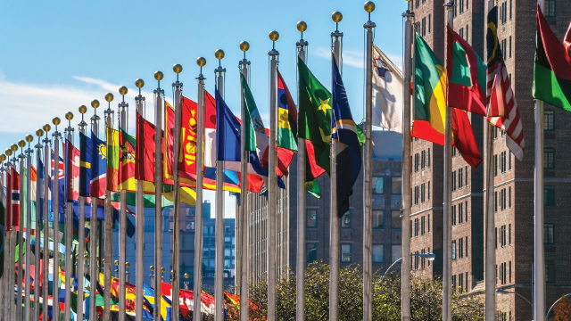
UN GENOCIDE CONVENTION DEFINITION OF GENOCIDE
Any of the following acts committed with the intent to destroy, in whole or in part, a national, ethnical, racial, or religious group:
Killing members of the group
Causing serious bodily or mental harm to members of the group
Deliberately inflicting on the group conditions of life calculated to bring about its physical destruction
Imposing measures intended to prevent births within the group
Forcibly transferring children of the group to another group
Notes:
Let's go over the UN definition of Genocide. Then we will talk about DAG's proposed medical definition.
The UN first defined genocide in Article II of the Convention on the Prevention and Punishment of the Crime of Genocide which was adopted by the UN General Assembly in 1948. This was the first human rights treaty adopted by the UN and established genocide as a crime under international law. It was adopted by 150 countries. Its preamble recognizes that “at
all periods of history genocide has inflicted great losses on humanity” and that international cooperation is required to “liberate
humankind from such an odious scourge”.
According to the Convention, genocide is a crime that can take place both in time of war as well as in time of peace. The definition contained in Article II of the Convention describes
genocide as any of the following crimes committed with the intent to destroy a national, ethnic, racial or religious
group, in whole or in part. 1)Killing members of the group
2)Causing serious bodily or mental harm to members of the group
3)Deliberately inflicting on the group conditions of life calculated to bring about its physical destruction
4)Imposing measures intended to prevent births within the group
5)Forcibly transferring children of the group to another group
Importantly, the Convention establishes a duty on State Parties to take measures to prevent and to punish the crime of genocide, including by enacting relevant legislation and punishing
perpetrators, “whether they are constitutionally responsible rulers, public officials or private
individuals” (Article IV).
The adoption of the Genocide Convention marked a crucial step towards the development
of international human rights and international criminal law as we know it today. It was the
first human rights treaty to be adopted by the General Assembly of the United Nations and
signified the international community’s commitment to ‘never again’ after the atrocities committed during the Second World War.
The definition of Genocide is made up of two elements, the physical element — the acts
committed; and the mental element — the intent. Intent is the most difficult element to determine. To constitute genocide, there must be a proven intent on the part of perpetrators to
physically destroy a national, ethnical, racial or religious group. It is this special intent, that makes the crime of genocide so unique.
To constitute genocide, it also needs to be established that the victims are deliberately targeted — not randomly — because of their real or perceived membership of one of the four groups protected under the Convention. This means that the target of destruction must be
the group, as such, or even a part of it, but not its members as individuals.
This definition was later adopted in Article 6 of the Rome Statute, which grants the International Criminal Court jurisdiction over genocide.

Slide 10
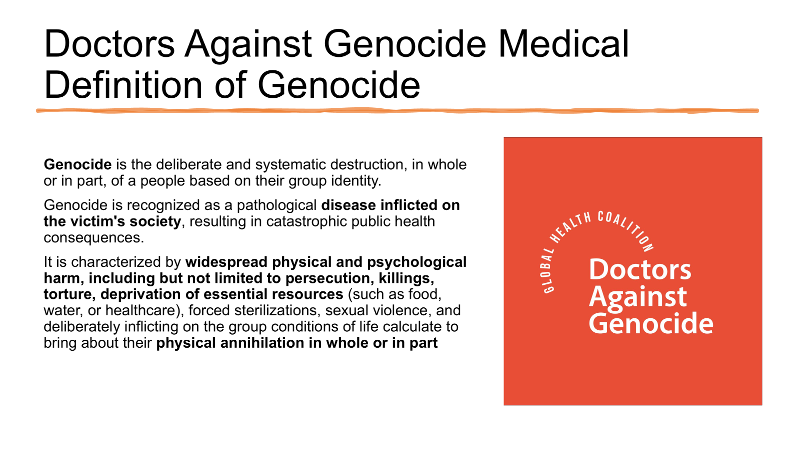
Notes:
Ok now that we have reviewed the UN definition of genocide, let's discuss DAG's definition of genocide, from a medical perspective.
DAG defines genocide as the deliberate and systematic destruction, in whole or in part, of a people based on their group identity.
DAG recognizes genocide as a pathological disease inflicted on the victim's society, resulting in catastrophic public health consequences.
It is characterized by widespread physical and psychological harm, including but not limited to persecution, killings, torture, deprivation of essential resources (such as food, water, or healthcare), forced sterilizations, sexual violence, and deliberately inflicting on the group conditions of life that are calculated to bring about their physical annihilation in whole or in part

Slide 11
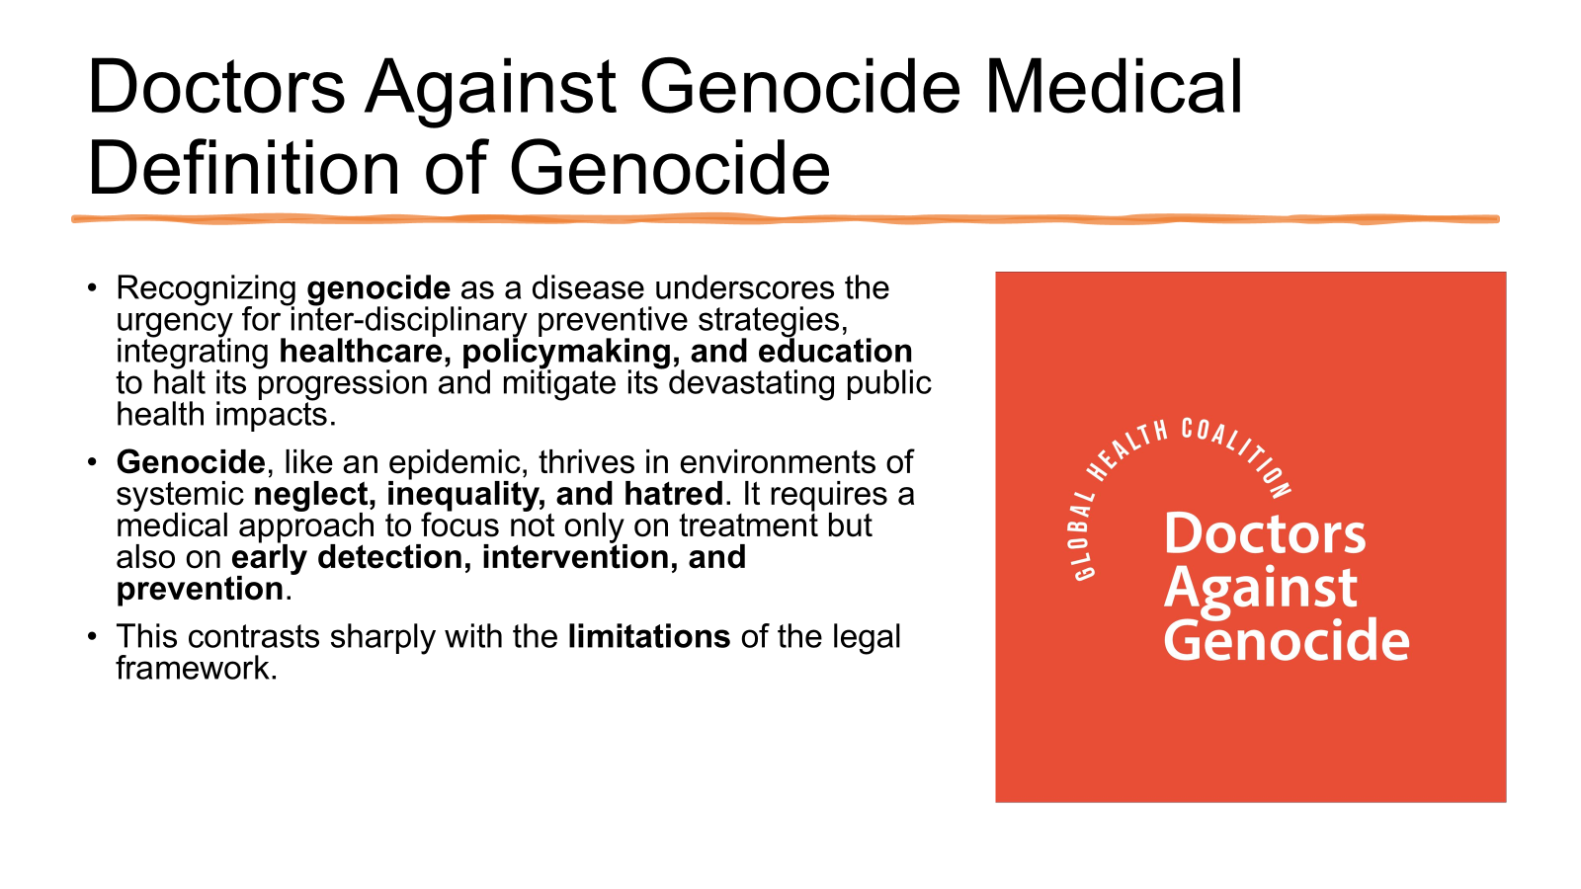
Notes:
By recognizing genocide as a disease, DAG underscores the urgency for inter-disciplinary preventive strategies, integrating healthcare, policymaking, and education to halt its progression and mitigate its devastating public health impacts.
Genocide, like an epidemic, thrives in environments of systemic neglect, inequality, and hatred. It requires a medical approach to focus not only on treatment but also on early detection, intervention, and prevention.
This contrasts sharply with the limitations of the legal framework.

Slide 12
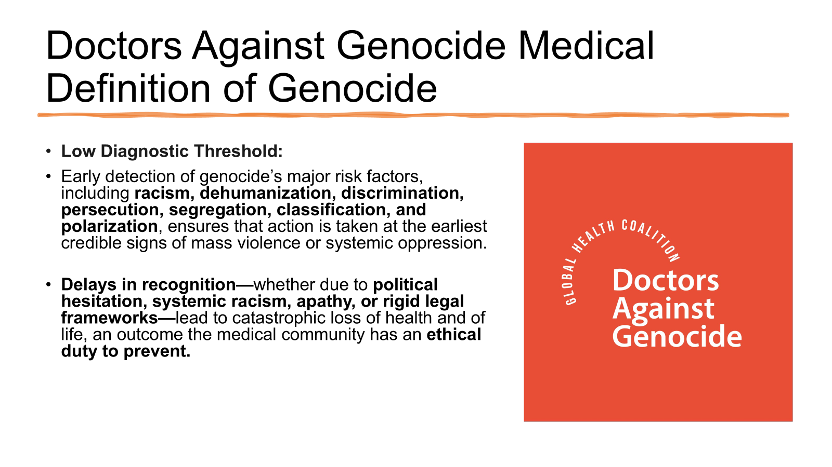
Notes:
Unlike the legal definition in the Genocide Convention, the DAG definition has a low diagnostic threshold that includes the early detection of genocide’s major risk factors, including racism, dehumanization, discrimination, persecution, segregation, classification, and polarization. This early detection ensures that action is taken at the earliest credible signs of mass violence or systemic oppression.
Delays in recognition—whether due to political hesitation, systemic racism, apathy, or rigid legal frameworks—lead to catastrophic loss of health and of life, an outcome the medical community has an ethical duty to prevent.

Slide 13

Notes:
DAG also believes that the prevention of genocide is a medical imperative.
We maintain that international laws, regulations and frameworks should prioritize prevention over retrospective adjudication.
The medical framework that we have proposed would overcome the current political obstinancy and protracted legal process that cost both time and lives.
We believe that the global community must adopt a health-oriented approach to genocide that is focused on the duty to prevent and protect, regardless of whether intent is conclusively proven, in order to save the maximum amount of lives and reduce harm.

Slide 14
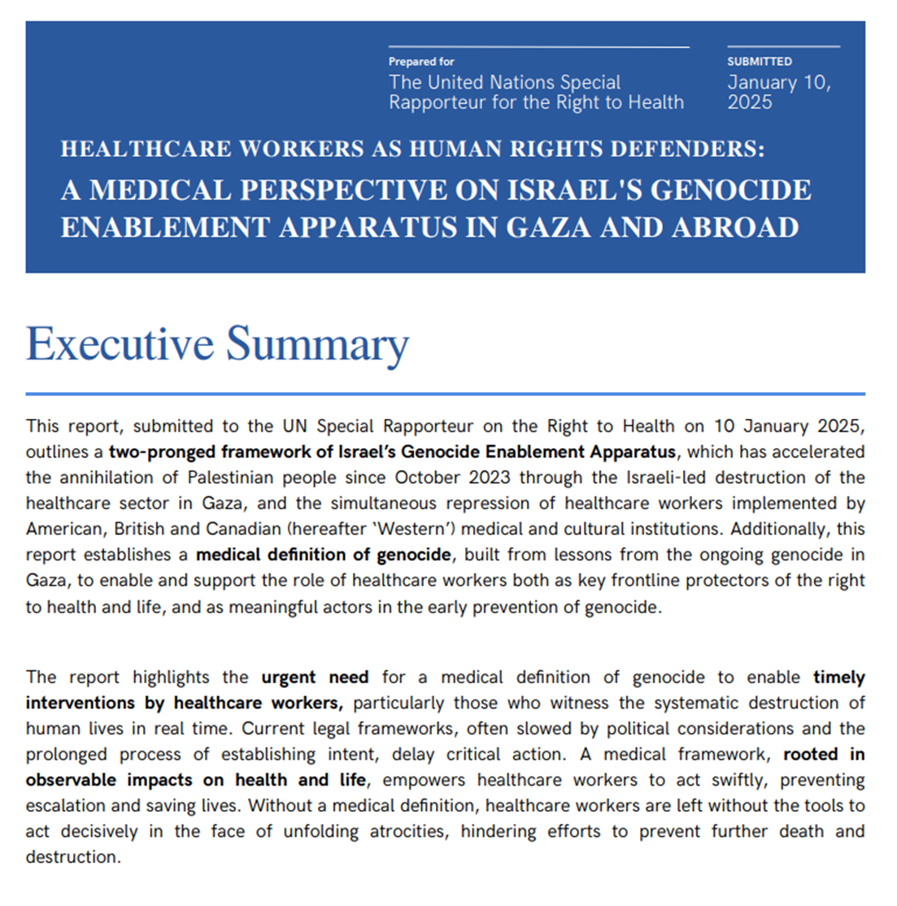
HEALTHCARE WORKERS AS HUMAN RIGHTS DEFENDERS
A MEDICAL PERSPECTIVE ON ISRAEL’S GENOCIDE ENABLEMENT APPARATUS IN GAZA AND ABROAD
Submitted to the UN Special Rappateur on the Right to Health on January 10, 2025
Establishes medical definition of genocide
Notes:
On January 10,2025, DAG's founders Dr. Nidal Jboor, Dr. Karama Kumerle and Maysa Hawash and several physicians who went on missions to Gaza like Dr. Mark Perlmutter, Dr Ghassan Abu Sitta and Dr. Yipeng Gi presented a report to the UN Special Rappateur on the Right to Health, Dr. Tlaleng Mofokeng from South Africa, entitled Healthcare workers as human rights defenders, a medical perspective on Israel's Genocide enablement apparatus in Gaza and Abroad.
It establishes a medical definition of genocide, built from lessons from the ongoing genocide in Gaza, to enable and support the role of healthcare workers both as key frontline protectors of the right to health and life, and as meaningful actors in the early prevention of genocide.
The report highlights the urgent need for a medical definition of genocide to enable timely interventions by healthcare workers,
particularly those who witness the systematic destruction of
human lives in real time. Current legal frameworks, often slowed by political considerations and the
prolonged process of establishing intent, delay critical action. A medical framework, rooted in
observable impacts on health and life, empowers healthcare workers to act swiftly, preventing escalation and saving lives. Without a medical definition, healthcare workers are left without the tools to
act decisively in the face of unfolding atrocities, hindering efforts to prevent further death and destruction.
The report underscores the urgent need to protect healthcare systems and workers during conflict and
amid genocidal violence. By adopting the frameworks outlined in this report, and establishing an independent international medical body with executive powers, the global medical community can
transform its response to atrocities against humanity. To prevent ongoing and possible future renditions of the types of genocidal violence that have been perpetrated against and continue to be
unleashed upon Palestinians in Gaza, the approach proposed in this report ensures that mass violence
and systemic racialized oppression are addressed with the urgency, precision, and the authority they demand—safeguarding human life and dignity above all else.

Slide 15

SUMMARY OF FINDINGS
Israel’s Genocide Enablement Apparatus
Cumulative Impact on Gaza’s Healthcare System
Reprisals and Repression in Western Institutions
Medical Definition of Genocide
Healthcare Workers as Human Rights Defenders
Notes:
Drawing upon hundreds of documented testimonials and the lived experiences of Palestinian and
international healthcare workers and advocates who have lived and worked in Gaza or who have advocated for the rights of Palestinians in other countries, along with the evidence materials and
documentation collected during their time in Gaza, this report makes five unique contributions:
1) Describing Israel's Genocide Enablement Apparatus
a) This apparatus includes the deliberate targeting of Palestinian healthcare infrastructure and personnel in Gaza since October 2023 which has accelerated the annihilation of the Palestinian people.
b) Simultaneously, it also involves western medical and cultural institutions that have engaged in the widespread
repression of healthcare workers advocating for Palestinian rights and thus suppressing a critical professional class that has a particular moral obligation to uphold life.
2. It describes the cumulative impact of the genocide on Gaza’s Healthcare System:
a) This includes the destruction of medical facilities, coupled with the closure of the Rafah crossing, which has severely restricted medical supplies and humanitarian aid, further exacerbating the health crisis.
b) It notes, that mass displacement, unsanitary conditions, and the collapse of healthcare infrastructure have
led to widespread preventable morbidity and mortality.
3. The report also emphasizes how reprisals and repression by Western Institutions have also contributed to the genocide. For instance, healthcare workers who document or speak out against Israel’s actions have and continue to face employment termination, harassment, censorship, and professional blacklisting, disproportionately affecting
marginalized groups.
This suppression normalizes the targeting of healthcare workers and facilities, setting a
dangerous global precedent.
4. The report proposes the medical definition of genocide, that we discussed before, built from the lessons of the ongoing genocide in Gaza, recognizing it as a societal disease and severe public health threat It emphasizes the need to support healthcare workers
as key actors in prevention and intervention.
5. And lastly, it makes the case for healthcare workers as human rights defenders,
In Gaza and globally, Healthcare workers bear witness to atrocities, provide vital care and document war crimes. Their role as first responders to genocide underscores the need for a
framework that empowers and protects them when giving testimony to war crimes at the local, national, regional, and international levels.

Slide 16
RECOMMENDATIONS
International adoption of a medical definition of genocide
An independent international medical body
Amend existing International Humanitarian Law
Notes:
In this report, the writers make 3 recommendations:
1. They recommend international adoption of a medical definition of genocide to prioritize prevention, risk reduction, and accountability.
2. The establishment of an independent international medical body with the authority to
a. Monitor and identify early signs of genocide using medical data;
b. to Mobilize international resources for intervention and protection; and
c. and to hold perpetrators accountable for targeting healthcare systems and workers.
3. And lastly, they recommend amending existing International Humanitarian Law to define the repression of healthcare workers
speaking out against acts of genocide as a form of genocide incitement and abetment, in violation
of the Genocide Convention (1948) and complicity in genocide, prohibited in Article 3(e).

Slide 17
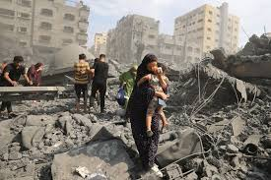
PUBLIC HEALTH CONSEQUENCES OF GENOCIDE
Long-term health effects:
Significant Rise in Mortality and Morbidity
Spread of infectious diseases, malnutrition, and chronic illnesses
Severe mental trauma for survivors and communities
Generational trauma, mental health disorders, displacement-related illnesses
Destruction of healthcare infrastructure
Extreme economic hardship
Notes:
To recap, Emman shared with us the medical professional's role in preventing genocide.
We also got to hear the UN's definition of genocide in addition to
DAG's definition.
We have been working towards the implementation of DAG's definition at the United Nations.
Genocide does not stay contained and will impact generations to come.
I will share some of the Long-term public health effects: of genocide which include
A significant Rise in Mortality and Morbidity
The spread of infectious diseases along with malnutrition, and chronic illnesses
And ofcorse the severe mental trauma for survivors and communities which include
generational trauma, mental health disorders, displacement-related illnesses
The destruction of healthcare infrastructure in itself is an intentional tool of genocide.
Gaza is also facing Extreme economic hardship-the destruction of agricultural assets, private sector businesses and infrastructure has severely impoverished Palestinian households contributing to the rise in poverty and unemployment.

Slide 18
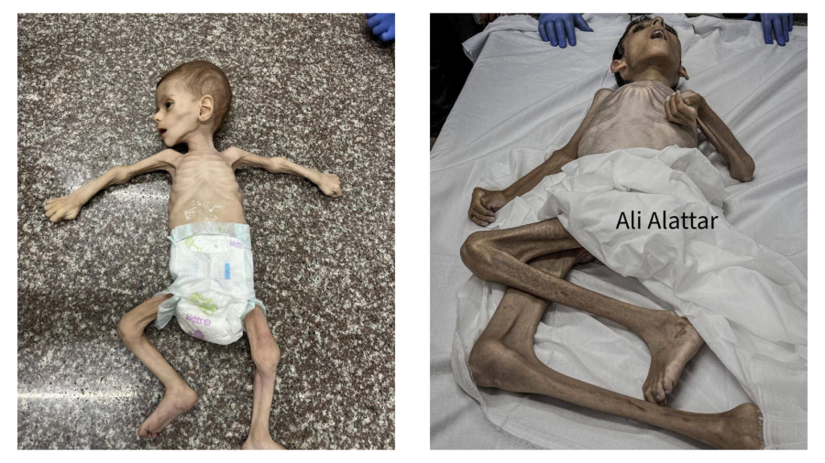
ORGANIZATIONS THAT HAVE CALLED WHAT IS HAPPENING IN GAZA A GENOCIDE
United Nations Independent International Commission of Inquiry -September 2025
United Nations special rapporteur Francesca Albanese-March 2024
UN Special Rapporteur on the Right to Food Michael Fakhri- February 2025
Amnesty International-December 2024
Human Rights Watch-December 2024
Doctors Without Borders-October 2025
B'Tselem- July 2025
Physicians for Human Rights–Israel- July 2025
International Association of Genocide Scholars - September
Lemkin Institute for Genocide Prevention- July 2023
Center for Constitutional Rights- October 28, 2023
The International Court of Justice- December 2023
Notes:
Here are some of the organizations that have called what is happening in Gaza a genocide.
The Lemkin Institute for Genocide Prevention, increasingly concerned about the deteriorating humanitarian situation in the territory of the State of Palestine (including Gaza and the West Bank), issued a statement in October 2023 statement, that they continue to update, to explain the reasons why they believe the Israel-Palestine situation constitutes an instance of genocide. On their website Lemkin Institute states they believe that Israel’s retaliation against Palestinians amounts not only to war crimes and crimes against humanity, but also to genocide. They note that "The continued complicity in genocide of Israel’s allies is resulting in horrific, immoral consequences for Palestians everywhere and is destroying any opportunities for global peace and security for the forseeable future."
In December 2024 Amnesty Int'l published a detailed report concluding that Israel is committing genocide against Palestinians in the Gaza Strip, based on acts of killing, causing serious bodily/mental harm, deliberately inflicting conditions of life calculated to bring about physical destruction, and examining intent via senior Israeli government/military statements
In July 2025 B’Tselem & Physicians for Human Rights Israel — Israeli-based human rights organizations publicly concluded that Israel is committing genocide in Gaza.
Physicians for Human Rights — Israel (PHRI) — 2–28 July 2025 — issued a health-system analysis and position paper saying this cumulative dismantling of Gaza’s health system “amounts to genocide.”

Slide 19
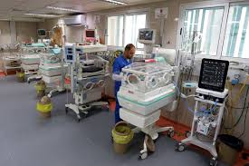
UPDATES ON GAZA’S HEALTHCARE SYSTEM
⅔ hospitals destroyed, remainder barely functional and significantly over capacity.
Staff depleted, overworked, traumatized, starving, displaced, injured.
89% of isolates from Gaza cohort displayed multi-drug resistance
Outbreaks of disease fueled by the destruction of water and sanitation infrastructure.
15,000 patients still in need of treatment outside Gaza – including 4,000 children
Notes:
These are brief updates on the healthcare systems in gaza.
⅔ of the hospitals are destroyed, remainder barely functional and significantly over capacity.
Staff is depleted, overworked, traumatized, starving, displaced and injured.
89% of isolates from Gaza cohort displayed multi-drug resistance
Outbreaks of disease fueled by the destruction of water and sanitation infrastructure.
15,000 patients still in need of treatment outside Gaza – including 4,000 children
Since the ceasefire, Gaza healthcare workers report almost no aid has entered the strip.

Slide 20
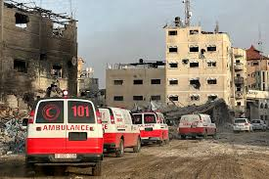
HEALTHCARE WORKERS SHOULD NEVER BE A TARGET
As of October 20, 2025:
309 of the 431 detained healthcare workers are now confirmed to have been released; of which 67 were released as part of the latest exchange deal on October 13
Five healthcare workers are still missing (three senior physicians, an UNRWA pharmacist and a senior physiotherapist)
Five HCWs have reportedly been killed or died in Israeli detention, however, their bodies have not been returned to their families.
1722 healthcare workers have been killed
Notes:
Health-care workers are the most critical component of any health system.
Despite being protected under international law, they have been killed and injured at alarming rates in Gaza since October 7 2023.
There is also growing evidence of inhumane treatment and abuse of health-care workers in Israeli detention. This has serious implications for the health of Palestinians, in both the short and long term.
These are some of the latest numbers As of October 20, 2025:
309 of the 431 detained healthcare workers are now confirmed to have been released; of which 67 were released as part of the latest exchange deal on October 13
Five healthcare workers are still missing which include (three senior physicians, a pharmacist and a senior physiotherapist)
Five HCWs have reportedly been killed or died in Israeli detention, however, their bodies have not been returned to their families.
1722 healthcare workers have been killed

Slide 21
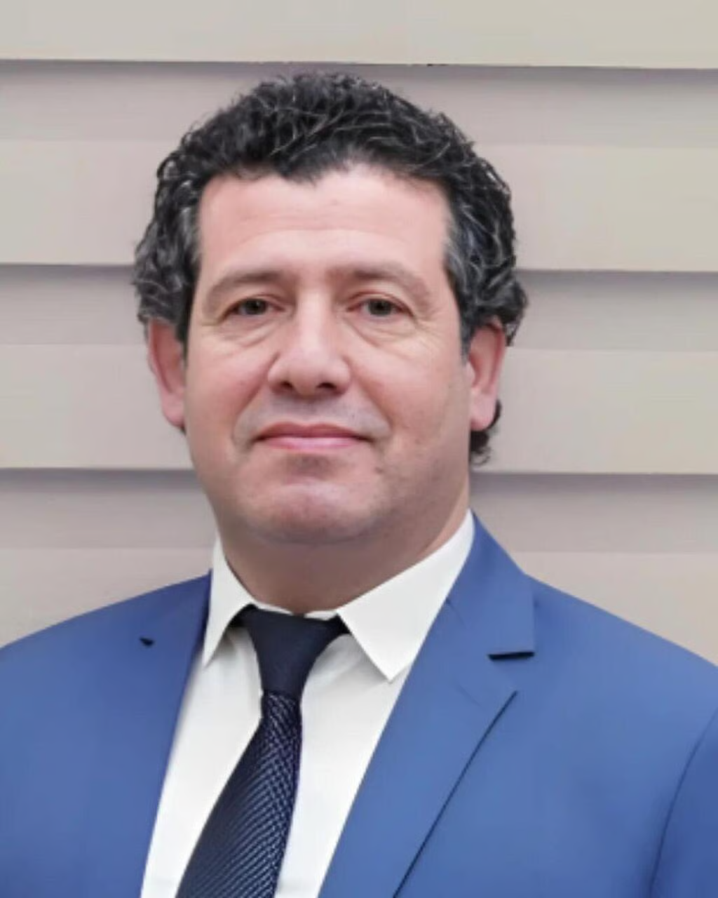
DR ADNAN AL BURSH
“Despite the pain, we are steadfast”
Head of Orthopedic Surgery at Al-Shifa Medical Complex
Dec 19, 2023, Dr Al Bursh was detained by IDF with 10 other medical staff and taken to notorious detention center- Sde Teiman.
He was subjected to was physical, psychological and sexual torture
April 19, 2024- The Israeli Prison Service issued a statement that a prisoner died in custody.
His body remains in Israeli custody
Not charged with any crime at this time
Notes:
This is Dr Adnan Al Bursh,
he is one of the 5 HCW's that have reportedly died in Israeli detention since 10/7/23.
Dr Adnan Al Bursh is also
infamously known as the doctor who was sodomized to death.
He was the Head of Orthopedic Surgery at Al-Shifa Medical Complex
We all got to know Dr Adnan from the videos he would publish on social media of the ongoing assaults on Gaza.
In many of his videos, he would state,
"despite the pain, we are steadfast"
On Dec 19, 2023, Dr Al Bursh was detained by the IDF with 10 other medical staff and taken to notorious detention center- Sde Teiman.
Its reported that he was subjected to physical, psychological and sexual torture.
On April 19, 2024- The Israeli Prison Service issued a statement that a prisoner had died in custody withholding the identity of the prisoner.
His fate was revealed to the world by the other healthcare workers who were detained with him and released.
Its significant to note that His body remains in Israeli custody and he has yet to be charged with any crime at this time

Slide 22
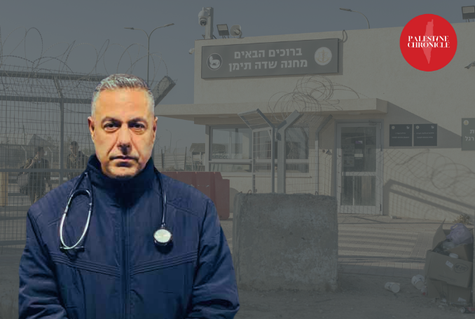
DR HUSAM ABU SAFIYA
Chief Pediatrician at Kamal Adwan Hospital
His son was targeted and killed by an Israeli drone strike.
Abducted on Dec 27,2024 from his hospital during a forced evacuation - including staff and patients
Oct 16, 2025, Dr Abu Saffiya was set to be released during the prisoner swap between Hamas and Israel. His administrative detention has been renewed under no legitimate pretext.
Notes:
Another colleague that is currently in Israeli detention is
Dr Hussam Abu Safiya
who is a dear friend to Doctors Against Genocide and was a regular contributor to our weekly webinars providing us with critical updates.
He is a Chief Pediatrician at Kamal Adwan Hospital.
He also bravely documented the unrelentless bombardment on Gaza's healthcare systems.
One could say his crime was his stubborn unwillingness to leave his patients.
On Oct 25, 2024, Kamal Adwan Hospital was stormed, Dr Abu Safiya along with 57 medical colleagues were detained during their shift. He was later released after several hours of interrogation.
Shortly after his release, Israeli forces killed his son following his refusal to abandon the hospital despite Israeli orders and threats.
Dr Abu Saffiya was abducted a second time on Dec 27th from his hospital during a forced evacuation, this included both staff and patients.
Dr Abu Safiya was last seen entering a Merkava tank.
During his lawyers last visit to the detention center, she reports he has lost 25 kg and has been denied treatment for heart disease and blood pressure.
He was set to be released during the recent prisoner swap between Hamas and Israel that occurred on oct 16.
Dr Abu saffiya's administrative detention has been renewed under no legitimate pretext.
October 29th marked his 10th month

Slide 23
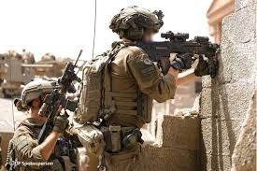
The Occupation’s Menatlity
“DONT LET THEM DIE, DONT LET THEM LIVE”
Notes:
Dr Al-Farra, friend of DAG and regular contributor on our webinars explains this phenomena carried out by the Israeli govt as
"The dont let them die, dont let them live" policy.
Israel’s ban on fuel entry to hospitals in the Gaza Strip constitutes a tool of direct killing and a means of forcibly displacing civilians, as it paralyzes medical facilities and turns them into death zones.
This reflects a systematic Israeli policy aimed at dismantling the population’s means of survival.
Dr Alfarra has explained that fuel and electricity is provided in limited amounts and at specific times and the appeal process that comes with having the supply renewed is mentally exhausting.
This is a deliberate execution of a slow-kill policy by Israel targeting the population’s right to life through denial of life-saving care.

Slide 24
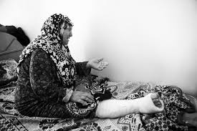
Zahra’s Story
Notes:
This is Zahra, she is a 73 yr old survivor
Her home in Northern Gaza was bombed which resulted in the majority of her family being killed. While she survived the attacks,
She spent 2 days under the rubble.
She was miraculously rescued by the Palestinian Civil Defense Services.
One of her sons also survived the airstrike.
She had an open fracture in her lower leg. She needed to get to a hospital and surgery. Both bones in her lower leg were broken.
She managed to walk with her son as he intermittently carried her, to Al Shifa Hospital, that journey took her almost 3 days with a broken leg.
Once she got to the hospital, she was informed she would need urgent dialysis first.
She had a severe crush injury
which leads to rhabdomyolysis which can potentially cause acute kidney failure.
This is a common injury in Gaza. The Israeli army stormed the hospital and instructed people to evacuate which delayed her surgery.
She was able to find a wheelchair, and her son wheeled her down to Al Aqsa Hospital. Just to give you an idea of distance. Al Shifa is located in Northern Gaza and Al Aqsa Hospital is located in Central Gaza.
When approached by the Orthopedic doctor, Zahra told him “I have adjusted to it, maybe we should just leave it alone” and smiled at him.
He wanted to cry for her, the way she was responding to it, it was like she was supporting him.
This testimony was brought to us by an Orthopedic resident who was touched by Zahra not wanting to add to his workload.

Slide 25
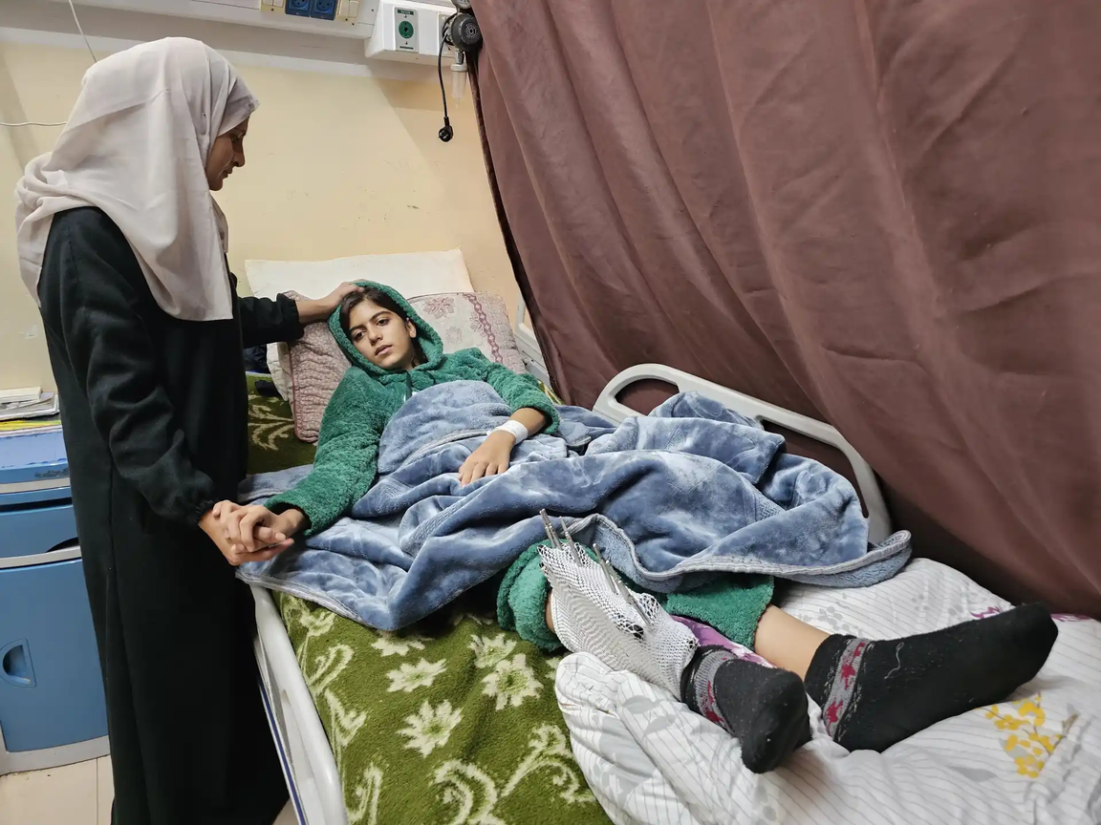
19 year old GHF site shoulder injury now paralyzed
Notes:
This is Omar.
he is A victim of the Gaza Humanitarian Foundation.
This GHF was a US backed Israeli initiative that sought to permanently replace UNWRA's presence in the Gaza Strip.
It was an initiative led by military contractors, not humanitarian
professionals. It operates with Israeli government oversight and without transparency,
independence, or accountability.
This violates the humanitarian
principles of neutrality, independence, and impartiality.
The Death toll at the GHF sites surpassed 1000 cases along with hundreds wounded.
Omar is just one the thousands permanently disabled. He is a 19 yo young man who went to one of the GHF sites to obtain aid for his family, while waiting, he got shot with a bomb bullet, which is unique in that once it makes impact it separates and blows up into multiple fragments in the body). Omar's shoulder was severely injured and he was paralyzed waste down.
He had to wait 4 days for CT scan. No spinal neurosurgeon available, no equipment to stabilize the spine. Requests to evacuate, denied because he is a male over the age of 16.
No hope that he will have his situation reversed.

Slide 26
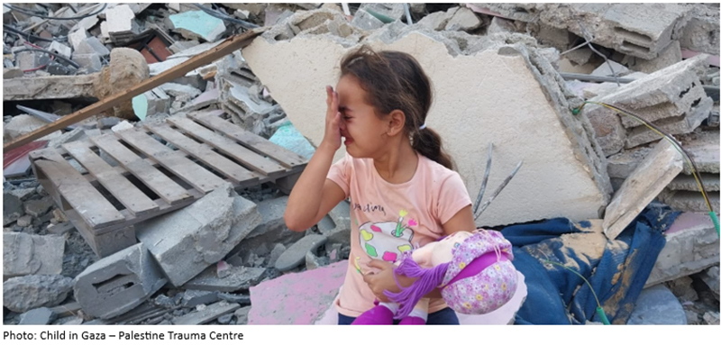
MENTAL HEALTH IN GAZA
The genocide in Gaza has severely impacted mental health sustainability due to the destruction of healthcare services, exacerbating
PTSD (Trauma is ongoing, there is no “post”)
anxiety
depression.
Access to psychological care is compromised, complicating recovery amid pervasive fear and community disruption.
Consequences of this genocide extend beyond immediate trauma, undermining social cohesion, economic stability, and overall quality of life
Normalization of fear and trauma not only undermines personal well-being but also disrupts family dynamics, perpetuating a cycle of despair and instability.
Notes:
The genocide in Gaza has severely caused negative impacts to the mental health state of everyone in Gaza.
It has severely impacted mental health sustainability due to the destruction of healthcare services, exacerbating
anxiety
depression
sleep deprivation
PTSD (Trauma is ongoing, there is no “post”)
Access to psychological care is compromised, complicating recovery amid pervasive fear and community disruption.
Consequences of this genocide extend beyond immediate trauma, undermining social cohesion, economic stability, and overall quality of life
The normalization of fear and trauma not only undermines personal well-being but also disrupts family dynamics, perpetuating a cycle of despair and instability.

Slide 27
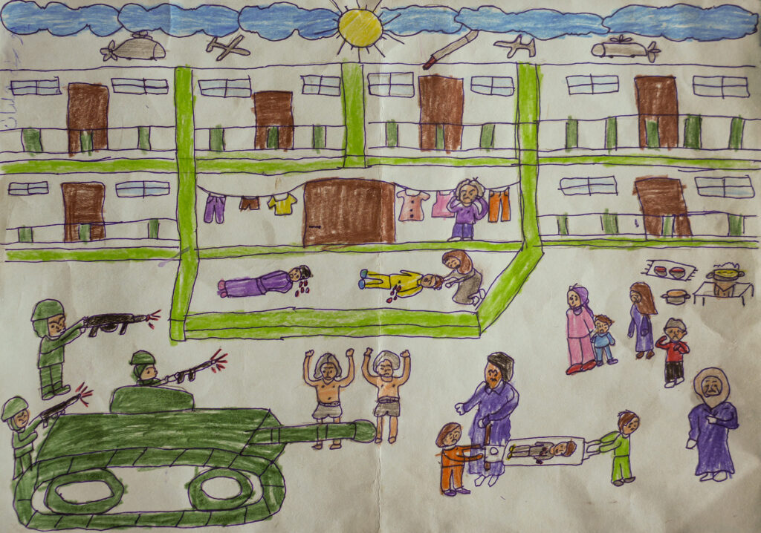
Hala, 10 year old girl, Al-Zaytoun, Gaza City
Notes:
The Gaza Community Mental Health Program has been doing incredible work with the skeletal resources they have been forced to work with to support their people during the ongoing genocide.
Hala is a young girl who receives psychological support at
Gaza Community Mental Health Program
This picture symbolizes the reality of what children have been forced to bear witness to over the past 2 years.
Take a look at her illustration and notice, the Israeli tank and the army carrying aiming their weapons at displaced people sheltering in a school.
Notice the men who are undressed and appear to be surrendering to the Israeli army.
Also take note of the people on the ground bleeding.
On the bottom right corner, a young kid appears to be carried on a stretcher.
This is very typical of illustrations made by Gaza's children even pre 10/7/23.
While, children at this age are expected to illustrate less grim images, art therapy has been effective in being a safe and nonverbal outlet for processing trauma.

Slide 28
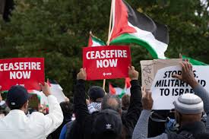
WHERE ARE WE POST “CEASEFIRE”?
Israel uses ceasefires not as steps toward peace, but as a tool to tighten control
Fragile truce brokered by US came into effect on Oct 10, 2025
Airstrikes continue to be carried out all over the Gaza Strip
Blockade has not been lifted
Heavy machinery not permitted to clear rubble
WHO reports only 10% of requested medical supplies have entered.
Mobile homes and heavy-duty tents also have not been permitted.
Delivery of 600 aid trucks per day has not been upheld
Notes:
While we have been able to share a few accounts with you all today; there are thousands of horrific experiences that we wont hear about.
That brings us to the present day ceasefire agreement that went into effect on oct 10, 2025.
The ceasefire announcement was long awaited. The Palestinians were in desperate need of the discontinuation of the rampant killing machine.
While the people in Gaza eagerly welcomed this, they shared with us their cautious optimism since historically, Israel has violated the ceasefire under fabricated pretexts.
I'd like to provide some updates since the ceasefire went into effect oct 10.
Airstrikes continue to be carried out all over the Gaza Strip
The Israeli army is still occupying 53% of Gaza and have not withdrawn.
Blockade has not been lifted-the Rafah border remains closed.
Heavy machinery for clearing rubble and extracting the thousands that remain under the rubble has not been permitted.
World Health Organization reports only 10% of requested medical supplies have entered.
Mobile homes and heavy-duty tents also have not been permitted despite Gaza entering the winter season.
Delivery of 600 aid trucks per day has not been upheld
On Oct 28th, Netanyahu made an announcement that forceful strikes will be carried out in Gaza in retaliation to Hamas returning an incorrect corpse.
The result of this bloody night was 104 Palestinians killed including 46 children.
According to The Gaza Ministry of Health, 211 Palestinians have been killed since the ceasefire has been announced.
I wanted to provide further context to this statement that was made by one of our colleagues in Gaza.
Israel uses ceasefires not as steps towards peace, but as a tool to tighten control.
This statement reflects a critical perspective on Israel’s use of ceasefires, often voiced by analysts and human rights observers who argue that temporary truces can be used tactically rather than as genuine steps toward lasting peace.
Some argue that Israel uses ceasefires primarily to regroup militarily, manage international pressure, or restructure control over Gaza and the West Bank—tightening blockades, expanding surveillance, or restricting aid and movement once the fighting pauses. In this view, ceasefires function as strategic pauses that reinforce the status quo rather than dismantle it.

Slide 29
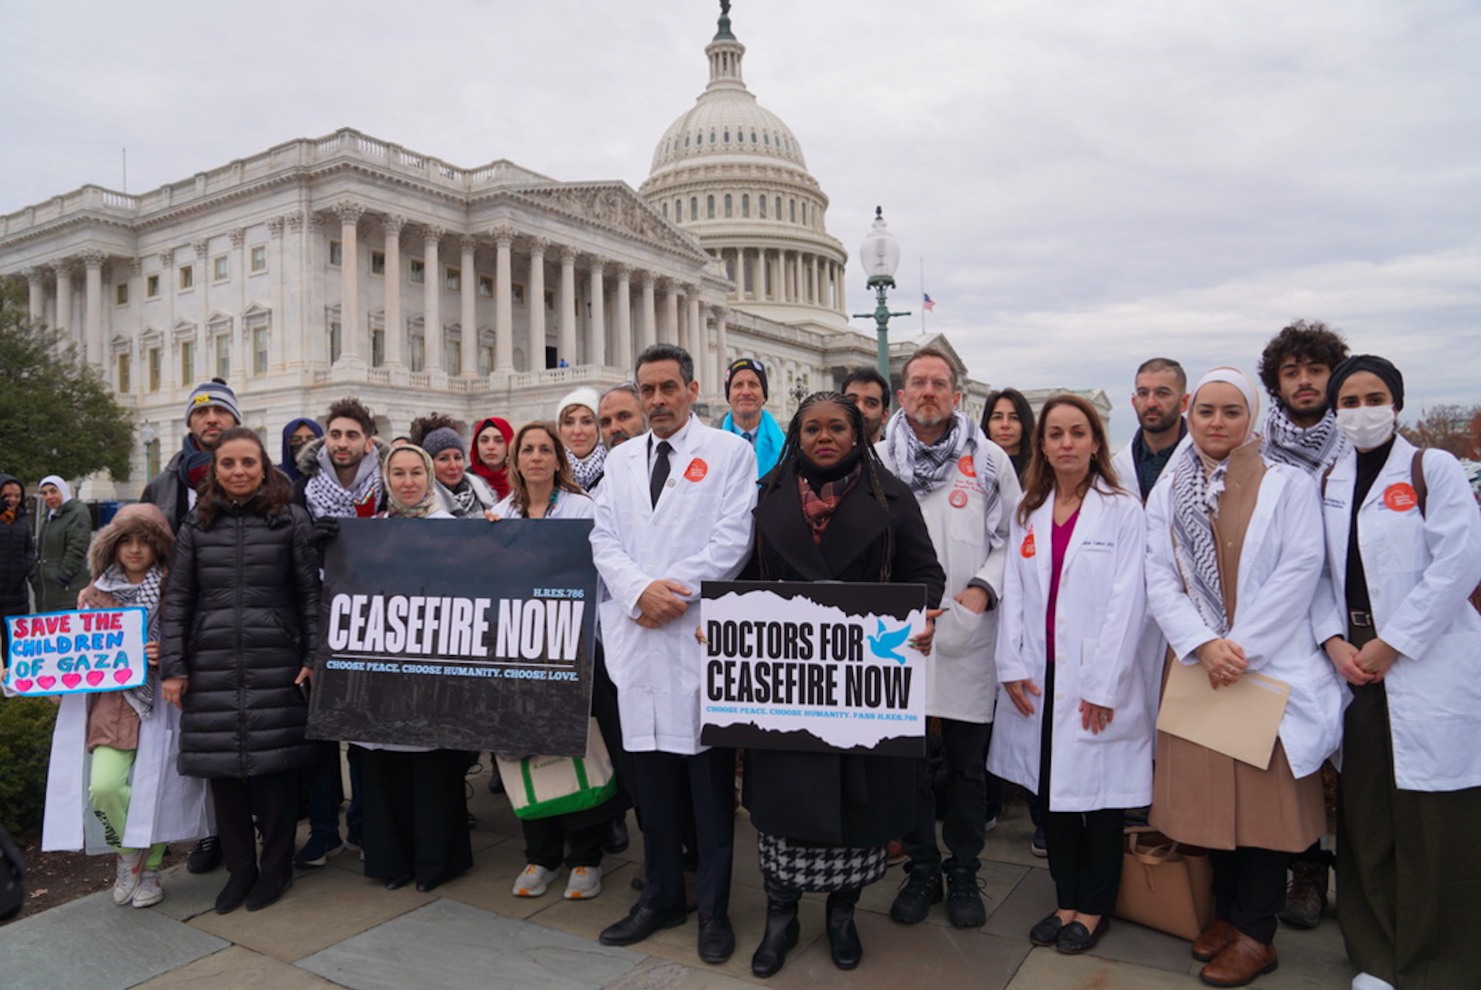
ADVOCACY
Doctors Against Genocide has been a strong presence both on the Hill and at local constituent’s congressional offices since October 7, 2023.
Our goal has been to share the voices of the people of Gaza, their primary concerns and their demands in the fight against genocide and occupation.
We accomplish these goals by meeting with Congressional offices, holding press conferences and attending protests.
Notes:
Our advocacy is most critical at this stage, it will determine if the people of palestine will return to the "status quo" which is life under militarized occupation and a slower paced genocide.
Doctors Against Genocide has held a strong presence both on the Hill and at local constituent’s congressional offices since October 7, 2023.
Our goal has been to share the voices of the people of Gaza, their primary concerns and their demands in the fight against genocide and occupation.

Slide 30
ADVOCACY
At DAG, we utilize our training for wider sociopolitical humanitarian impact, unlimited by the confines of hospitals and clinics and stepping into the halls of US Congress.
DAG members rewrite the conventional prescription into the modern global prescription needed to end genocide.
We update this prescription monthly and present it to members of Congress on our advocacy trips to Washington D.C.
Our focus: halting weapons to Israel, while also prescribing a surge of humanitarian aid including the restoration of UNWRA.
Notes:
At DAG, we utilize our training for wider sociopolitical humanitarian impact, unlimited by the confines of hospitals and clinics and stepping into the halls of US Congress.
DAG members rewrite the conventional prescription into the modern global prescription needed to end genocide.
We update this prescription monthly and present it to members of Congress on our advocacy trips to Washington D.C.
Our focus: halting weapons to Israel, while also prescribing a surge of humanitarian aid including the restoration of UNWRA

Slide 31
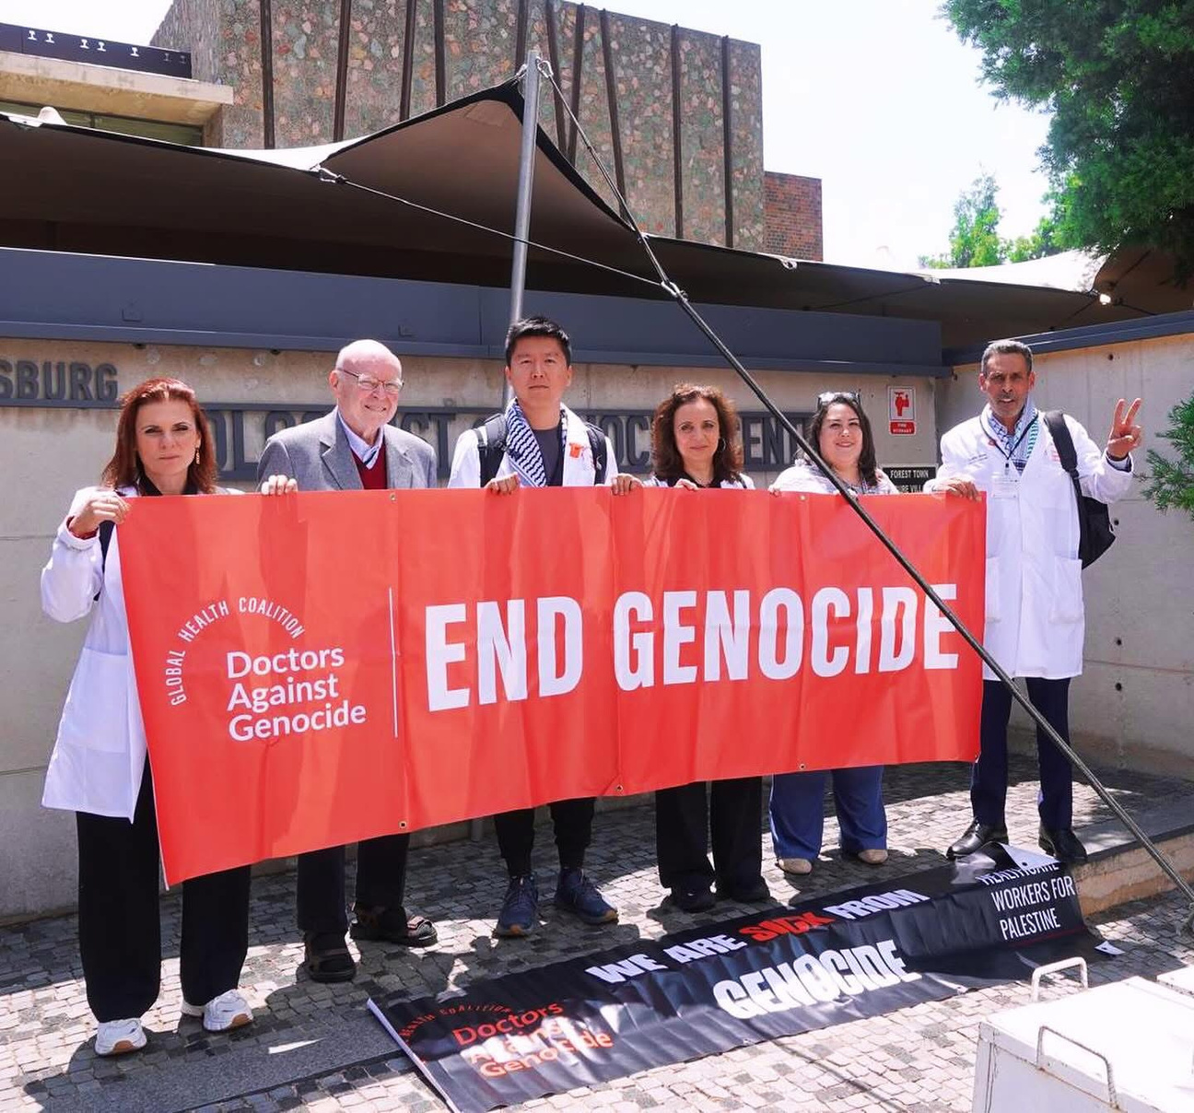
DAG GOES TO SOUTH AFRICA
2025 International Association of Genocide Scholars Conference
Notes:
At DAG, we also focus on education through our medical advocacy work.
We believe that genocide can be prevented and we don't need to wait for the autopsies to confirm what we as a medical community already know.
A week ago, DAG's leadership delivered a landmark presentation on the medical mandate to prevent genocide at the International Association of Genocide Scholars Conference
in Johannesburg.

Slide 32
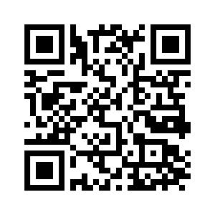
HOW YOU CAN GET INVOLVED
Join Us! Go to our website and get on our emailing list: https://doctorsagainstgenocide.org/ or click on the QR code below
Notes:
for many of us, the moral injury has been difficult to contend with.
Once you understand our role as Americans in the genocide of the Palestinians, it's both impossible and inhumane to turn a blind eye.
A unique and centralized effort DAG has embarked on since the beginning of the genocide is amplifying frontline voices and documenting the truth through our weekly webinars where we hear updates from Palestinian healthcare workers, journalists and community coordinators
I encourage all the healthcare workers in the audience to join us and get involved.

Slide 33
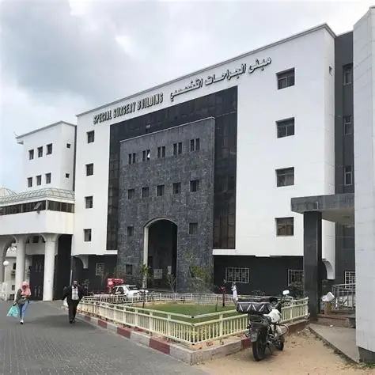
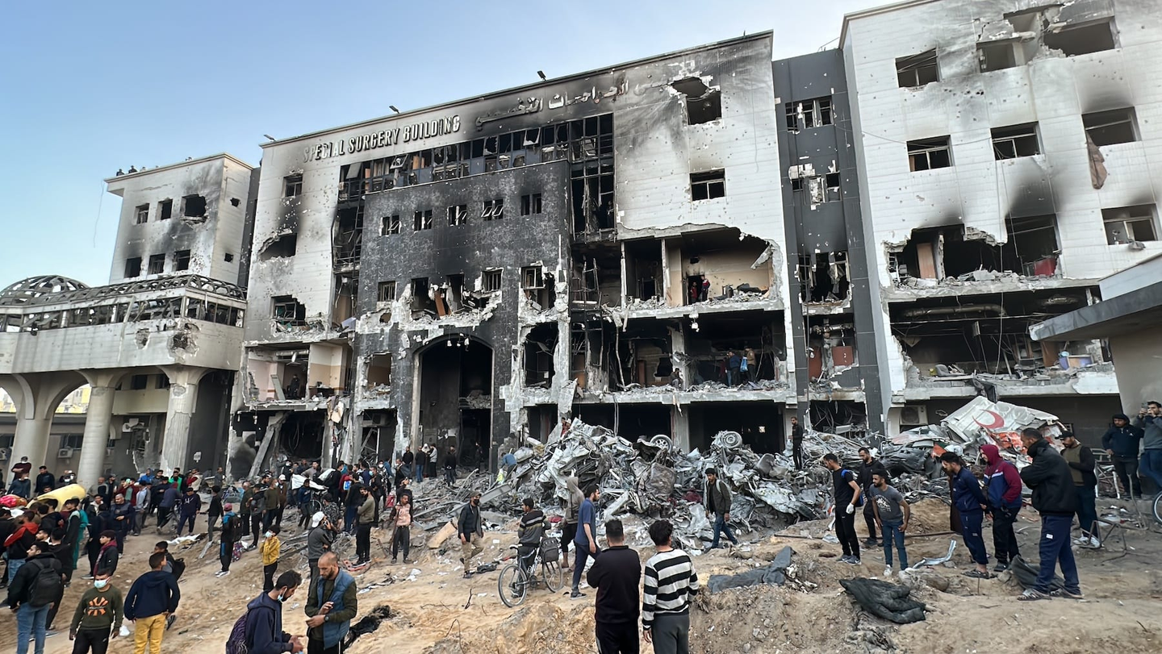
HELP US REBUILD AL-SHIFA HOSPITAL
Known as the beating heart of Gaza’s healthcare system
Notes:
A special initiative we have been trying to work on is the rebuild of Alshifa hospital.
Al-Shifa Hospital, once the beating heart of Gaza’s healthcare system, now stands in ruins.
After months of unrelenting bombardment, it is barely functional, just when Gaza needs it most, especially after the shutdown of the Indonesian, Al-Awda, and Kamal Adwan hospitals due to targeted attacks and repeated siege conditions.
The importance for DAG to help partake in rebuilding one of their healthcare institutions is to return agency back to Palestinians and allow them the opportunity to heal their own people.

